Slide 1
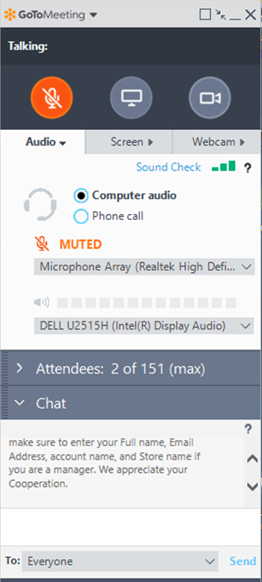
Please sign in
Hello Attendees,
Please enter the following information in the chat box before the training begins.
Name
E-mail address
Account name
Store name and role
We appreciate your cooperation and will begin the training shortly.
Notes:
Say: Good morning! Welcome to Scan Data Troubleshooting Training. We’ll get started in a few minutes. In the meantime, please enter the following information into the chat box below. Your name, email address, account name, store name, and role. We appreciate your cooperation and will begin shortly.
Do: <Click> to advance to next slide

Slide 2
Scan Data Troubleshooting Altria (IRI) RJR (MSA)
October 2019
Notes:
Say: Welcome to Scan Data Troubleshooting Training.
Do: <Click> to advance to next slide

Slide 3
Agenda
Pricebook Set Up Refresher
Altria Error Code Review
RJR Errors Review
Test Your Knowledge
Notes:
Say: The Agenda for today’s training session includes:
Do: Review slide
Do: <Click> to advance to next slide

Slide 4
Pricebook Set Up Refresher
Items set up correctly
Parent/child relationships set up if applicable
Create item tags for VAP (Value Added Promotions)
Promotions set up correctly
3rd party loyalty programs
Notes:
Say: In order for the reports to have accurate information, these are the things in price book that need to be configured properly. (Read slide)
Do: <Click> to advance to next slide

Slide 5
Price Book Items Set Up
Units of Measure (Item Size) need to be set up according to the guidelines in the contract:
Tobacco Category | Acceptable Units of Measure | Not Acceptable Units of Measure
Cigarettes | Pack, Carton, Case | Pk, Pck, Ct, Ctn, Cas, Cs, Ea, Bx, Cn, Tn, Tb, Rl, Sl, Pch, Bk
Cigars / Little Cigars | Each (for single sticks of cigars, Pack, Box, Case
Moist Tobacco or Snus | Can, Tin, Tub, Roll, Sleeve, Box, Case
Pipe Tobacco | Pouch, Bag, Tub, Canister, Case
E-Cigs | Each (for single E-Cigs), Pack, Kit, Bottle, Cartridge, Box, Case
Tubes | Tubes, Pack, Carton, Box, Case
RYO | Pack, Bag, Canister, Box, Case
Loose Tobacco | Pouch, Pack, Canister, Box, Case
Papers/ Wraps | Booklet, Pack, Box, Case
Premium Cigars | Each (for single sticks of cigars), Bundle, Pack, Box, Case
Notes:
Say: Per the requirements for both Altria and RJR, the units of measure need to be set up properly. This would be the size field in C-Store Office.
For example in your cigarettes category you will need to make sure the size field is spelled out as Pack or Carton instead of pk or ct.
Do: <Click> to advance

Slide 6
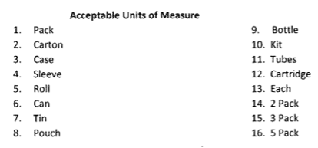
Price Book Items Set Up – By Item
Notes:
Say: From CSO Homepage, Price Book > Items, find the item and edit the size.
Do: <Click> to advance

Slide 7
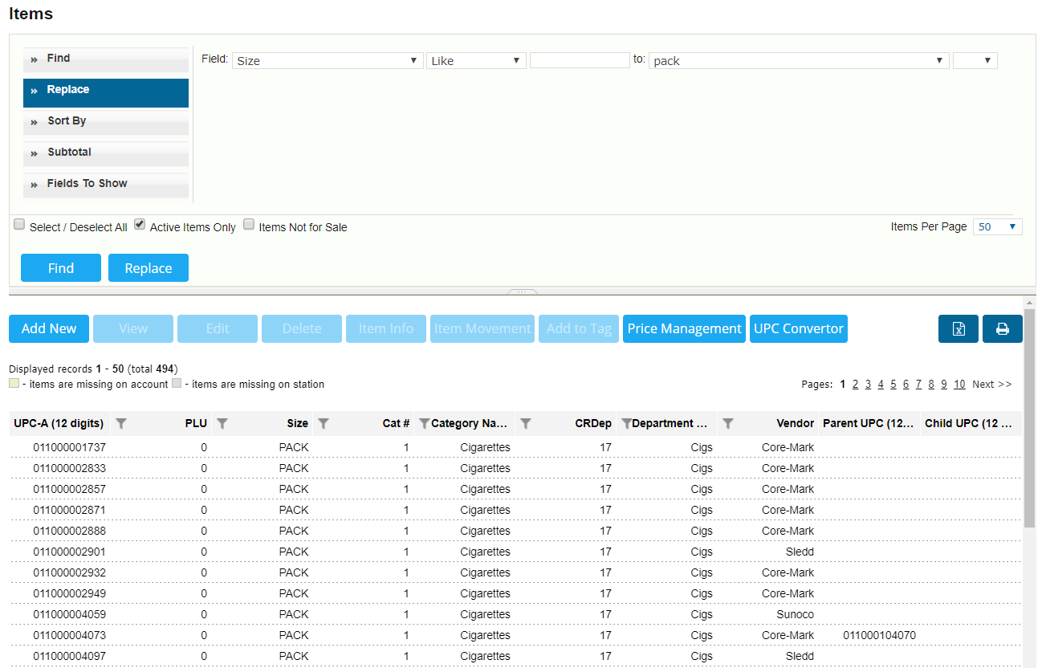
Price Book Items Set Up Correctly – By Find and Replace Tool
Notes:
Say: You can use the find and replace tool to make these changes. Find a group of items in your price book that may have incorrect size and change in bulk through the find and replace took.
Do: <Click> to advance

Slide 8
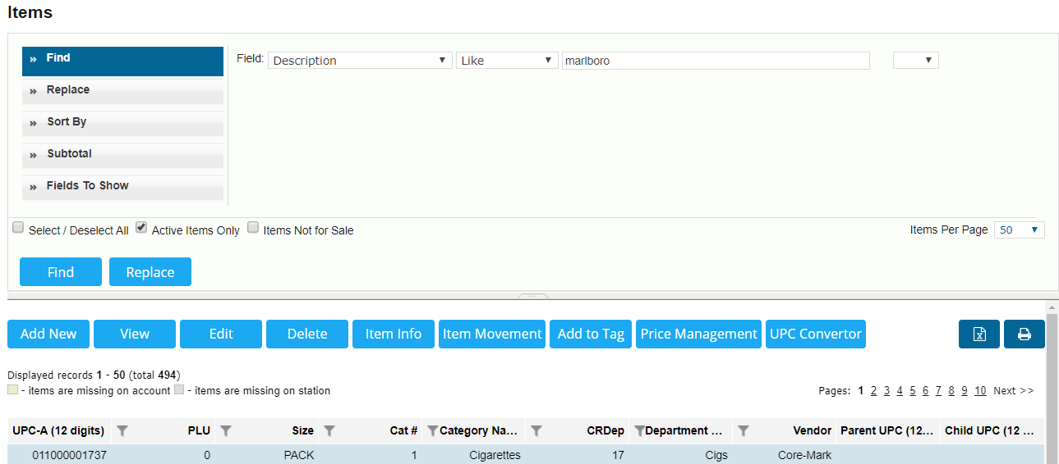
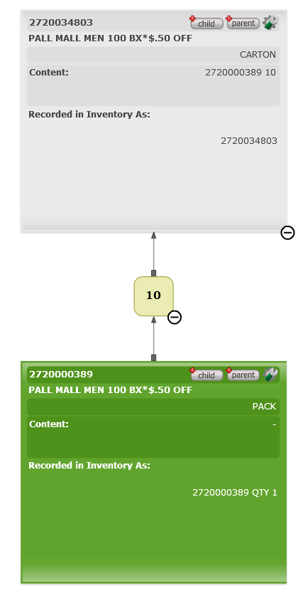
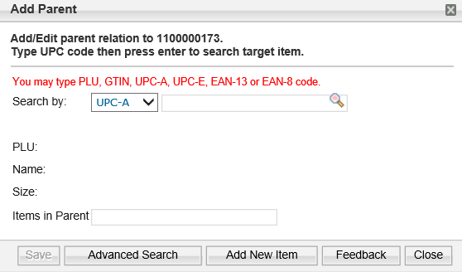
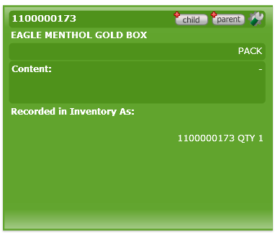
Price Book Set Up - Parent/Child Relationships
Notes:
Say: For the scan data reports to work properly, ensure that parent/child relationships are set up correctly. For instance if you sell both the carton of cigarettes and the single packs, the packs should be set up as the child and the carton is the parent. To set this up, find the item in your price book, view the item set up page.
Do: <Click> to advance
Say: Click on the Parent Child tab. It is a grey colored button.
Do: <Click> to advance
Say: The visualizer box will appear. Start with the Child and click to add Parent.
Do: <Click> to advance
Say: Fill out the information on the next screen with the UPC of whichever you need to attach, add 1 for parent and Save.
Do: <Click> to advance
Say: Here is an example of a completed Parent/ Child relationship set up.
Do: <Click> to advance to next slide

Slide 9
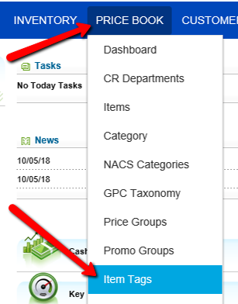
Price Book Set Up – Value Added Promotion Item Tags
Create Item Tags for Value Added Promotion Items
Cigarettes in the white Cartons
$0.50 off, $0.75 off, $1.00 off
Any B1G1 or B2G1 items
Notes:
Say: In order to give visibility on scan data reports to Altria and RJR as to what items sold that are considered a promotional item. For instance, $0.50 off packs or B1G1 or the bundles that come in already marked at a reduced price. In order to differentiate those items in the report, we need to place an item tag on those specific promotional items. To accomplish this, you will need to add a new item tag in your price book. Go to Price Book > Item Tags
Do: <Click> to advance to next slide

Slide 10
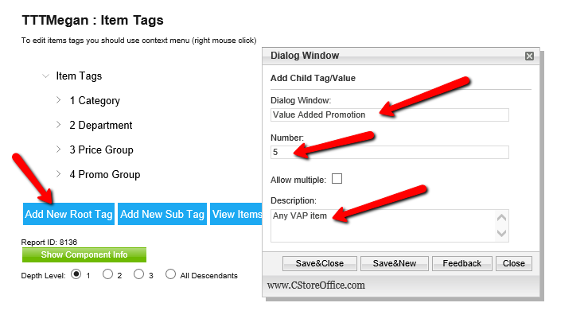
Price Book Set Up – Value Added Promotion Item Tags
Notes:
Say: Click “Add New Root Tag” in the Dialog Window type “Value Added Promotions”, in the Number Field use the next number in the sequence, in the Description field type “any VAP items.
Do: <Click> to advance to next slide

Slide 11
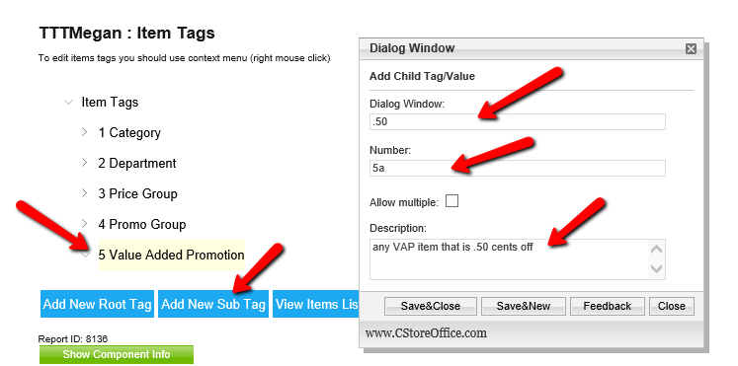
Price Book Set Up - Value Added Promotion Item Tags
Notes:
Say: You also need to add new sub tags that correspond to each discounted amount. Click on the Value Added Promotion tag, then click on “Add New Sub Tag”. in the Dialog Window type “.50” or what ever the tag value is, in the Number Field use the next number in the sequence, for example 5a and in the Description field type “any VAP items that are .50 cents off.”
Do: <Click> to advance to next slide

Slide 12
Price Book Set Up - Value Added Promotion Item Tags
Attach the Item Tags to the appropriate items:
New Item Setup
Edit single item
Use the Find and Replace tool
Notes:
Say: The next step is to attach the item tag you just created to all your single promotional items. For instance, packs (not cartons), single cans of snuff (not sleeves). You can do this 2 different ways. One is to do it during the item set up process or to use the find and replace tool for existing items.
Do: <Click> to advance to next slide

Slide 13
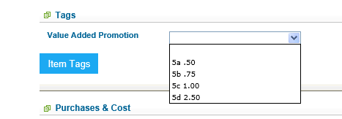
Price Book Set Up - Value Added Promotion Item Tags
New Item Set Up
Notes:
Say: In order to attach a tag when setting up a new item, you need to be at the account level in the new item set up screen. You then scroll down to the tags section. Click on the tab switcher in the middle to open. The list of available tags will appear, and the drop down will show the sub tags. Choose which one is appropriate for this item.
Do: <Click> to advance
Say: If you have questions on how to set up an item
Do: <Click> to advance to next slide

Slide 14
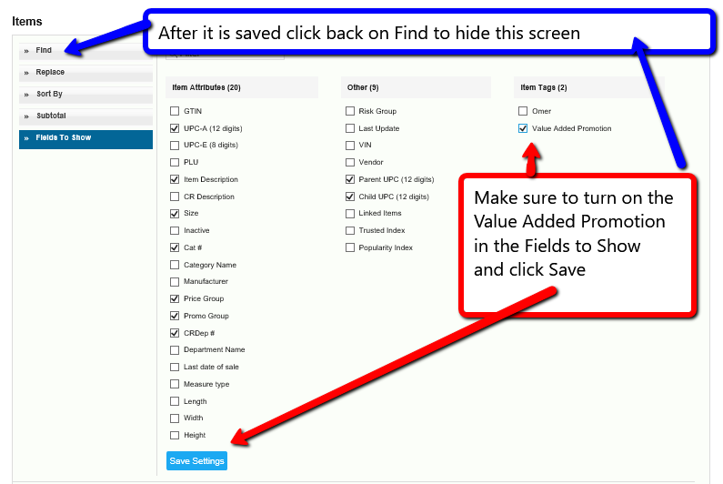
Price Book Set Up - Value Added Promotion Item Tags
Find and Replace Tool
Notes:
Say: In order to see the column header for the Value-Added Promotion Tags you will need check it on the Fields to Show in the Find and replace tool Price Book > Items. First click on Fields to Show and to the right you will Item Tags section. Put a check mark in the box next to Value Added Promotion. Click Save Settings. Then click on Find to hide this screen. Click on the Blue Find button and the column will show in your search results.
Do: <Click> to advance to next slide

Slide 15
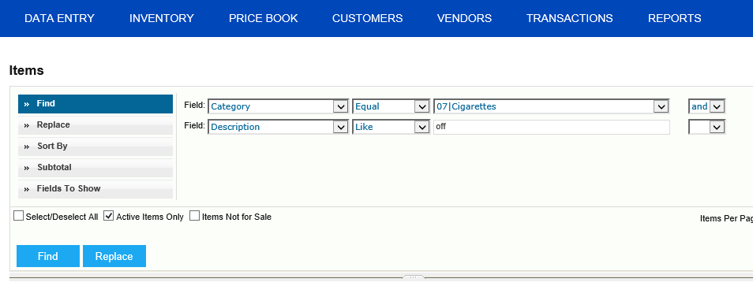
Price Book Set Up - Value Added Promotion Item Tags
Find and Replace Tool
Notes:
Say: Search for the items that you have in your price book that are considered promotional. This will vary depending on what categories you have and how you entered these promotional items. By using this example (Category, equal, cigarettes, and, description, like, off) you will find items that are only in your cigarette category and have the word off in their description. If you created items that had .50 off and put that in the description, they would be found this way. You only add the tag to packs, not cartons.
Do: <Click> to advance to next slide

Slide 16
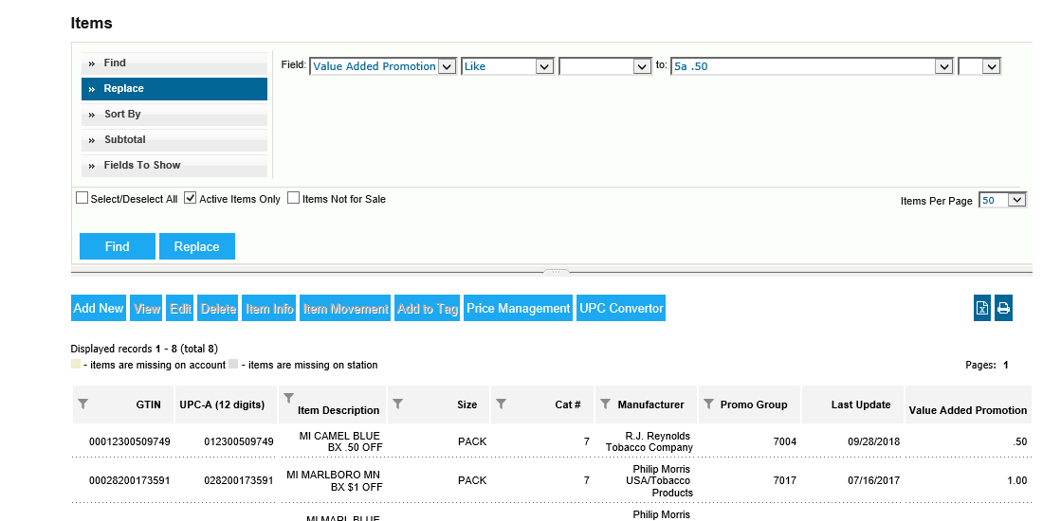
Price Book Set Up - Value Added Promotion Item Tags
Find and Replace Tool
Notes:
Say: Once you have your list of items that are promotional, click on the ones you need to add the tag. Then click on the first Replace at the top left and choose from Value Added Promotion, like, blank (because the item does not have a tag yet) to the correct amount from the drop down. Change your fields to show and add Value Added Promotion so you can see the blanks ones and the changes you make. Check for different categories until you have tagged all the promotional items in your Price Book.
Do: <Click> to advance to next slide

Slide 17
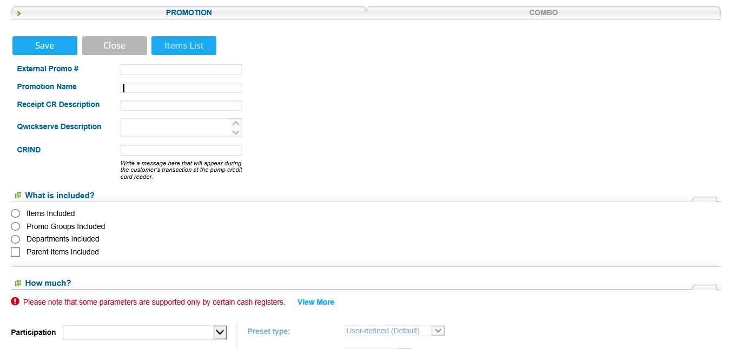
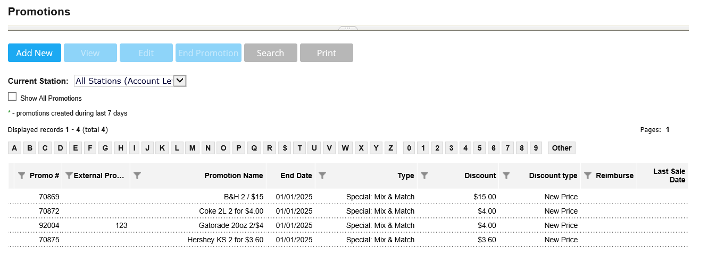
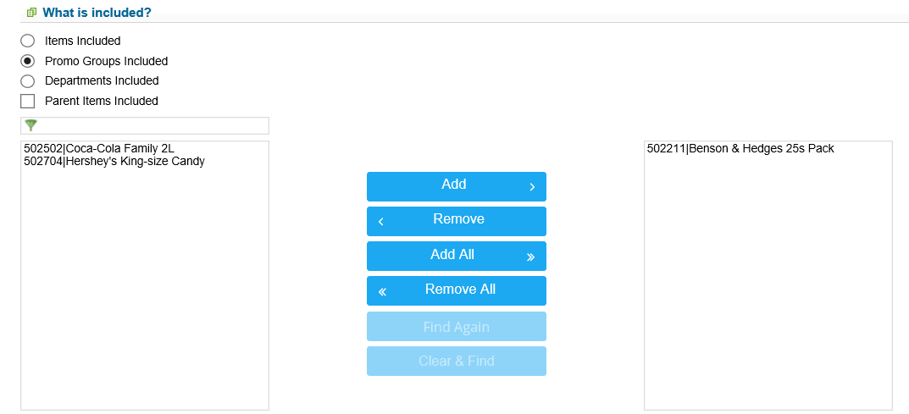
Price Book Set Up - Promotions
Notes:
Say: For all Promotions set up go to Price Book >Promotions and Add new.
Do: <Click> to advance
Say: Type in the Promotion name (how Altria or RJR requires you to name the promotion), the receipt CR description can be edited and has a 10-character limit. Choose what is included, Promo groups are ideal.
Do: <Click> to advance
Say: Drag the promo group to the right and then the second half of the promotion will depend on the promotion type. We will go through the four promotion types for Scan Data
Do: <Click> to advance to next slide

Slide 18
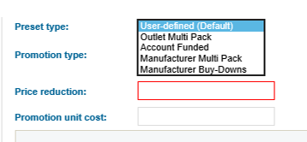
Price Book Set Up - Promotions
Scan Data Promotions have pre-set options to select from:
Outlet Multi Pack
Account Funded
Manufacturer Multi Pack
Manufacturer Buy-Downs
Gilbarco Passport Registers have a specialized way for creating Manufacturer/Outlet Funded Co-Promotion
Notes:
Say: For the scan data report to be able to provide Altria and RJR the appropriate information. There are different kinds of promotions that are pre-set in C-Store office for your convenience:
Outlet Funded Multipack
Account Funded
Manufacturer Multipack
Manufacturer Buy Down
Gilbarco Passport Registers have a specialized way for creating Manufacturer/Outlet Funded Co-Promotion
Do: <Click> to advance to next slide

Slide 19
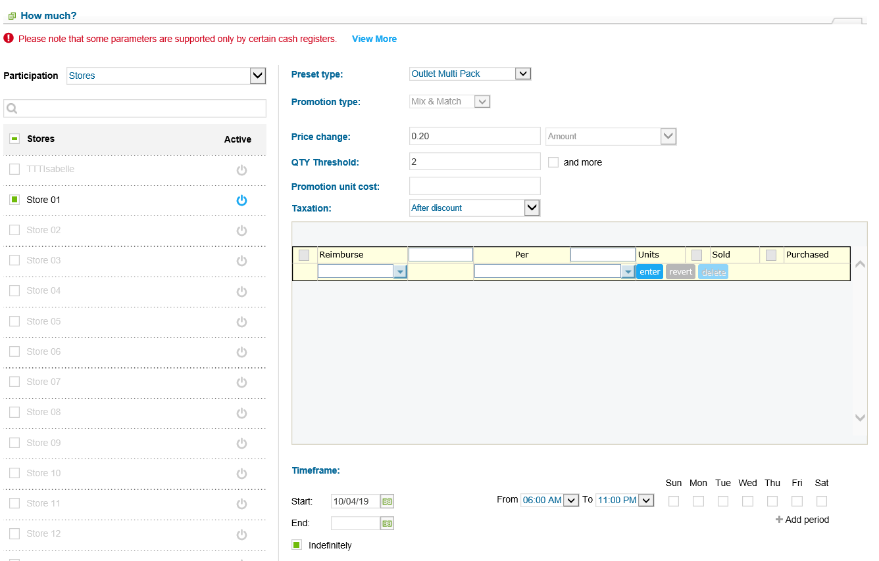
Price Book Set Up – Outlet Multi Pack Promotion
Outlet Multi Pack Promotion is funded by Individual Station
Notes:
Say: The Outlet Multi Pack Promotion is funded by the individual station. These are promotions where the station is absorbing the cost of the discount. To set up this promotion, in the “How Much” section choose the locations participating. Under promotion type, select Outlet Multi Pack preset. Mix and Match promotion type will default. In red Price Change and Qty threshold are required to fill out. You would NOT use the reimbursement section. In this example the promotion is taking .20 off of a 2 pack purchase. Choose the time frame for the promotion and Save on the top left..
Do: <Click> to advance to next slide

Slide 20
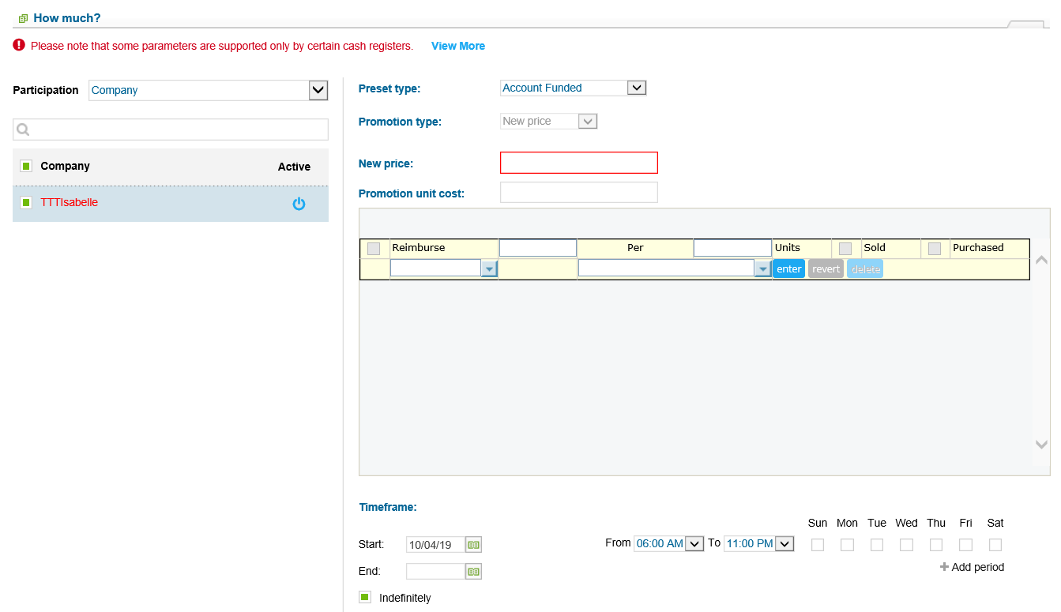
Price Book Set Up – Account Funded Promotions
Account Funded Promotions are funded at the Account level.
Notes:
Say: The Account Funded Promotion is funded at the account level. To set up this promotion, in the “How Much” section under preset type, you would choose Account Funded. This is intended for single items that are being reduced and that the account is absorbing the cost of the discount. You would NOT use the reimbursement section.
Do: <Click> to advance to next slide

Slide 21
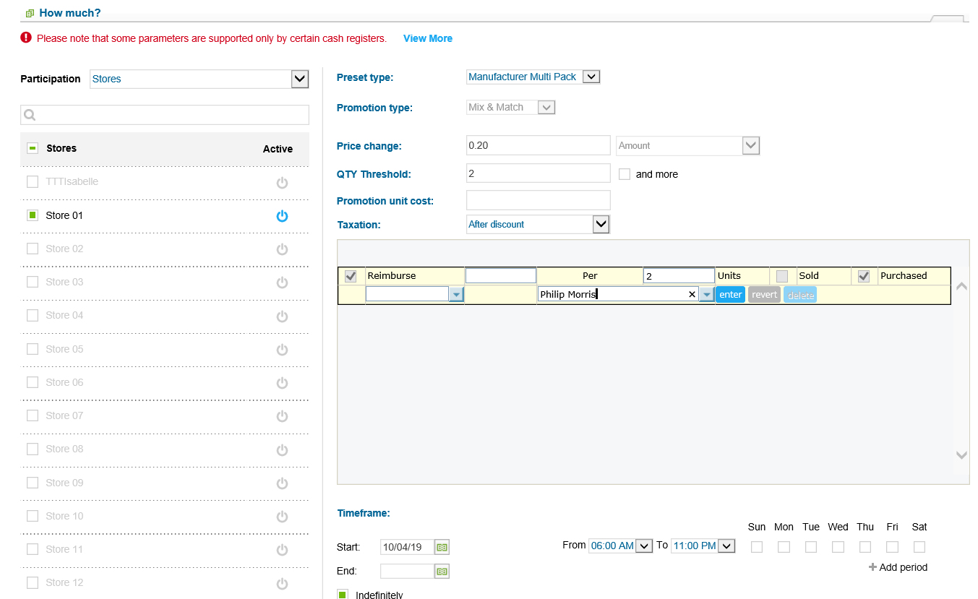
Price Book Set Up – Manufacturer Multi Pack Promotions
Manufacturer Multi Pack Promotions is funded by the Manufacturer
Notes:
Say: The Manufacturer Multi Pack Promotion is funded by the manufacturer. To set up this promotion, in the “How Much” section under promotion type, you would choose preset type manufacturer multi pack and enter Price Change and the Qty threshold must be 2 or more. The reimbursement section will check reimburse and purchased. Enter the corresponding units on the right of Per and drop down and choose the vendor, in this example Phillip Morris.
Do: <Click> to advance to next slide

Slide 22
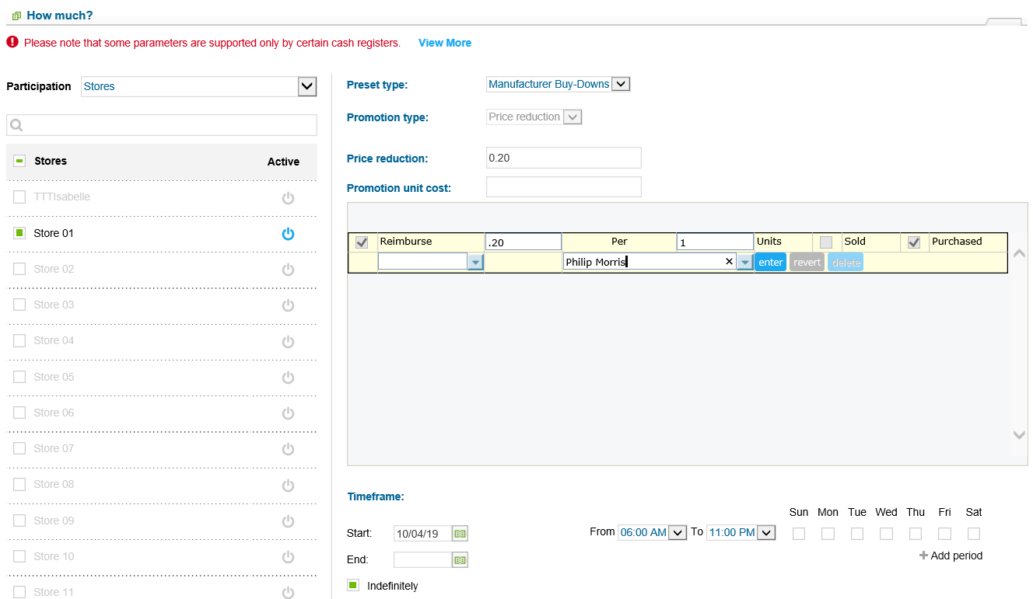
Price Book Set Up – Manufacturer Buy-Downs
Manufacturer Buy-Downs is funded by the manufacturer
Notes:
Say: The Manufacturer Buydown is funded by the manufacturer and is associated with a single pack purchase. To set this up, under preset type would choose Manufacturer Buy-Downs, type in price reduction, in the reimbursement section put price reduction per number of units and drop down and choose vendor. Choose Enter. In this example, Philip Morris is reimbursing .20 for every unit. Be sure to name the promotion as RJR or Altria has directed you or if they have not, put a BD in the beginning of the name description to be able to better discern this type of Buy Down promotion.
Do: <Click> to advance to next slide

Slide 23
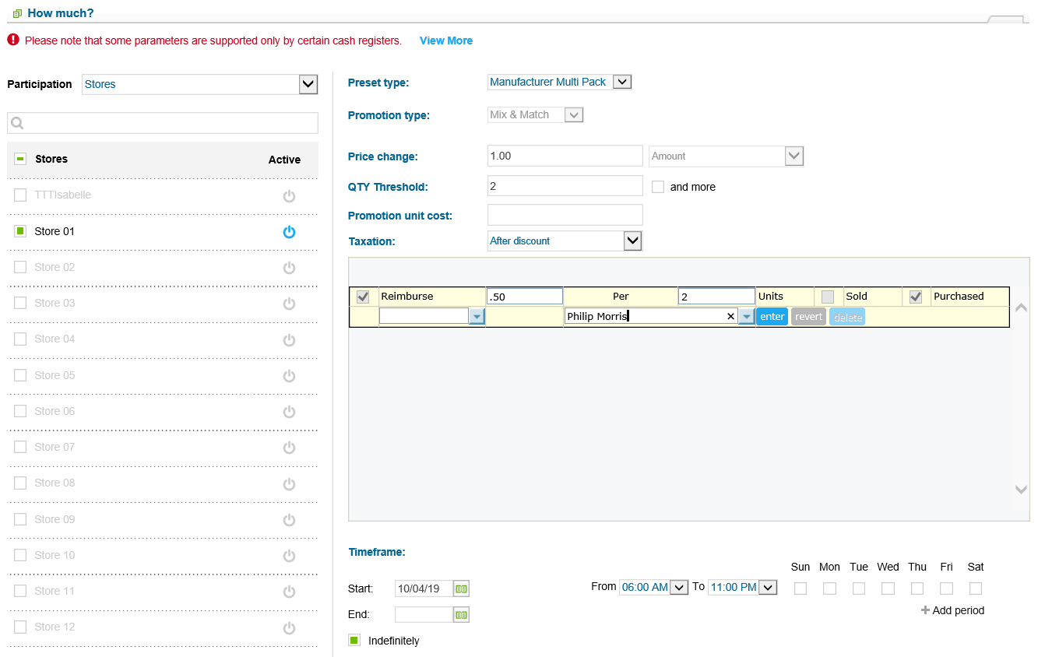
Price Book Set Up – Promotions - Gilbarco Passport Registers Only
Outlet Funded Multi Pack Promotion and Manufacturer Multi Pack Promotions should be set up as 1 Promotion
Notes:
Say: With a Gilbarco Passport Register both the Outlet Funded MP and the Manufacturer Multi Pack promotions, should be set up together in 1 promotion. Use the Manufacture Multi Pack promotion. For instance $0.50 discount on Outlet Funded and $0.50 discount on Manufacture Funded in the 1 promotion list the discount as $1.00 and only add the reimbursement to the Manufacturer Reimbursement, the system will know that the rest is Outlet Funded and will push that discount into the other Outlet Funded fields. In the reimbursement field be sure to break down the cost per units and drop down and choose manufacturer and click enter.
Do: <Click> to advance to next slide

Slide 24
Price Book Set Up -3rd Party Loyalty
If you have a 3rd party loyalty card, be sure this is set up properly in C-Store Office.
Submit an online support ticket if you have a loyalty provider and it is not coming into the shift reports.
Notes:
Say:If you currently have a 3rd party loyalty card you will need to place a help ticket with our technical dept to ensure that we have the settings correct. You can place a help ticket from the home page of C-Store Office.
Do: <Click> to advance to next slide

Slide 25
Altria Scan Data Error Codes and Solutions
IRI

Slide 26
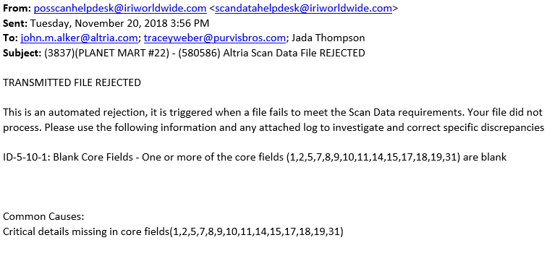
Altria Scan Data Report E-mail Notification of Error
Notes:
Say: Here is an example of what that may look like. Refer to the packet from Altria explaining their confirmations and error codes.
Do: <Click> to advance to next slide

Slide 27
Altria Error Code Description and Solution
Error Description | Solution
20190928 YYMMDD Missing File | Check to see if store was open during missing day information, if closed e-mail Altria representative to let them know if store was closed due to holiday or other event. Ensure DC box is online. Ensure shift was accepted for the missing day information. Resend the file for the missing week.
Notes:
Do: Review slide
Do: <Click> to advance to next slide

Slide 28
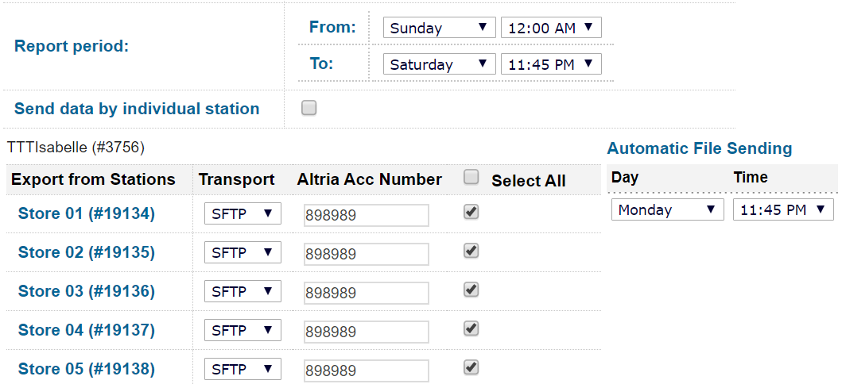
Altria Error Code Description and Solution
Error Description | Solution
4-4-1 Invalid Summary (First Line in File) Format or Summary Line Missing 4-4-2 Invalid Summary (First Line in File) Line | Ensure Altria Account Number field is filled in with Account Number for each station if sending files by individual Station. If sending 1 file that includes all stations data enter the same Account Number in each station.
Notes:
Do: Review slide
Do: <Click> to advance to next slide

Slide 29
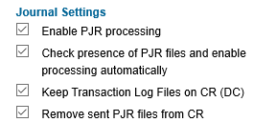
Altria Error Code Description and Solution
Error Description | Solution
4-4-5 Empty Data File 5-10-1 Blank Core Fields | Ensure DC is online in CSO Make sure shift is accepted Ensure PJR Files on Register are enabled, Help Menu has instructions Ensure PJR Files on C-Store Office are enabled CSO Homepage > Data Entry > Dashboard > Misc > Journal Settings Check Account Number in Report Settings Ensure entire store address is filled out in General Tab CSO Homepage > User Sign In > General > Locations 6. Submit a support ticket to Petrosoft if the above didn’t resolve issue.
Notes:
Do: Review slide
Do: <Click> to advance to next slide

Slide 30
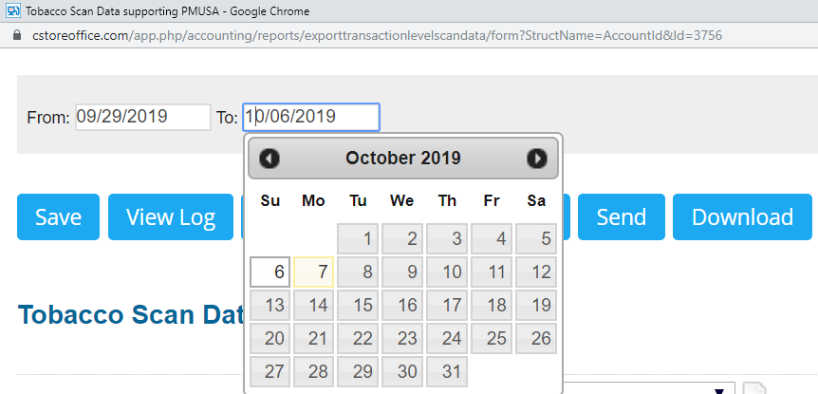
Altria Error Code Description and Solution
Error Description | Solution
5-2-3 Incorrect Week Ending Date Failed: Week ending date is not on Saturday | When sending manual test file, choose correct week ending date. Resend file.
Notes:
Do: Review slide
Do: <Click> to advance to next slide

Slide 31
RJR Data Error Descriptions and Solutions
MSA

Slide 32
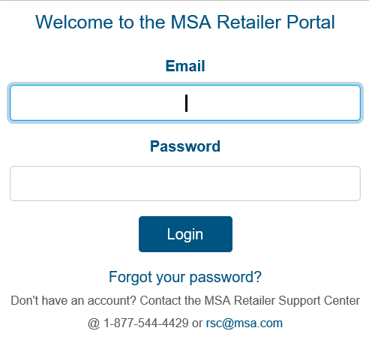
MSA Portal
Notes:
Say: Log into the RJR (MSA) portal and check and see if they received the file and if there are any errors. This is different than Altria, because Altria sends you an email. For RJR, login to MSA and check.
Do: <Click> to advance to next slide

Slide 33
RJR Error Description and Solution
Error Description | Solution
Unit of Measure is Required | Refer to Cigarette packet for required verbiage in Unit of Measure (i.e. Pack, Carton, etc). Size in C-Store Office Price Book must be accurate. Use Find and Replace Tool to update items Size in bulk Resubmit report
Notes:
Do: Review slide
Do: <Click> to advance to next slide

Slide 34
RJR Error Description and Solution
Error Description | Solution
File is missing expected fields- null | Ensure DC box is online in CSO Make sure shift is accepted Ensure PJR Files on Register are enabled, Help Menu has instructions Ensure PJR Files on C-Store Office are enabled CSO Homepage > Data Entry > Dashboard > Misc > Journal Settings 6. Wait 1 full week to resubmit a new file.
Notes:
Do: Review slide
Do: <Click> to advance to next slide

Slide 35
RJR Error Description and Solution
Error Description | Solution
Promotion Flag must be “Y” if Account Promotion Name is supplied If Account discount amount is blank, then account promotion name must also be blank. | Ensure Account Funded promotion is set up in C-Store Office correctly. Resubmit File
Notes:
Do: Review slide
Do: <Click> to advance to next slide

Slide 36
RJR Error Description and Solution
Error Description | Solution
Promotion Flag must be ‘Y’ if Manufacturer Multi-pack Quantity is supplied. Promotion Flag must be ‘Y’ if Manufacturer Promotion Description is supplied. Manufacturer Multi-pack Amount must be supplied if Manufacturer multi-pack Flag is ‘Y’ | Ensure Manufacturer Funded promotion is set up in C-Store Office correctly. Resubmit File
Notes:
Do: Review slide
Do: <Click> to advance to next slide

Slide 37
RJR Error Description and Solution
Error Description | Solution
Outlet Multi-pack Discount Amount must be supplied if Outlet Multi-pack Flag is ‘Y’ Outlet Multi-pack Flag must be ‘Y’ if Outlet Multi-pack Quantity is supplied Outlet Multi-pack Discount Amount, Account Discount Amount, Manufacturer Discount Amount or Manufacturer Multi-pack Amount is required if Promotion Flag is ‘Y’ | Ensure Outlet Funded promotion is set up in C-Store Office correctly. Resubmit File
Notes:
Do: Review slide
Do: <Click> to advance to next slide

Slide 38
RJR Error Description and Solution
Error Description | Solution
Manufacturer Buy-down Description must be supplied if Manufacturer Buy-down Amount is supplied | Ensure Manufacturer Buy-down Funded promotion is set up in C-Store Office correctly. Resubmit File
Notes:
Do: Review slide
Do: <Click> to advance to next slide

Slide 39
RJR Error Description and Solution
Error Description | Solution
File format not recognized for the file submitted. Please resubmit the certified format. | Submit a support ticket online to Petrosoft.
Notes:
Do: Review slide
Do: <Click> to advance to next slide

Slide 40
RJR Error Description and Solution
Error Description | Solution
Expected File Format can not be determined. | Submit a support ticket online to Petrosoft.
Notes:
Do: Review slide
Do: <Click> to advance to next slide

Slide 41
Gilbarco Passport Outlet Funded Promotion Not Reporting
Problem | Solution
Passport Register and Outlet funded promotion not reporting. | Manufacturer / Outlet Funded Co-Promotion set up correctly.
Notes:
Do: Review slide
Do: <Click> to advance to next slide

Slide 42
Support
Online ticketing system via C-Store Office
Call 412-306-0640
Dial 2 for Customer Support
Dial 3 for Technical Support
Available 24 hours a day 7 days a week
Notes:
Say: Here are the different ways you can contact us at Petrosoft for support. You can call 24/7 or submit a support ticket via web. You can also access a lot of information using the help menu on CSO
Do: <Click> to advance to next slide

Slide 43
Questions
Notes:
Say: We want to open it up now for questions.
Do: Take questions
Do: <Click> to advance slide

Slide 44
Conclusion
Notes:
Say: Thank you for your time.
Do: <End Meeting>

