Slide 1
Pricebook

Slide 2
Agenda
Vendor Setup
Departments
Promo Groups
Price Groups
Categories
Item Setup
Find & Replace Tool
Parent-Child Relationships
Promotions (Mix & Match)

Slide 3
Vendor Setup
From the main page of CStoreOffice®, to access the Vendors List
Select:
Vendors
Vendor’s List

Slide 4
Vendor Setup: Non-EDI Vendor
From the Vendors List, to add a Non-EDI Vendor
Select:
Add New
Vendor

Slide 5
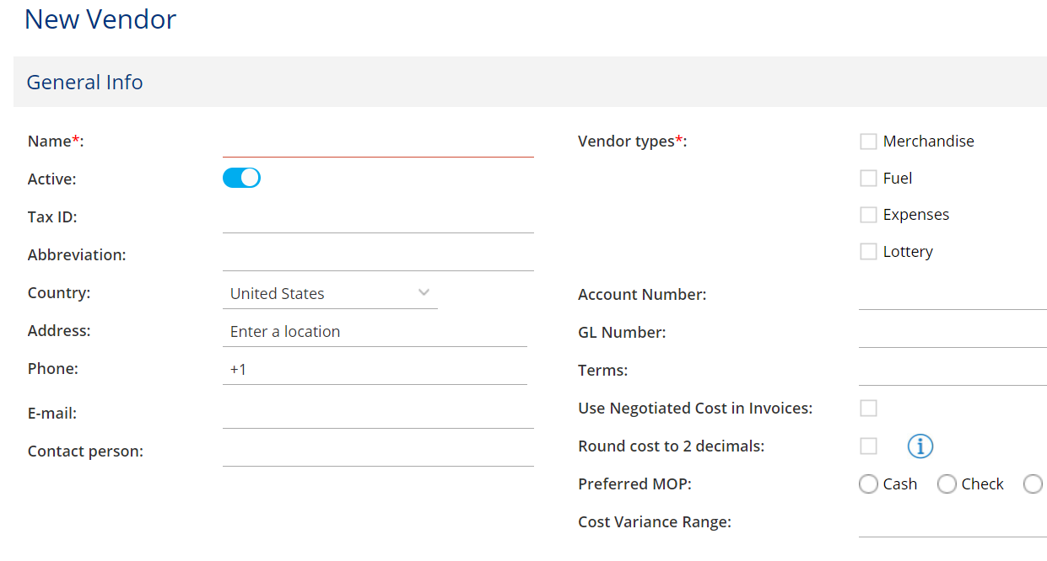
Vendor Setup: Non-EDI Vendor
Complete the following required fields:
Name
Vendor Types (Select multiple types if applicable)
NOTE: All other fields shown are optional

Slide 6
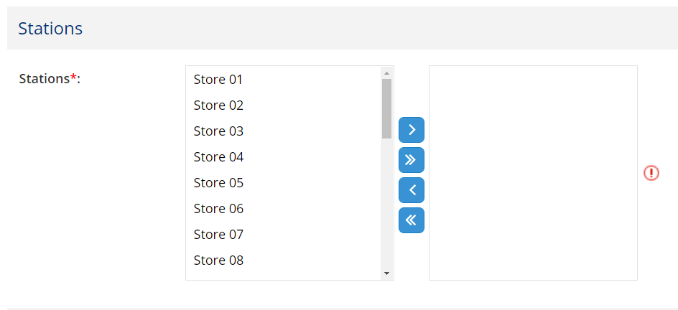
Vendor Setup: Non-EDI Vendor
Scroll down to the “Stations” section
Under Stations:
Select applicable store locations from the left side and use the center arrows to move them to the right side

Slide 7
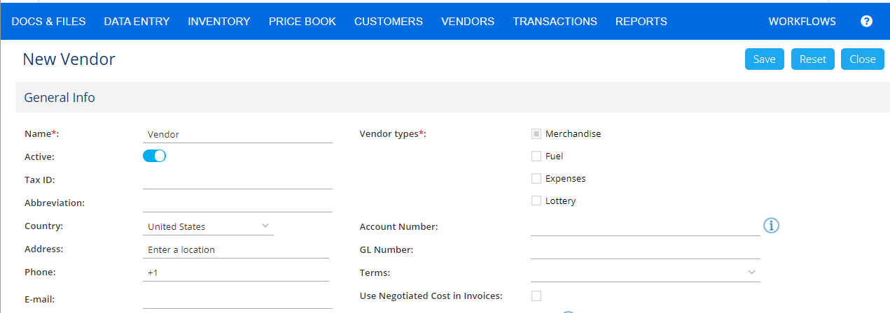
Vendor Setup: Non-EDI Vendor
Scroll to the top and click “Save”

Slide 8
Vendor Setup: EDI Vendor
From the Vendors List, to add an EDI Vendor
Select:
Add New
EDI Vendor

Slide 9
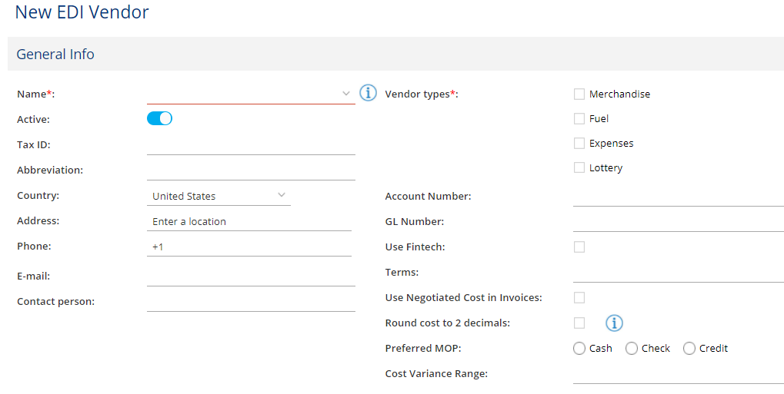
Vendor Setup: EDI Vendor
Complete the following required fields:
Name
Select name from dropdown menu
Vendor Types (Select multiple types if applicable)
NOTE: Do not alter e-mail or contact person, if one populates.
If none populate, you should complete these fields with your own contact person’s information

Slide 10
Vendor Setup: EDI Vendor
Scroll down to the “Stations” section
Under Stations:
Select applicable store locations from the left side and use the center arrows to move them to the right side

Slide 11
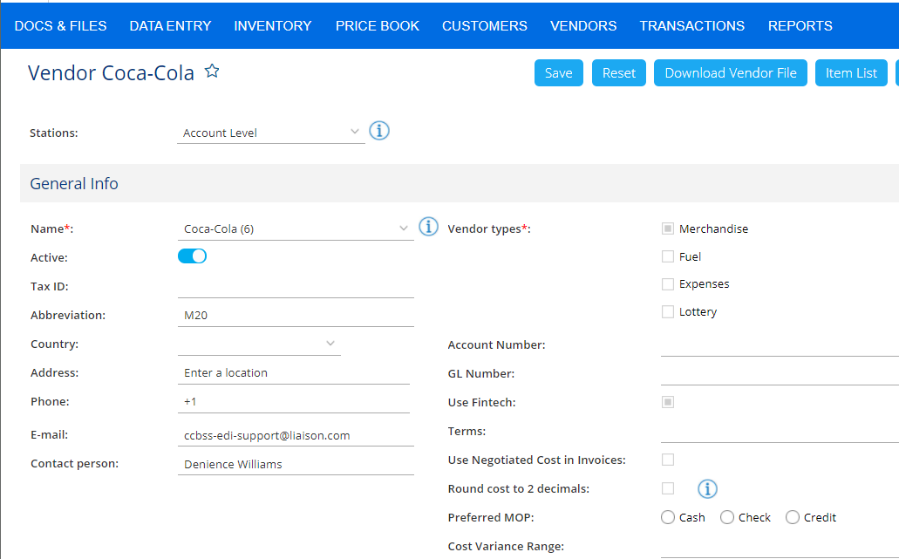
Vendor Setup: EDI Vendor
Scroll to the top and click “Save”

Slide 12
Vendor Setup: EDI Vendor
For each applicable station:
Go to the station level
Click dropdown arrow next to “Stations:”
Select station location

Slide 13
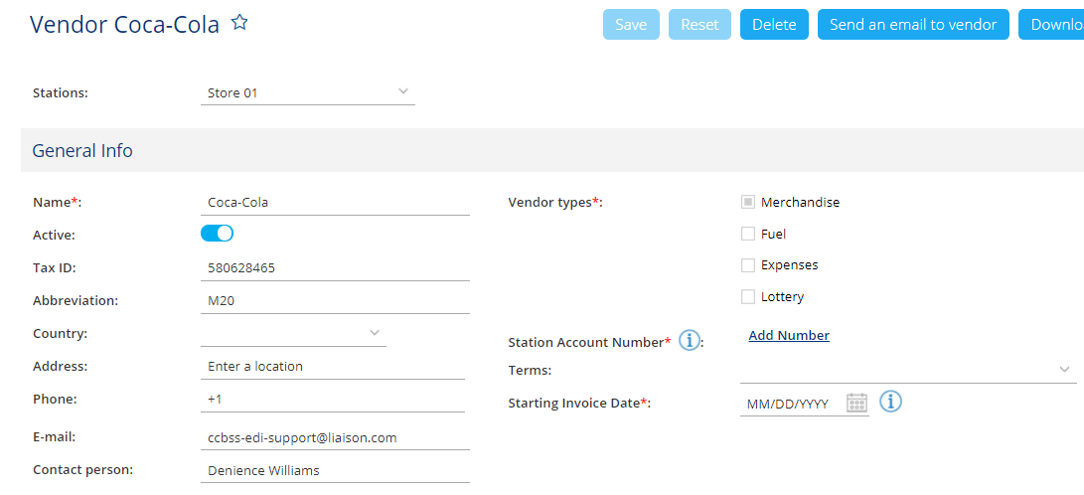
Vendor Setup: EDI Vendor
Complete the following additional fields:
Station Account Number
Starting Invoice Date
Click Save

Slide 14
Vendor Setup: EDI Vendor
To Send EDI request to vendor:
Select:
Send an Email to vendor

Slide 15
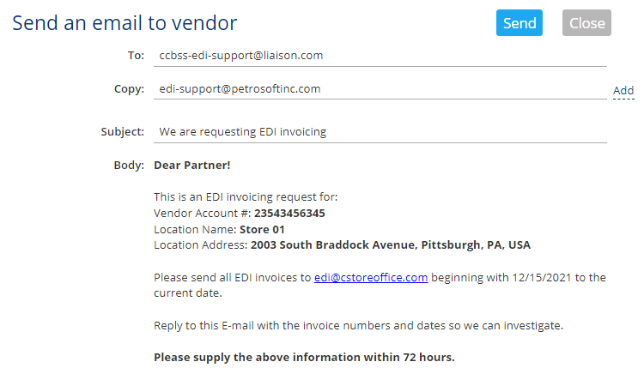
Vendor Setup: EDI Vendor
To Send EDI request to vendor:
Select:
Send an Email to vendor
Review information for accuracy
Click Send

Slide 16
Categories
From the main page of CStoreOffice®, to access the Categories List
Select:
Pricebook
Category

Slide 17
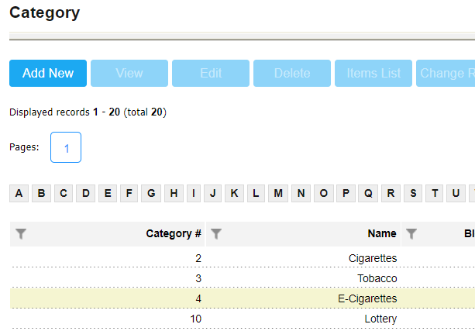
Categories: Add New Category
From the Category List, to add a new category:
Select
Add New

Slide 18
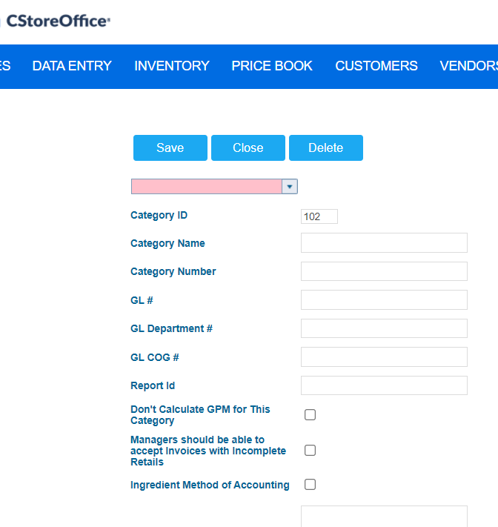
Categories: Add New Category
Complete the following fields, if applicable:
Category ID – Category Identifier
Category Name
Category Number
GL # - General Ledger Number
GL Department # - General Ledger Department number
GL COG # - General Ledger cost of goods number
Report ID – Report identifier

Slide 19
Categories: Add New Category
Specify the following parameter, if needed:
Don’t calculate GPM for this Category
Managers should be able to accept invoices with incomplete retails
Ingredient Method of Accounting – Exclude items in the category from the full audits list

Slide 20
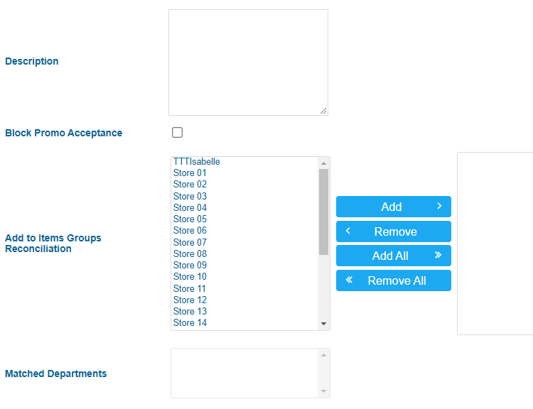
Categories: Add New Category
Complete the following if applicable:
Description – Description of category
Block Promo Acceptance – Forbid deactivating the promotion with items from this category
Add to Items Groups Reconciliation – Use center arrows to add desired stations to the Items Groups Reconciliation (Item movement) count page.

Slide 21
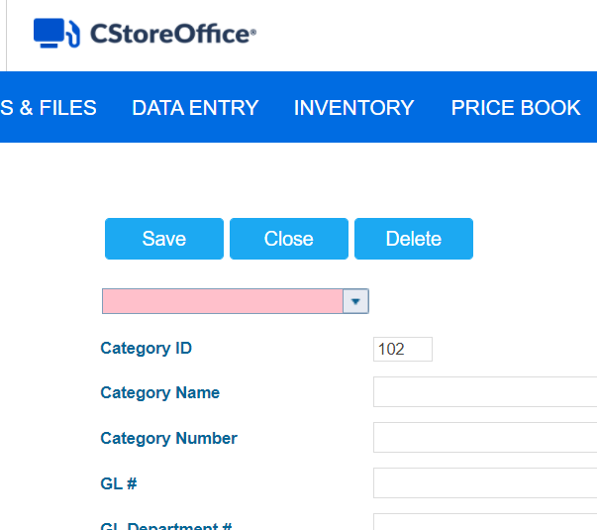
Categories: Add New Category
Scroll to the top and click Save

Slide 22
Departments
From the main page of CStoreOffice®, to access the Department List
Select:
Pricebook
CR Departments

Slide 23
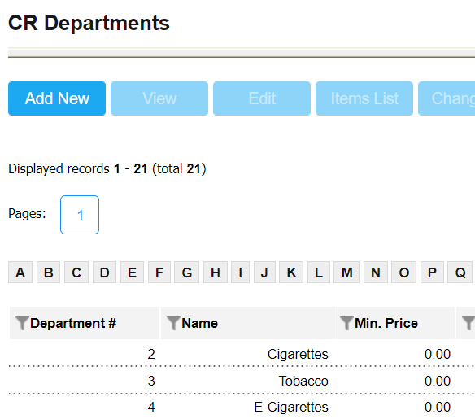
Departments: Add New Department
From the Department List, to add a new department:
Select
Add New

Slide 24
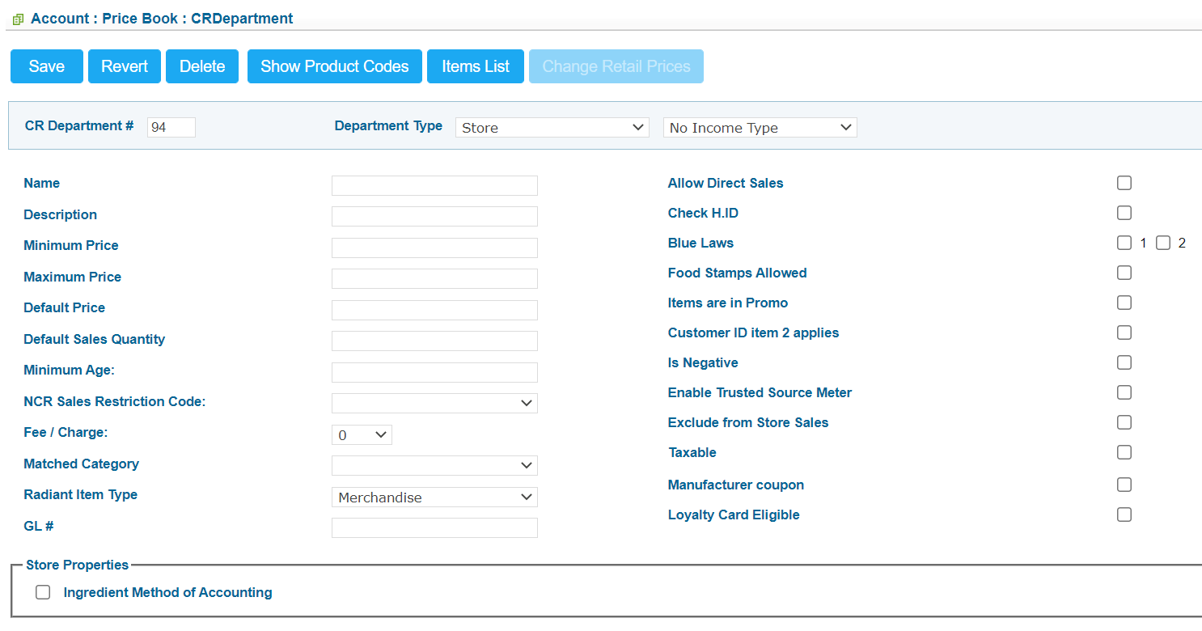
Departments: Add New Department
Complete the following fields:
CR Department #
Name
Description – max 10 characters

Slide 25
Departments: Add New Department
Complete the following, if applicable:
Minimum Price – minimum selling price
Maximum Price – maximum selling price
Default Price – default selling price
Default Sales Quantity – Usual number of items sold per purchase in this dept
Minimum Age – minimum age restriction for purchasing items in this dept

Slide 26
Departments: Add New Department
Select the following options, if applicable:
Allow Direct Sales – permits direct department sales
Check H.ID – Prompt to check ID
Blue Laws – For alcoholic beverages only. Sets restriction on selling items at certain hours (1 or 2 based on register configuration)
Food stamps are allowed
Is Negative – Turns on negative values
Enable Trusted Source Meter
Exclude from store sales
Taxable
Manufacturer coupon
Loyalty Card Eligible
Ingredient Method of Accounting

Slide 27
Departments: Add New Department
Scroll to the top and click Save

Slide 28
Price Groups
From the main page of CStoreOffice®, to access the Price Groups List
Select:
Pricebook
Price Groups

Slide 29
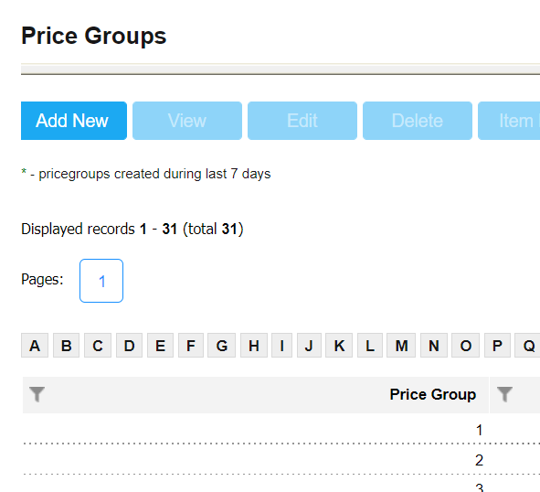
Price Groups: Add New Price Group
From the Price Groups List, to add a new Price Group:
Select
Add New

Slide 30
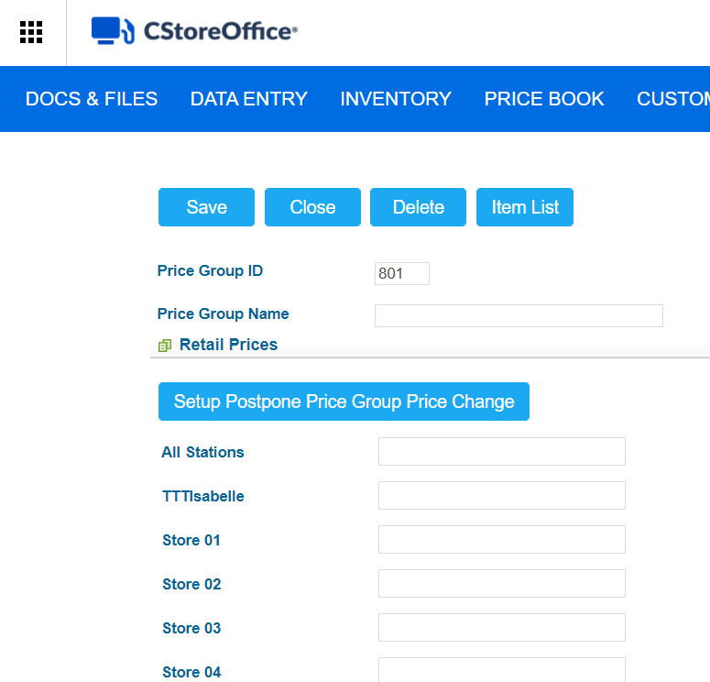
Price Groups: Add New Price Group
Complete the following:
Price Group ID
Price Group Name
Retail Prices
All stations – add the same price to all stations at once
OR
Add by individual station
Click Save

Slide 31
Promo Groups
From the main page of CStoreOffice®, to access the Promo Groups List
Select:
Pricebook
Promo Groups

Slide 32
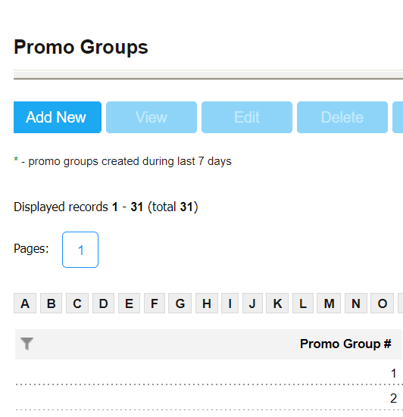
Promo Groups: Add New Promo Group
From the Price Groups List, to add a new Price Group:
Select
Add New

Slide 33
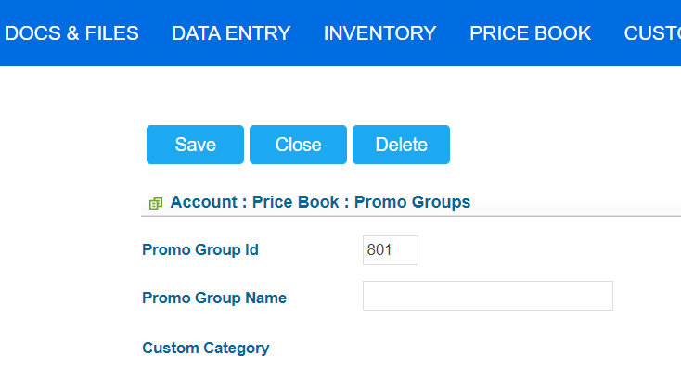
Promo Groups: Add New Promo Group
Complete the following:
Promo Group ID
Promo Group Name
Click Save

Slide 34
Item Setup
From the main page of CStoreOffice®, to access the Item search Engine
Select:
Pricebook
Items

Slide 35
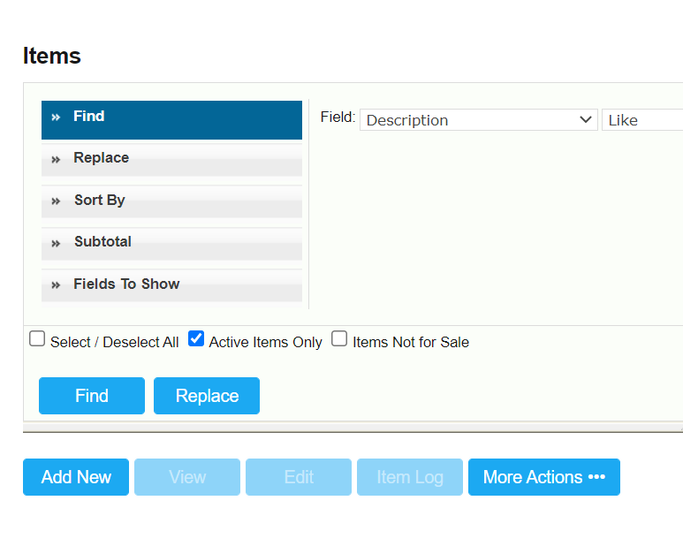
Item Setup: Add New Item
From the Items search engine, to add a new item:
Select
Add New

Slide 36
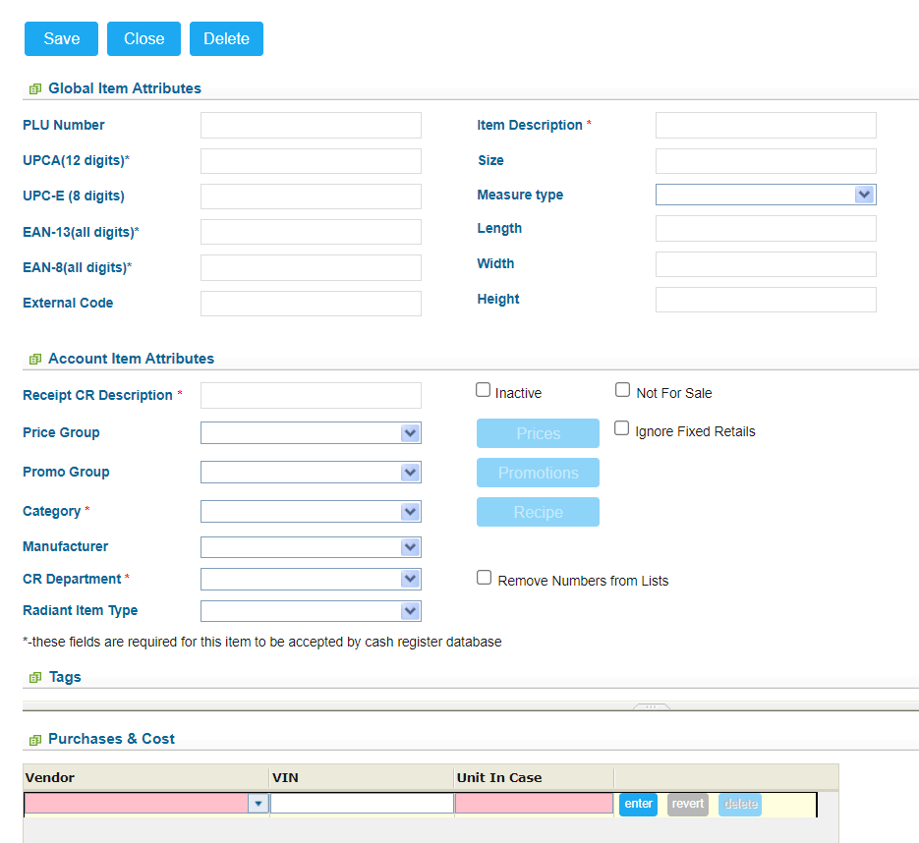
Item Setup: Add New Item
Complete ONE of the following:
PLU Number
UPC – A
UPC – E
EAN – 13
EAN – 8
Complete the following required fields:
Item Description - No character limit
Receipt CR Description - 10-character limit
Category
CR Department
Other fields are optional

Slide 37
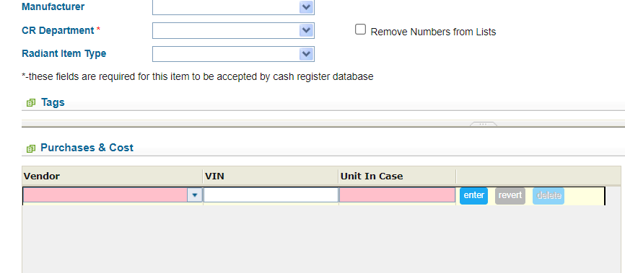
Item Setup: Add New Item
Complete the following Fields:
Vendor
VIN – Vendor Identification # (If item number not provided, use last 5 digits of UPC
Unit In Case
Click Enter

Slide 38
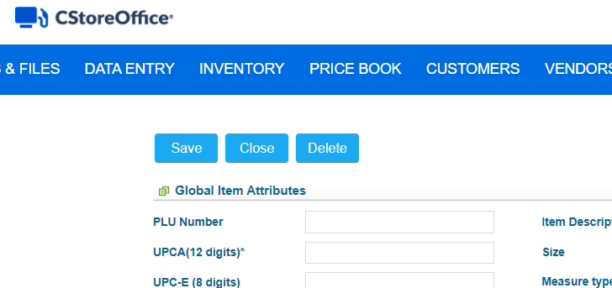
Item Setup: Add New Item
Scroll to the top and click Save

Slide 39
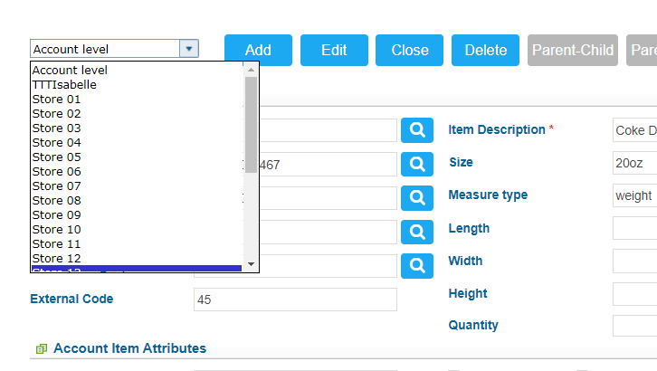
Item Setup: Add Retail Price (If not in Price Group)
From Item Setup screen, go to station level:
Click dropdown arrow
Select station location

Slide 40
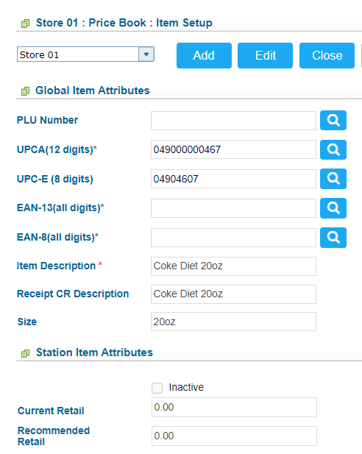
Item Setup: Add Retail Price (If not in Price Group)
Click Edit

Slide 41
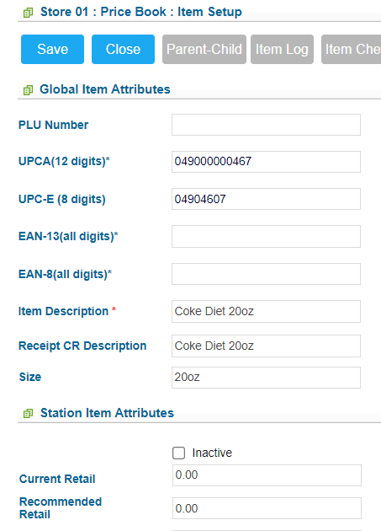
Item Setup: Add Retail Price (If not in Price Group)
Edit Current retail field
Click Save

Slide 42
Find & Replace Tool
From the main page of CStoreOffice®, to access the Item search Engine
Select:
Pricebook
Items

Slide 43
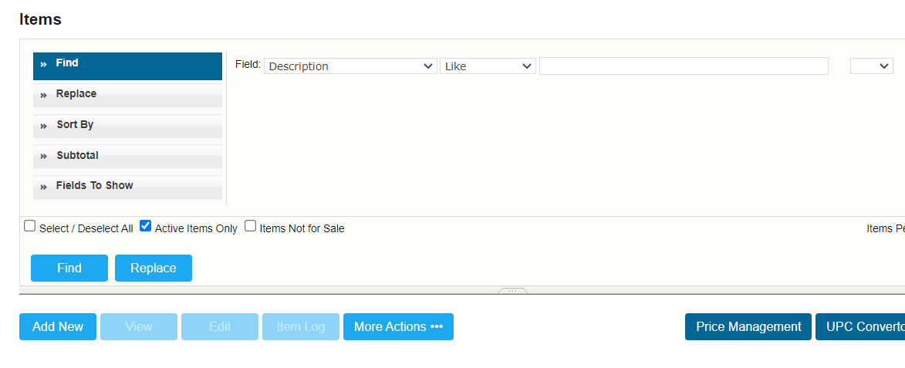
Find & Replace Tool
Use the Find option to locate the desired Items:
Select a field that the search criteria should be based on
Select a search operator (in the center)
Type a search value
Click Find

Slide 44
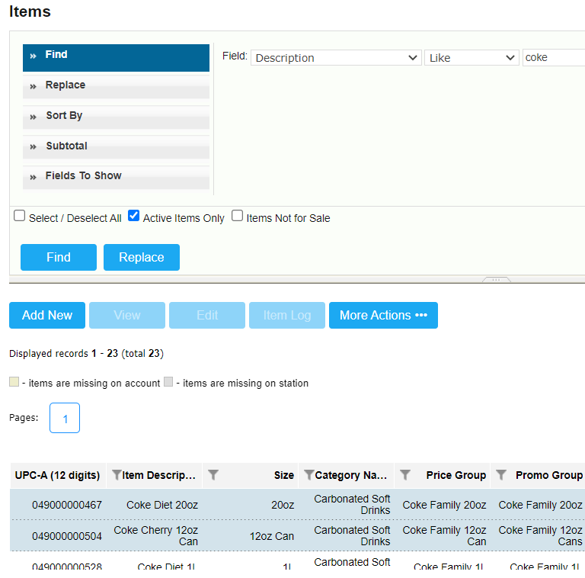
Find & Replace Tool
Your search results will be displayed at the bottom of the screen
Click on each applicable item to select it (it will highlight blue)
Click Replace on the left side of the search tool

Slide 45
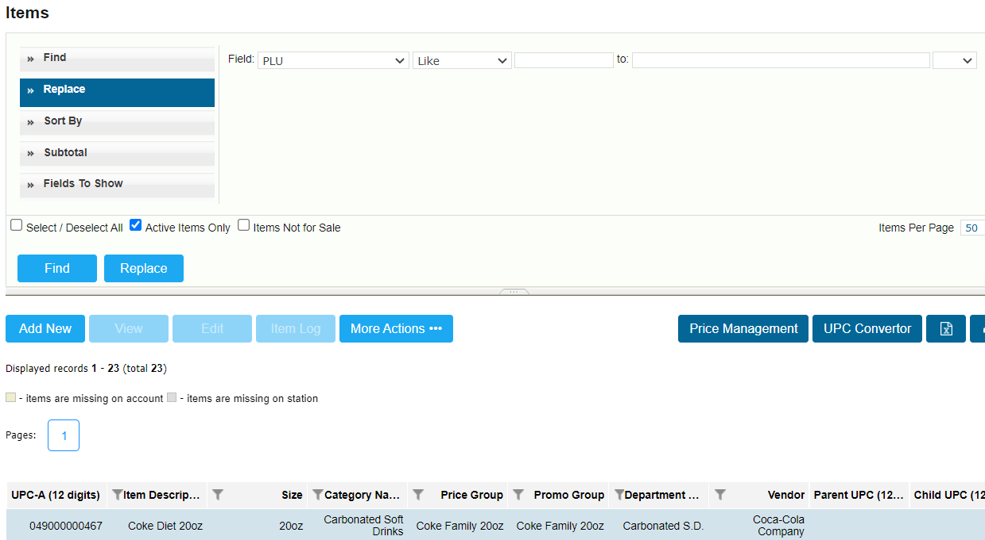
Find & Replace Tool
Select field to replace
Select a search operator (in the center)
Enter what you would like to change the field to
Click the blue replace button
Result: All selected items will have the specified field replaced

Slide 46
Parent-Child Relationships
To set up a parent-child relationship, you must start from the item search engine
From the main page of CStoreOffice®, to access the Item search Engine
Select:
Pricebook
Items

Slide 47
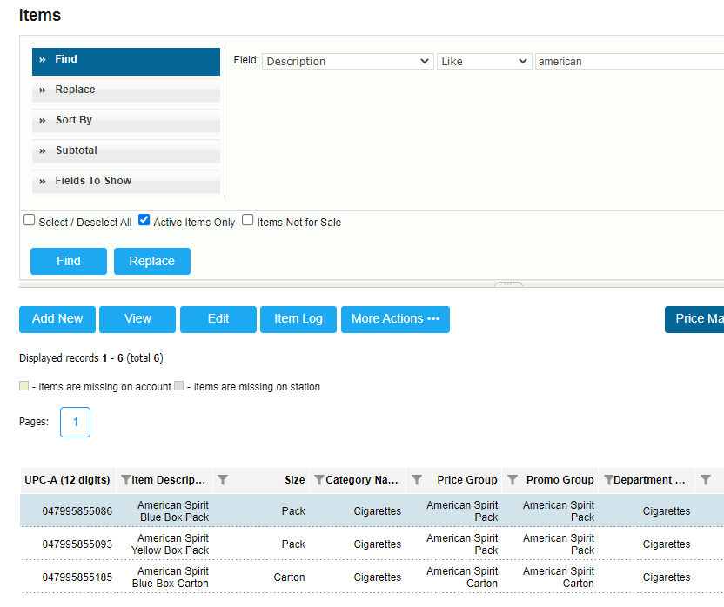
Parent-Child Relationships
Use the search engine to locate the desired item
NOTE: You can start with either the parent or the child
Click on the item (it will highlight Blue)
Click View

Slide 48
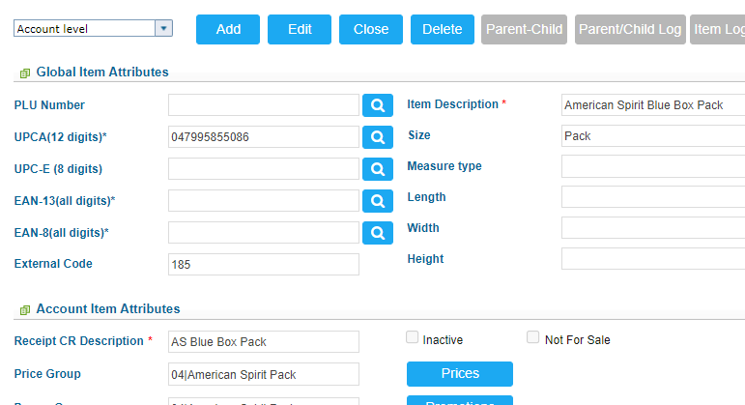
Parent-Child Relationships
Click the Parent-Child Button

Slide 49
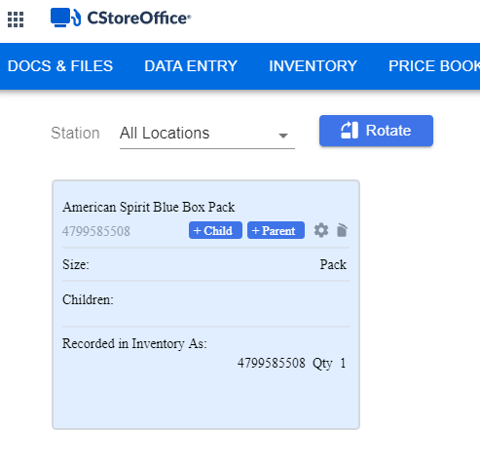
Parent-Child Relationships
Click the +Child or +Parent Button
If you started with the child, click “+Parent”
If you started with the parent, click “+Child”
A white box will appear to the right of your screen

Slide 50
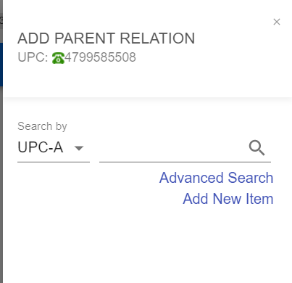
Parent-Child Relationships
If you have the UPC, fill in the UPC field
Click the Search Icon

Slide 51
Parent-Child Relationships
If you DO NOT have the UPC, Click Advanced Search
You will be taken to the item search tool

Slide 52
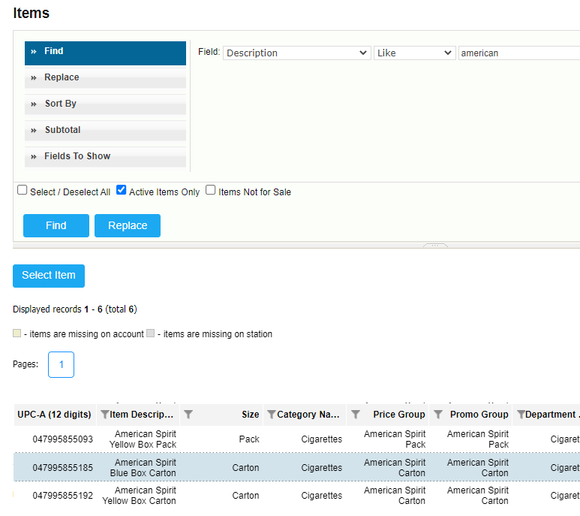
Parent-Child Relationships
Use the item search tool to locate the desired item
Click on the item (It will highlight in blue)
Click Select Item

Slide 53
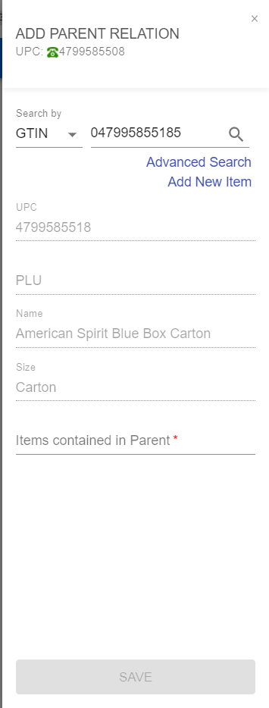
Parent-Child Relationships
The item details will populate
Enter the number of items contained in the parent
Click Save

Slide 54
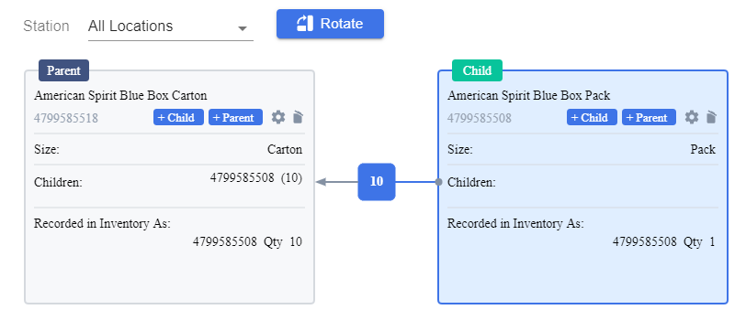
Parent-Child Relationships
The Parent-Child relationship will show

Slide 55
Promotions
From the main page of CStoreOffice®, to access the promotions list
Select:
Pricebook
Promotions

Slide 56
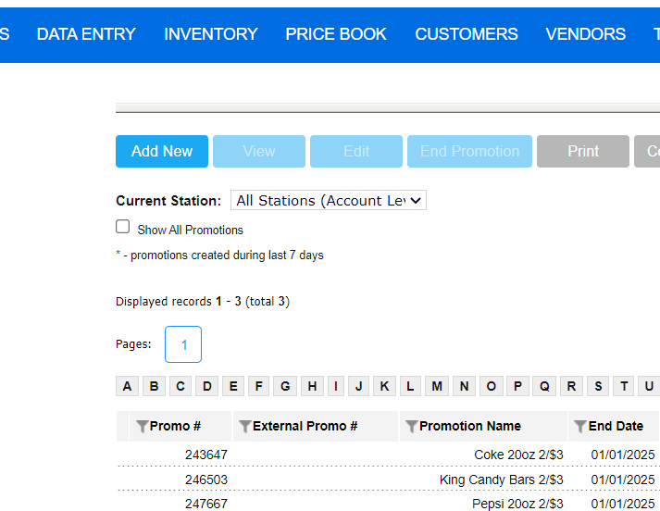
Promotions: Add a New Mix & Match Promotion
To add a new Promotion:
Click Add New

Slide 57
Promotions: Add a New Mix & Match Promotion
Complete the following fields:
Promotion Name
Receipt CR Description (10-character limit)
Promotion type – Click the dropdown arrow and select Mix & Match from the list

Slide 58
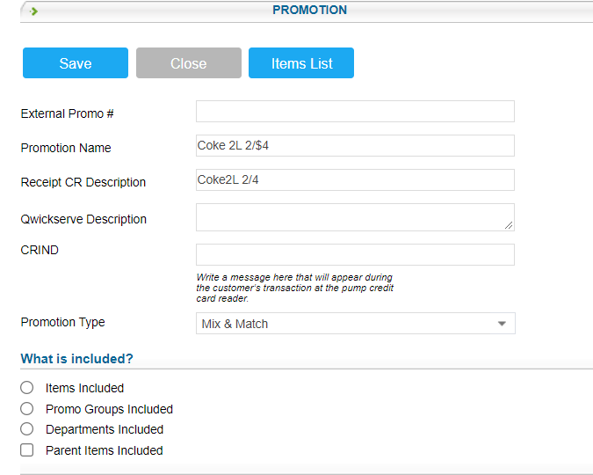
Promotions: Add a New Mix & Match Promotion
What is included?
Items Included
You will be taken to the item search tool

Slide 59
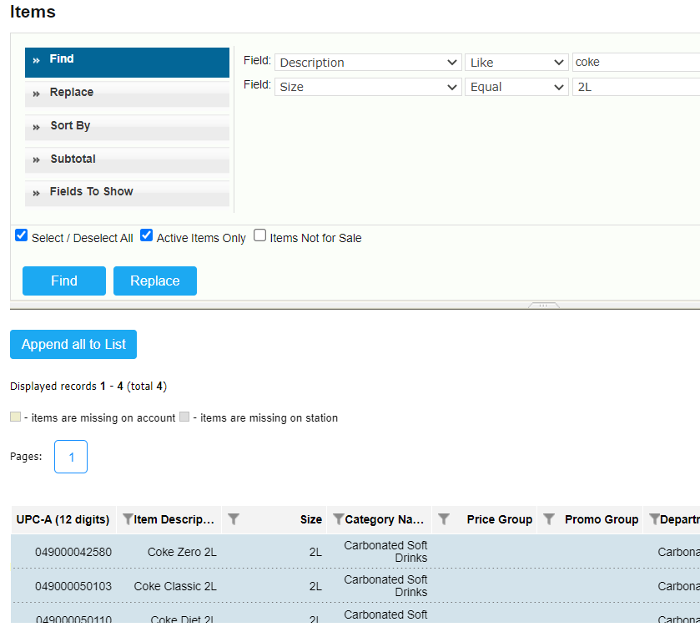
Promotions: Add a New Mix & Match Promotion
Use search tool to locate items to be included in the promotion
Select all desired items (will be highlighted in blue)
Click Append All To List

Slide 60
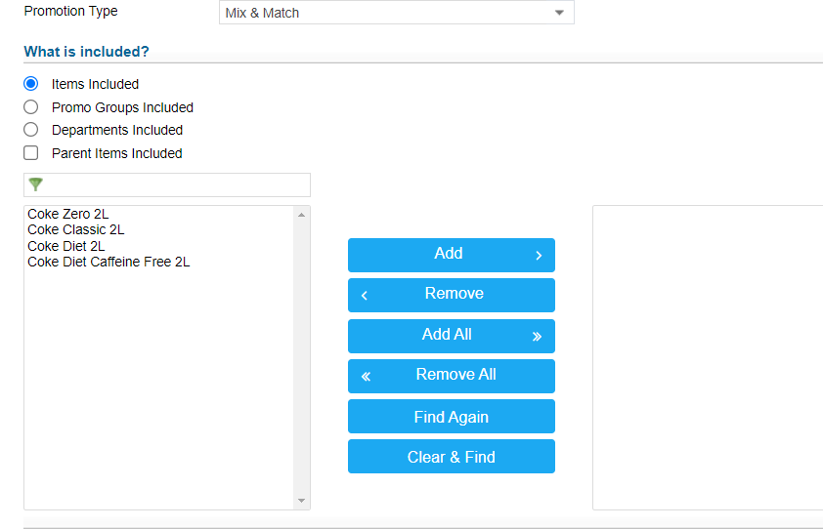
Promotions: Add a New Mix & Match Promotion
Selected items will appear in left box
Use center buttons to move items to right side

Slide 61
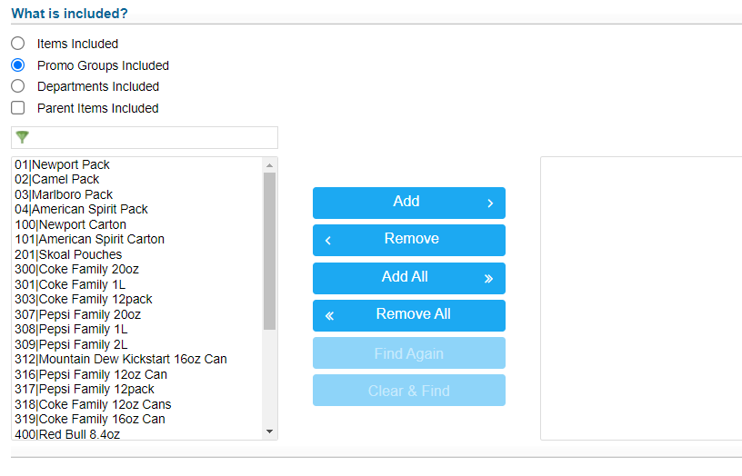
Promotions: Add a New Mix & Match Promotion
What is included?
Promo Groups Included
Promo groups will appear in left box
Use center buttons to move desired promo groups to right box

Slide 62
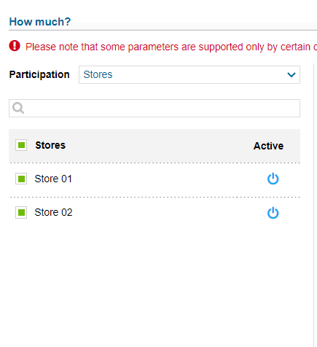
Promotions: Add a New Mix & Match Promotion
How Much?
Participation – Select “Stores” from dropdown menu
Select boxes to the left of each applicable store location
Click Symbol to the right to activate promotion for those locations

Slide 63
Promotions: Add a New Mix & Match Promotion
How Much?
Price Change – Select type of price change from the dropdown menu and enter amount.
New Price – Enter new total price for promo items
Amount – Enter dollar amount of the discount
Percentage – Enter percentage discount
QTY Threshold – Enter quantity that must be purchased to receive discount
Timeframe – Enter start and end date of promotion
Select “Indefinitely” if there is no specific end date

Slide 64
Promotions: Add a New Mix & Match Promotion
Promo Result
Review results for accuracy

Slide 65
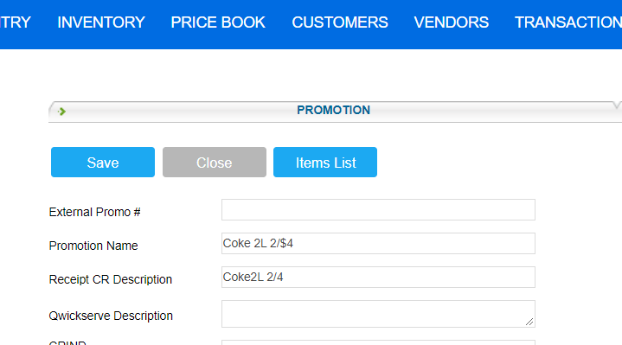
Promotions: Add a New Mix & Match Promotion
Scroll to the top of the page
Click Save

Slide 66
THANK YOU!
Notes:
Say: Thank you for your time. Does anyone have any questions?
Do: Respond to questions.
Do: <End Meeting>

