Slide 1
Lottery

Slide 2
Agenda
Game Setup
Count
Sales and Inventory
Purchases & Returns

Slide 3
Prerequisites
Lottery Category is set up in CStoreOffice ®
Lottery CR Department is set up in CStoreOffice®
Vendor, from which you purchase your lottery, is set up in CStoreOffice®

Slide 4
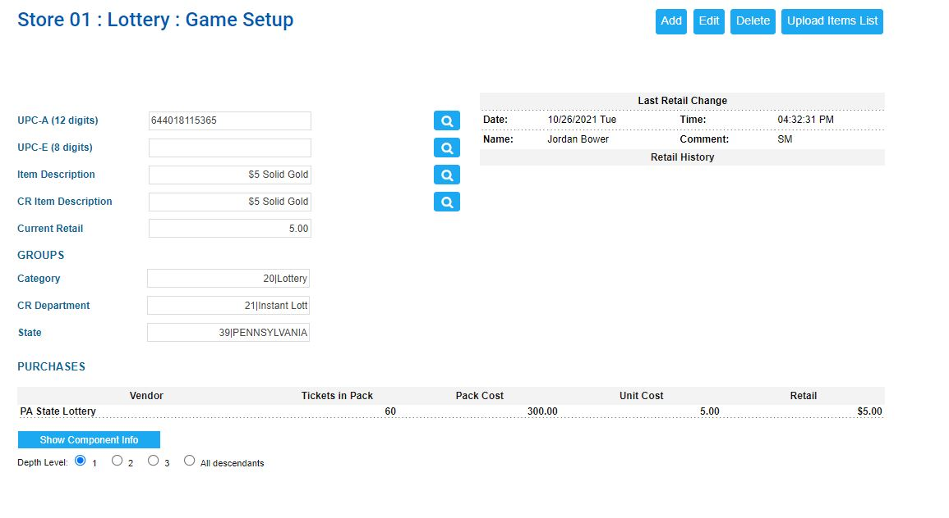
Game Setup
Add Games
Edit Games
Delete Games
Upload items List

Slide 5
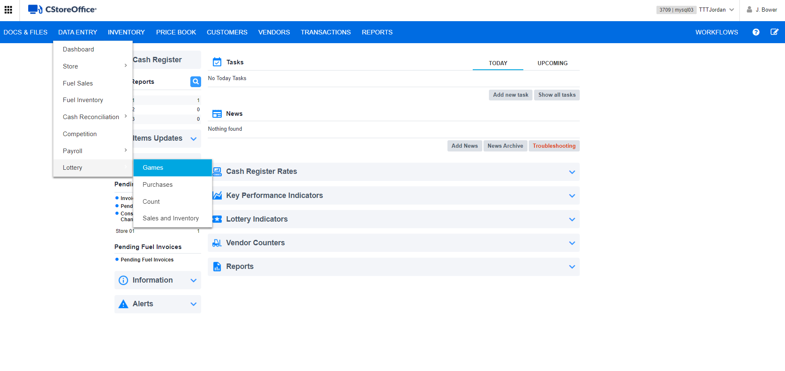
Add Games
From the main page of CStoreOffice®, access the Lottery Game Setup page.
Select
Data Entry
Lottery
Games

Slide 6
Add Games
For each game sold at the station level, select the Add button.

Slide 7
Add Games
Enter the following information for the lottery game:
UPC-A (12 Digits) or UPC-E (8 Digits)
Item Description
CR Item Description
Current Retail
Category
CR Department
State

Slide 8
Add Games
Continue to the Purchases section and enter the following information for the lottery game:
Vendor
Tickets in Pack
Pack Cost
Unit Cost
Retail

Slide 9
Editing Existing Lottery Games
Select a lottery game you want to edit, using one of the following ways:
Using the magnifying/search buttons.
Select which field to search by:
UPC-A
UPC-E
Item Description
CR Item Description
Enter full or partial data in one of the fields and then click the search button.

Slide 10
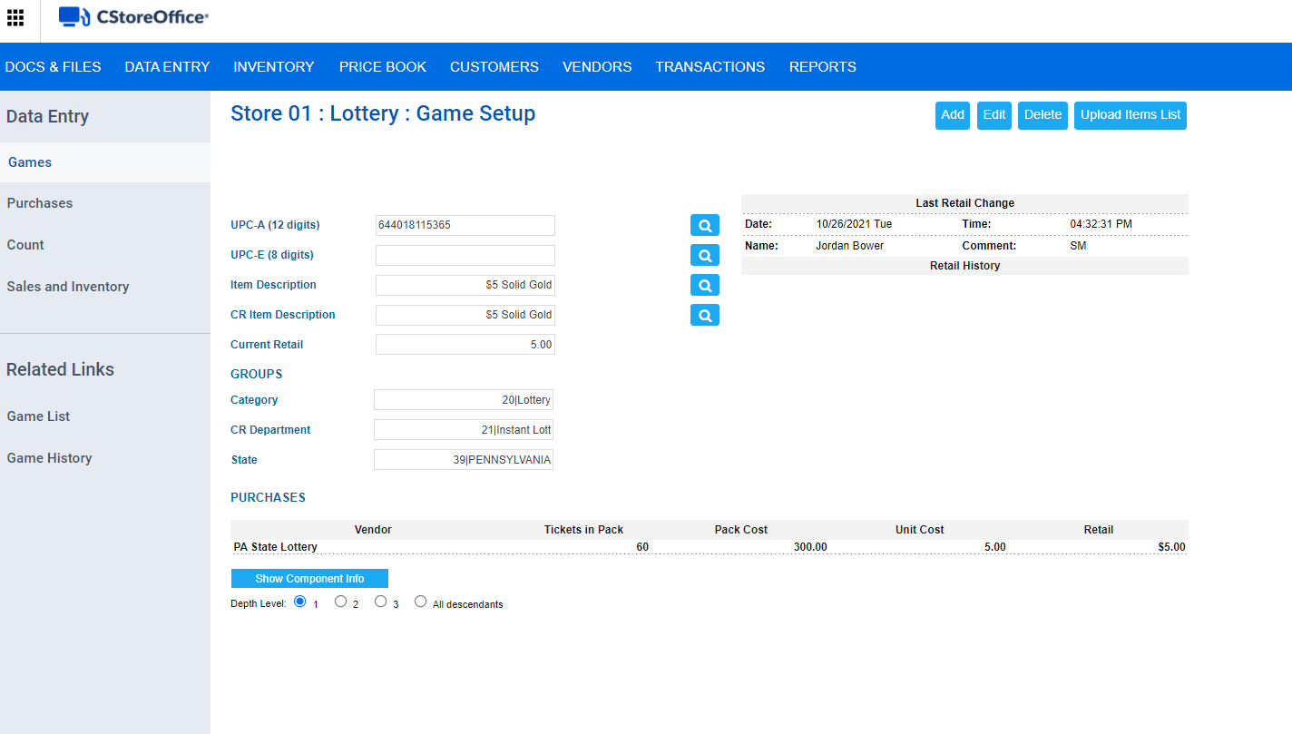
Editing Existing Lottery Games
Select a lottery game you want to edit, using one of the following ways:
2. Select the game from the Games List link.

Slide 11
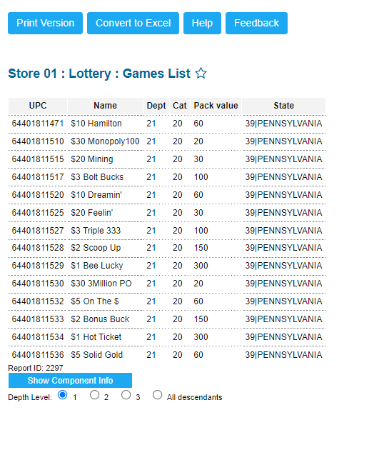
Editing Existing Lottery Games
Choose the game in which you want to edit from the Lottery Games List

Slide 12
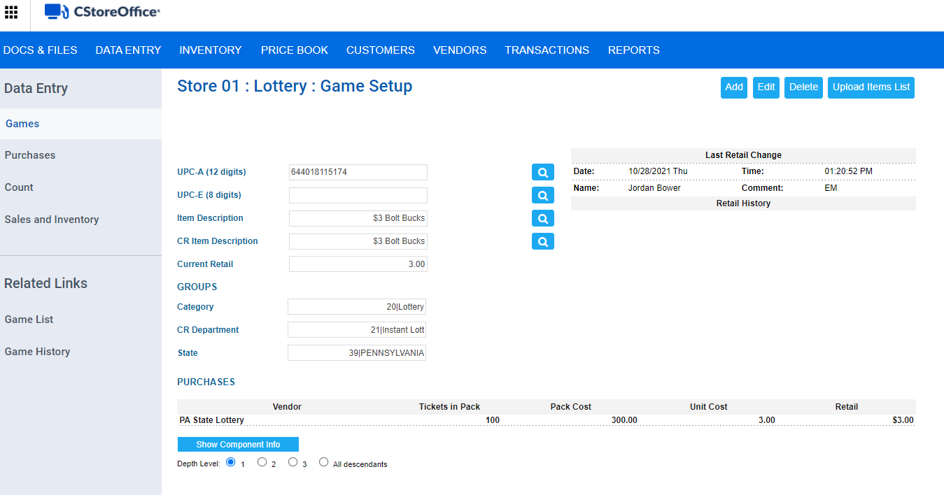
Editing Existing Lottery Games
At the top right of the Game Setup form, click the Edit button.

Slide 13
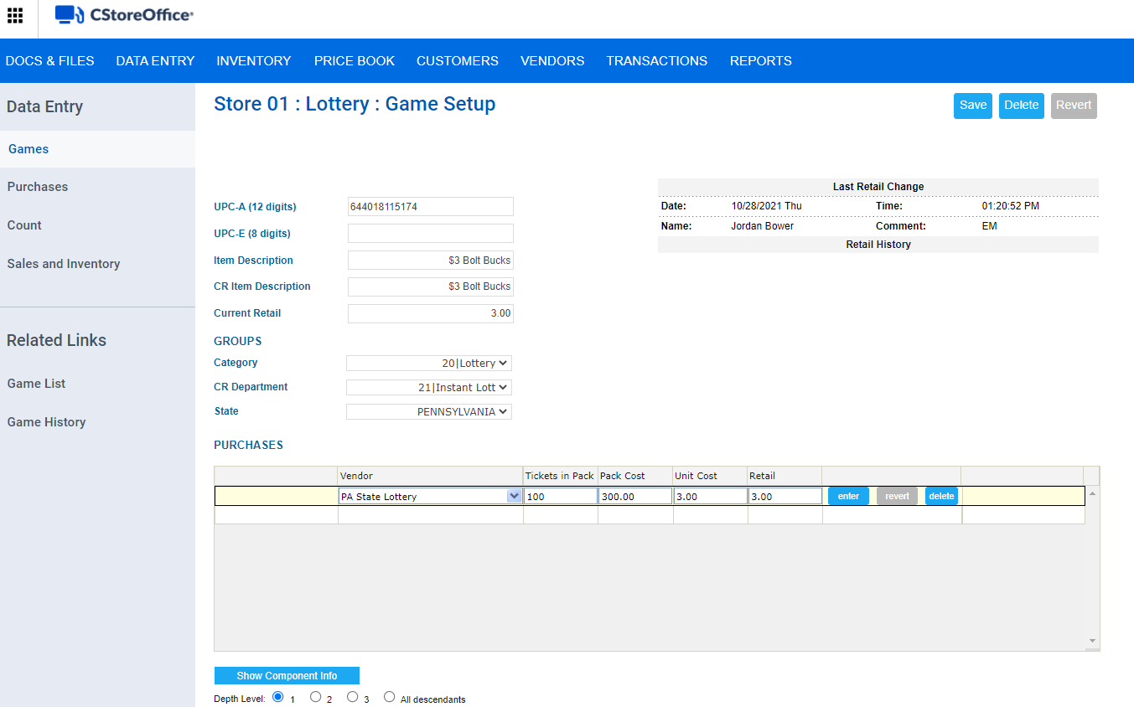
Editing Existing Lottery Games
Edit the information you need, and then click Save

Slide 14
Delete Games
Select the game from the list of lottery games. (Shown previously)
At the top right of the Game Setup form, click the Delete button.

Slide 15
Uploading Lottery Games
At the top right of the Game Setup form, click the
Upload Items List button.

Slide 16
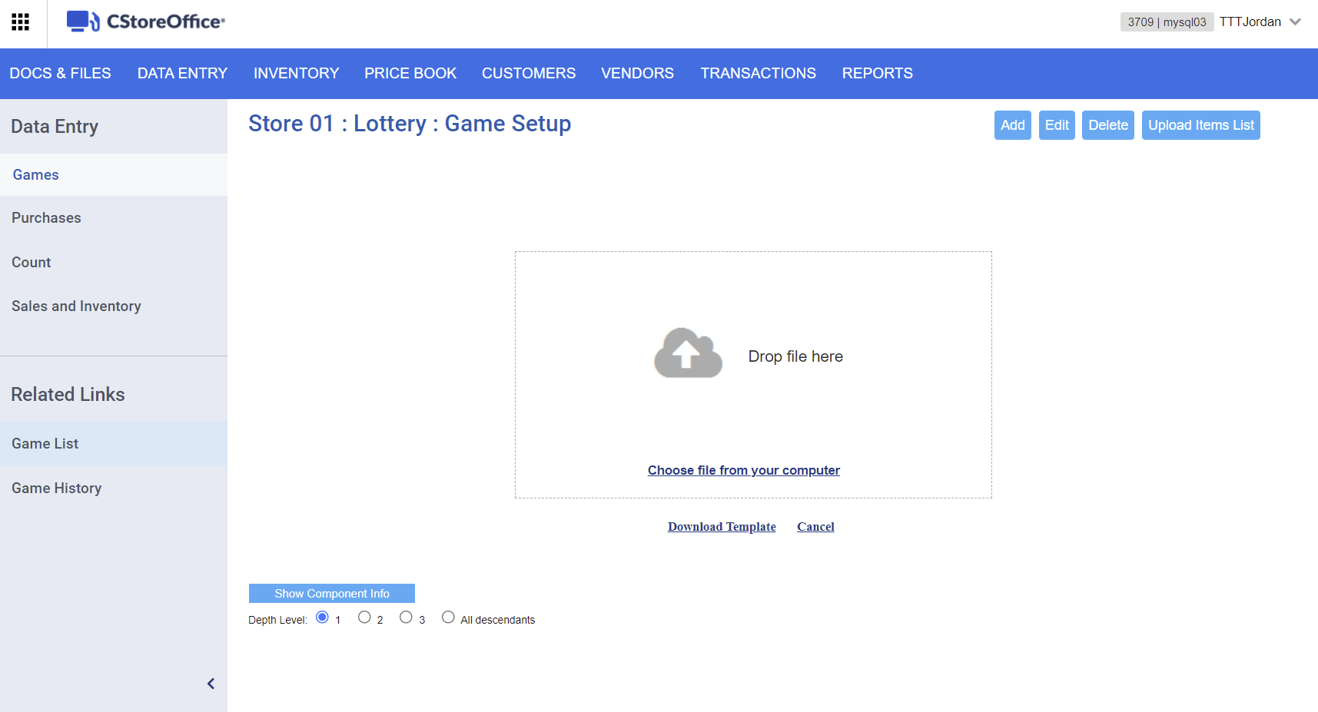
Uploading Lottery Games
Make sure the XLS file you want to import data from, has a correct data structure.
To view the structure example, click Download Template

Slide 17
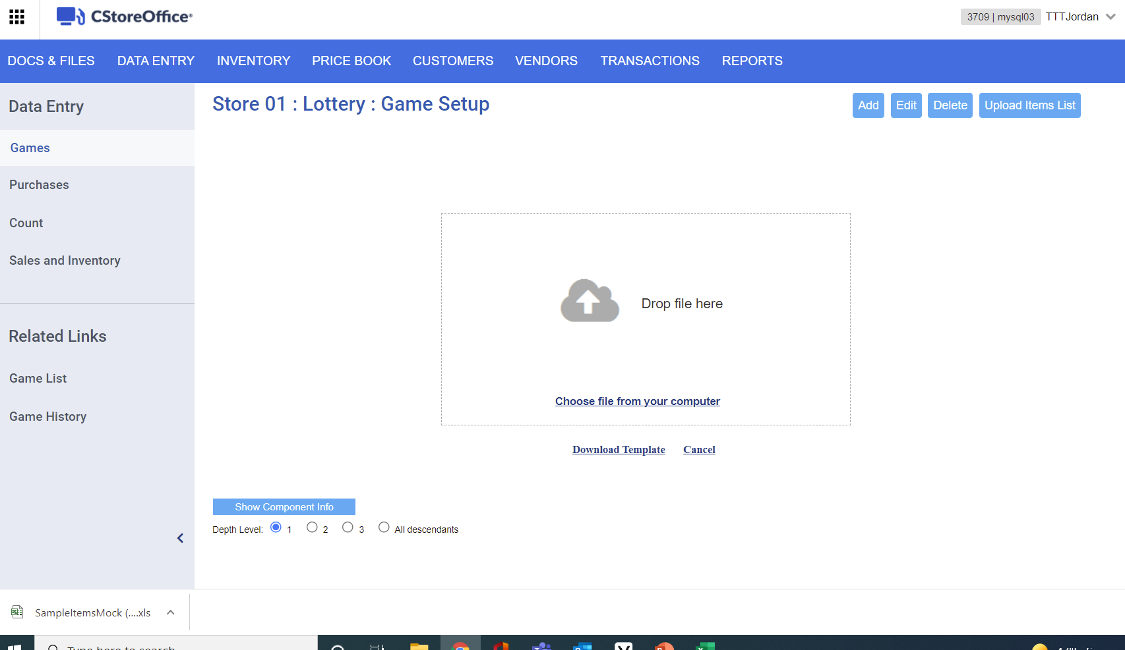
Uploading Lottery Games
Open the downloaded Excel template worksheet

Slide 18
Uploading Lottery Games
Input all requested information for each column header
When typing in the SKU Code, you must leave off the 12th digit, or check digit. CStoreOffice® will assign upon upload

Slide 19
Uploading Lottery Games
Once completed, upload the file by doing one of the following:
Drop the XLS file to the Drop here section, if this operation is supported by your browser.
or
Click Choose file from your computer and then select the XLS file.

Slide 20
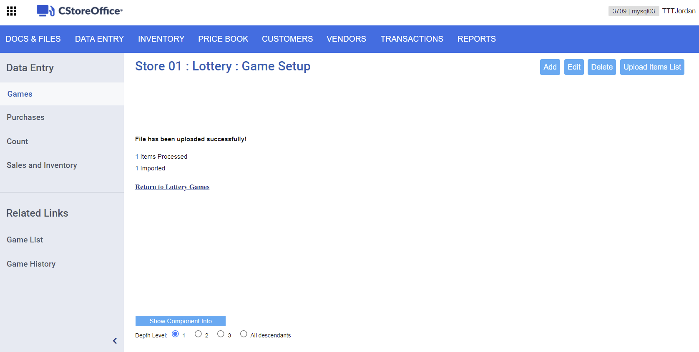
Uploading Lottery Games
Review the upload status

Slide 21
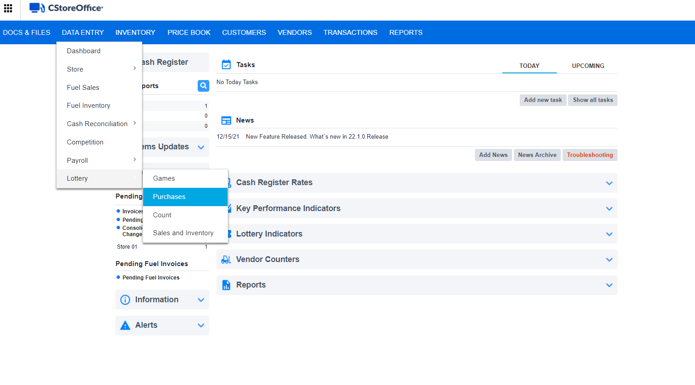
Purchases
Go to the CStoreOffice® home page and then click:
Data Entry
Lottery
Purchases

Slide 22
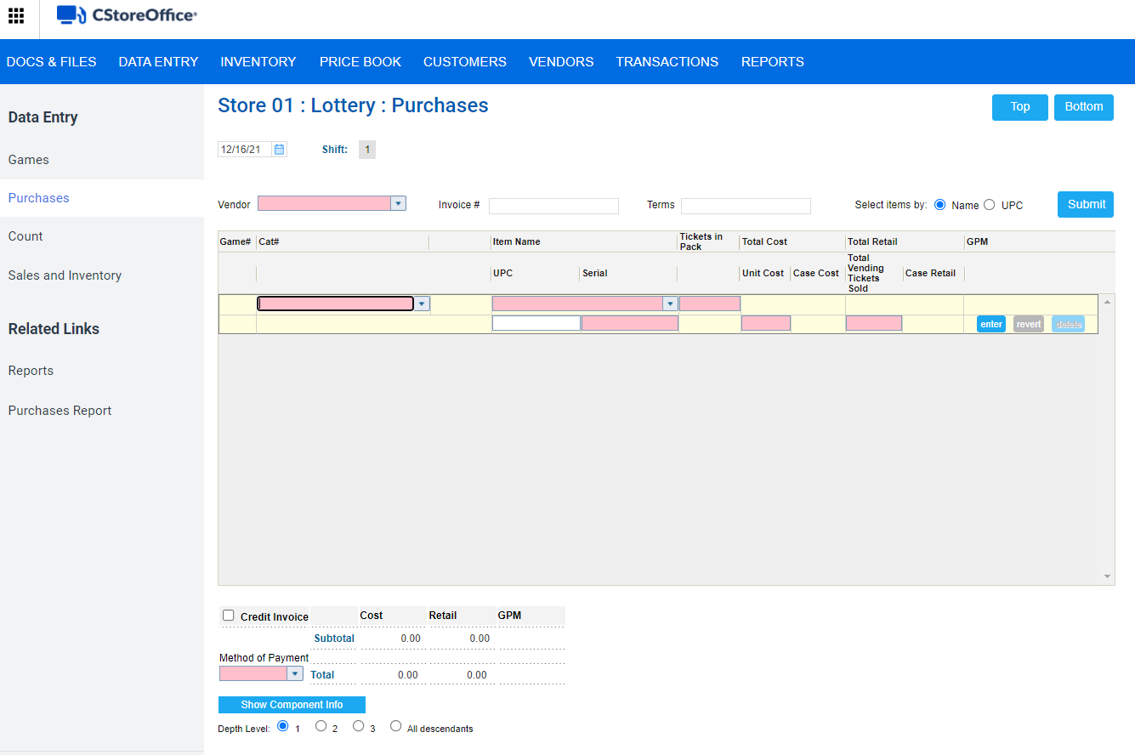
Purchases
At the top of the Purchases form, make sure you have the correct date and shift number selected.

Slide 23
Purchases
select the lottery vendor
enter the invoice number
Specify Search Item By criteria
Click Submit

Slide 24
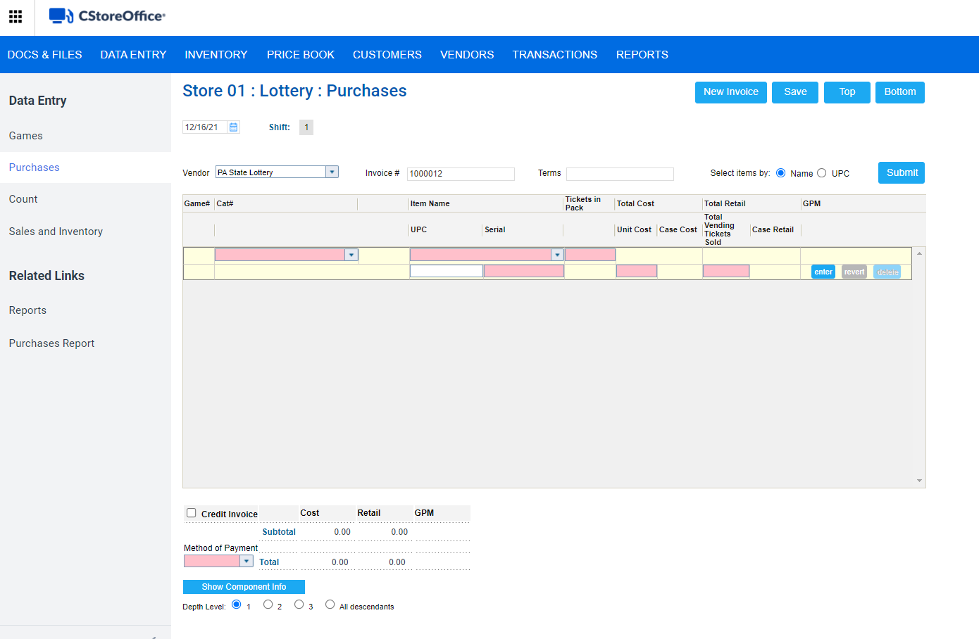
Purchases
Select the Category
Enter in Item Name or UPC
Enter in Serial Number
Click Enter
Repeat for all lottery ticket packs that you have

Slide 25
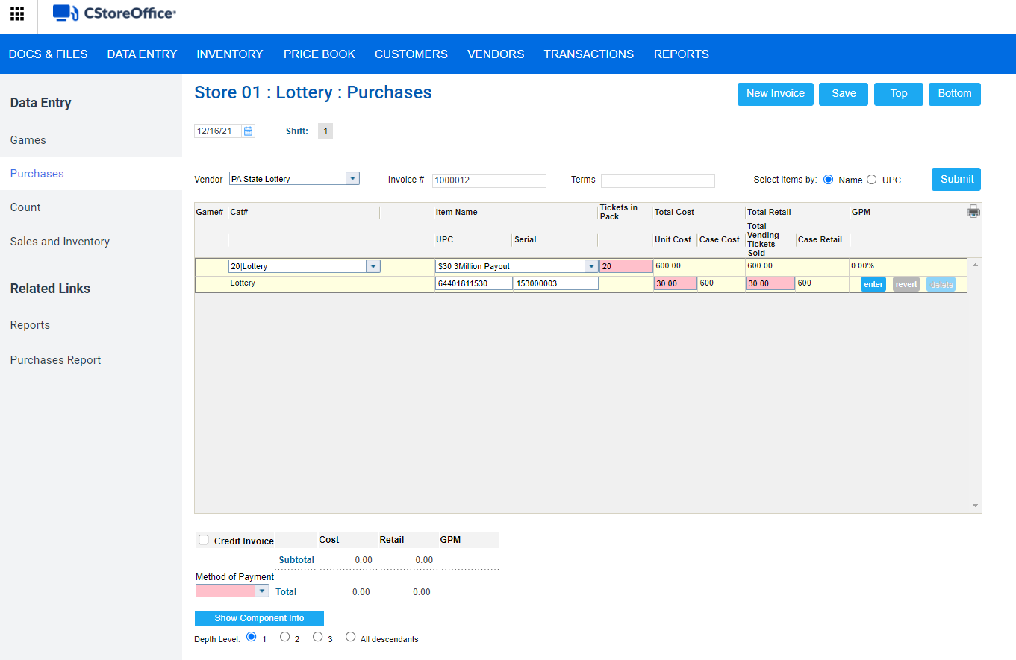
Purchases
Select the method of payment
Then select Save

Slide 26
Lottery Returns
Lottery returns are lottery purchases for which the Credit Invoice option is enabled.
Create a regular lottery purchase.
select the lottery vendor
enter the invoice number
Specify Search Item by criteria
Click Submit
At the bottom of the Purchases form, select the Credit Invoice check box.

Slide 27
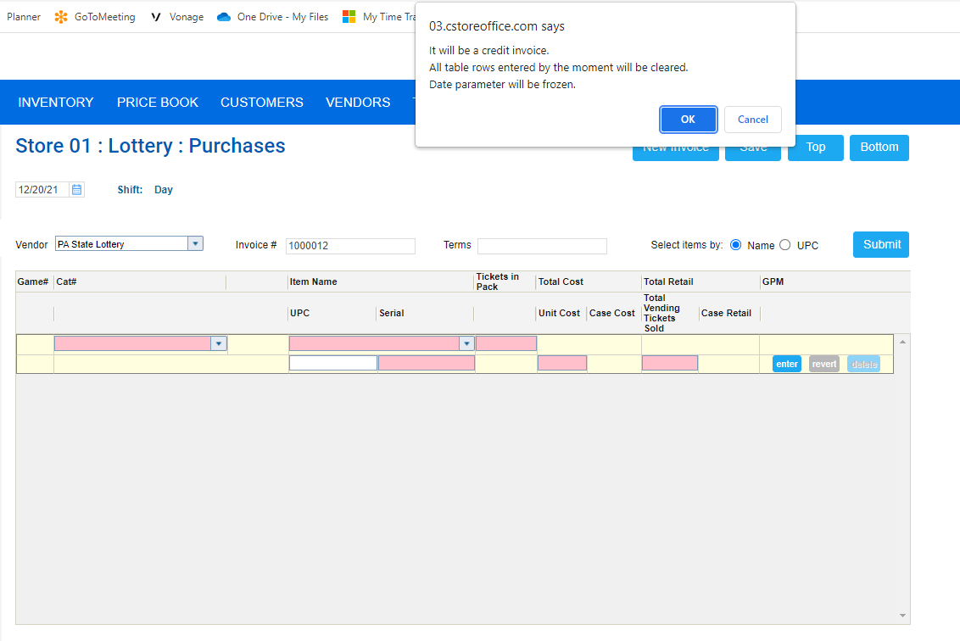
Lottery Returns
You will receive a message box informing about a credit invoice creation appears.

Slide 28
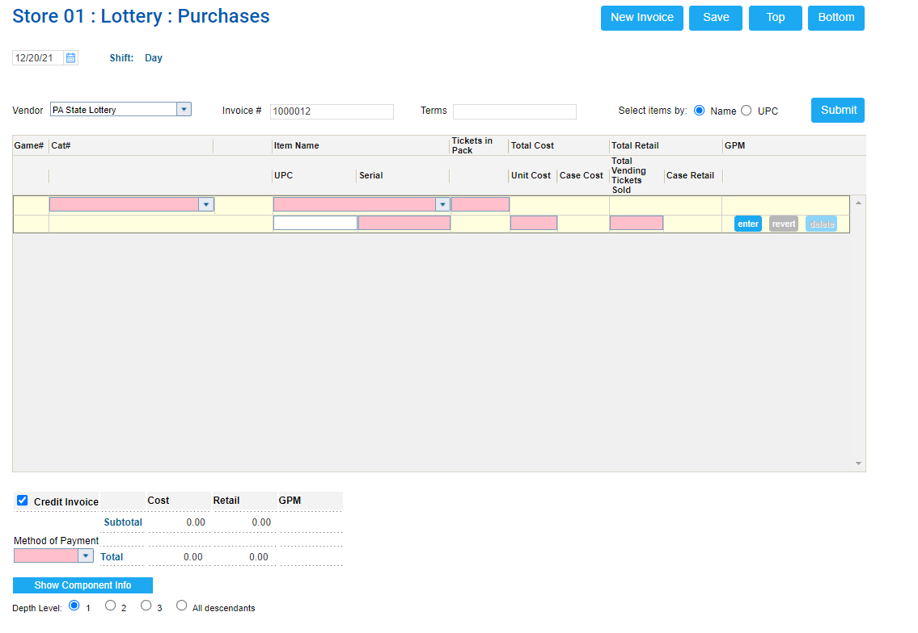
Lottery Returns
Select the Category
Enter in Item Name or UPC
Enter in Serial Number
You must have the game’s unique serial number in order to process a credit.
For the credit invoice purchase, the system will use the number of tickets specified in the Lottery Count form, and auto populate the Tickets in Pack field.

Slide 29
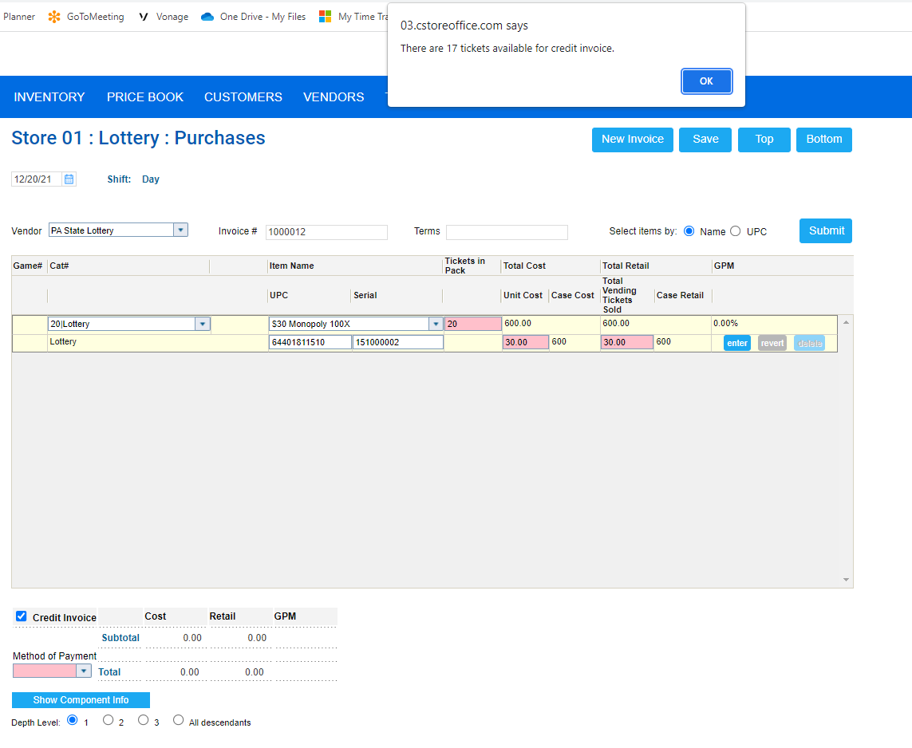
Lottery Returns
You will receive a notification message box with how many tickets are available for the credit invoice.
You will not be able to edit the tickets number. To fix the totals, you must research and fix mistakes on the day they were made using the Lottery Count Changes History Report.

Slide 30
Lottery Returns
Repeat for all lottery ticket packs that you are returning for the credit.
Select the method of payment
Then select Save

Slide 31
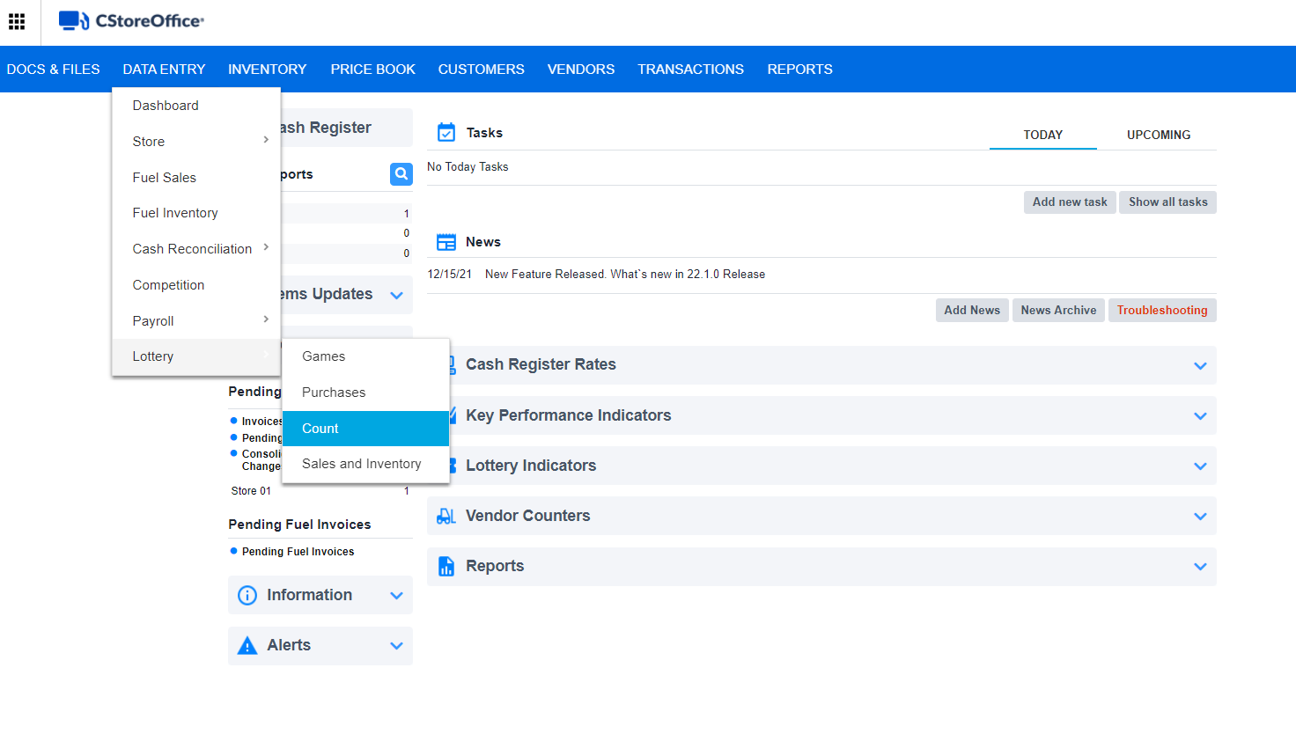
Lottery Count
Go to the CStoreOffice® home page and then click
Data Entry
Inventory
Lottery Count

Slide 32
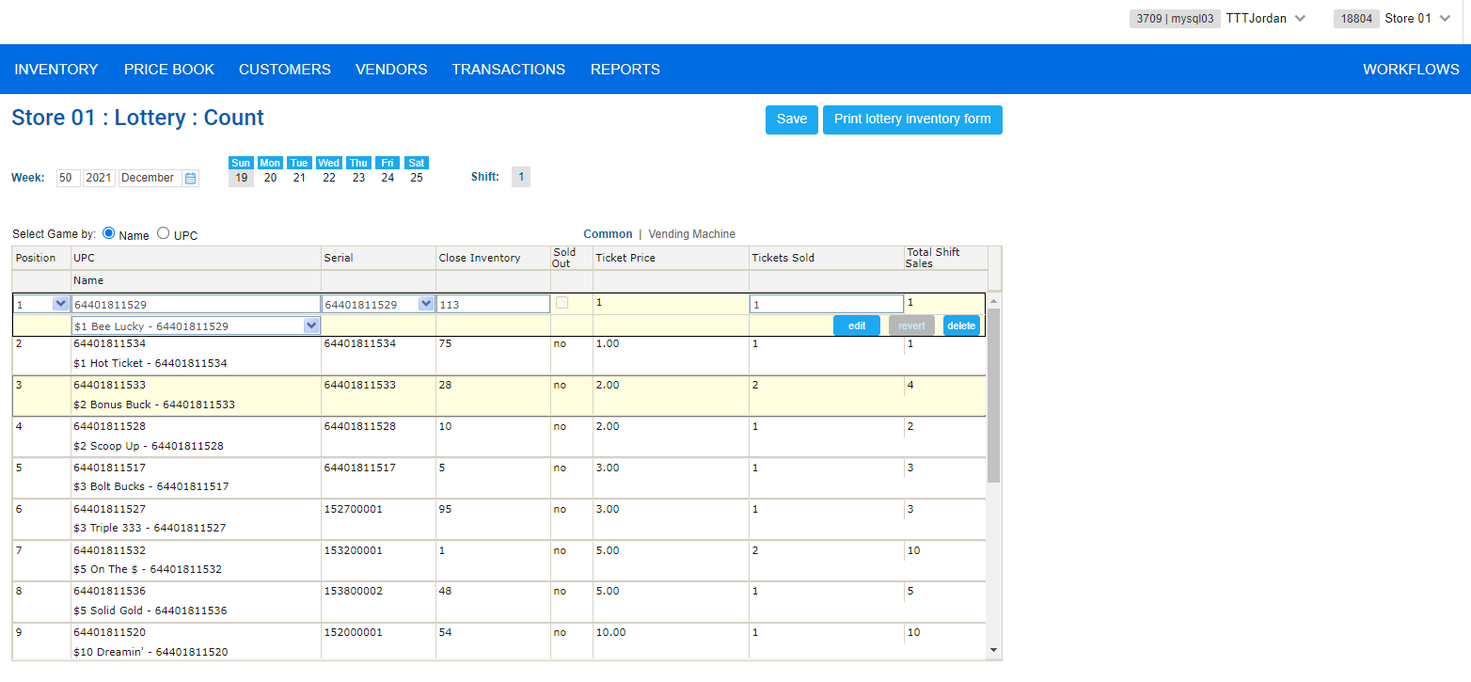
Lottery Count
Select the station where the lottery game is going to be sold.
Select the date.
Specify the Search Game by criteria:
By name
By UPC
Select if you want to enter a regular lottery game or one for the vending machine.

Slide 33
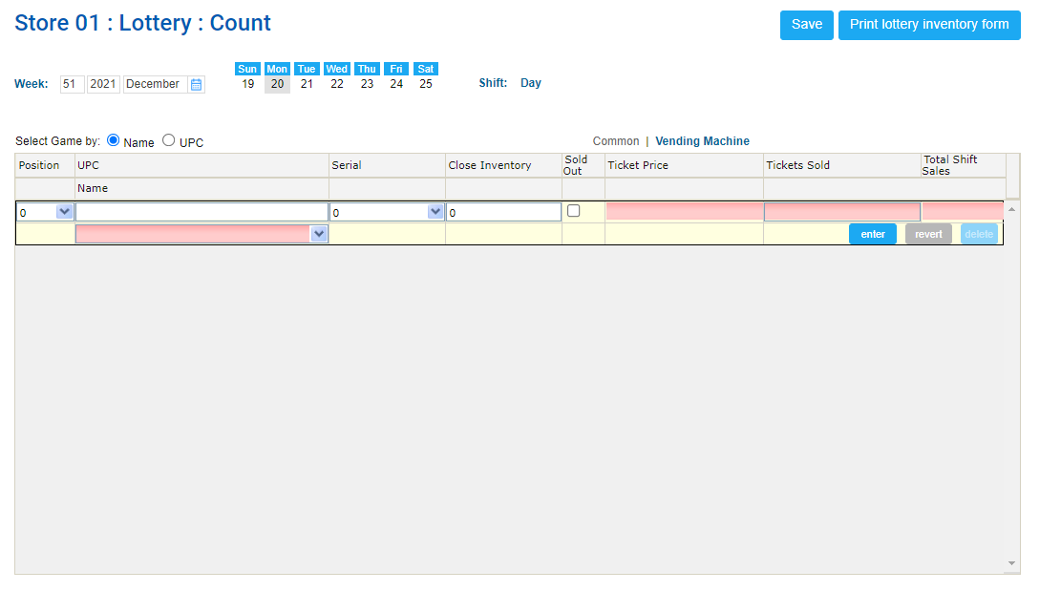
Lottery Count
In the Position column, select the game position number.
When you enter a game into the form, make sure the position number matches the location of the game on the display rack.
In the UPC Name column, enter or select the name of the game or UPC, depending on the option selected from the “Select Games By” field.
In the Serial column, enter the serial number manually or select it from the list. The serial number must match the number of the game you have for sale.

Slide 34
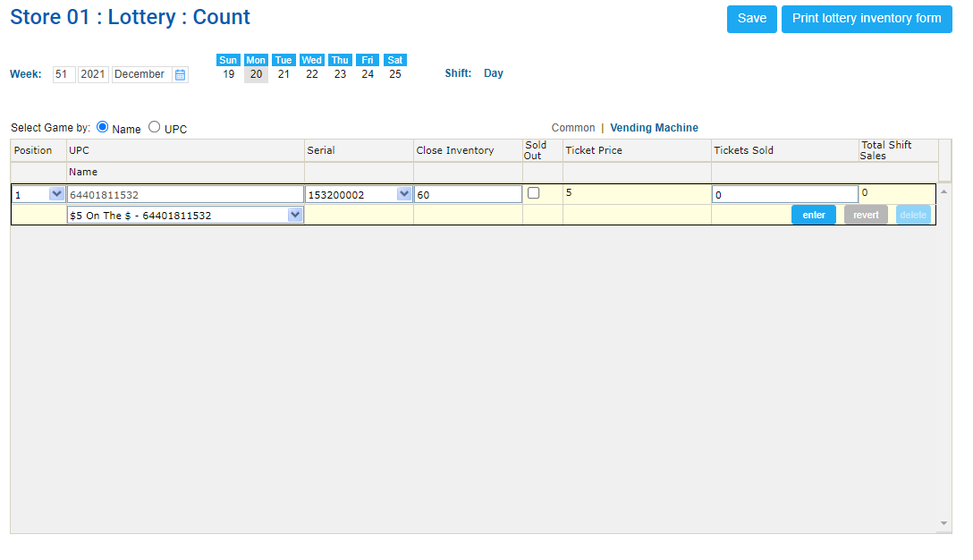
Lottery Count
In the Close Inventory column, enter the number of the tickets remaining in the pack after the sales for the displayed shift.
If alterations are needed: in the Tickets Sold column, enter the number of tickets sold.
In the Total Shifts Sales column, view the total retail amount sold.
At the end of the game row, click Enter.
Proceed the same way with the next game.

Slide 35
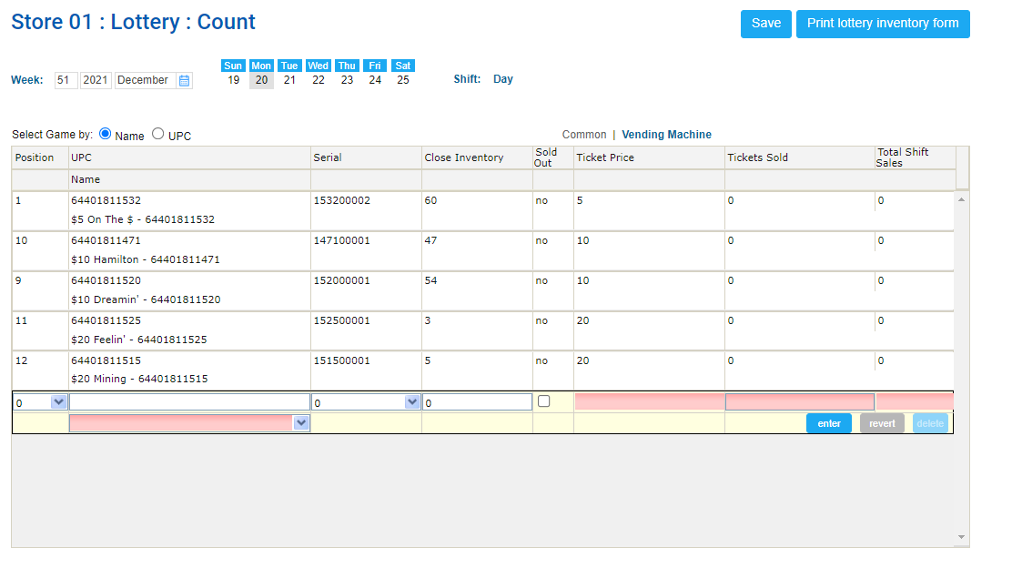
Lottery Count
When you arrange all games and enter the number of tickets within them, click Save

Slide 36
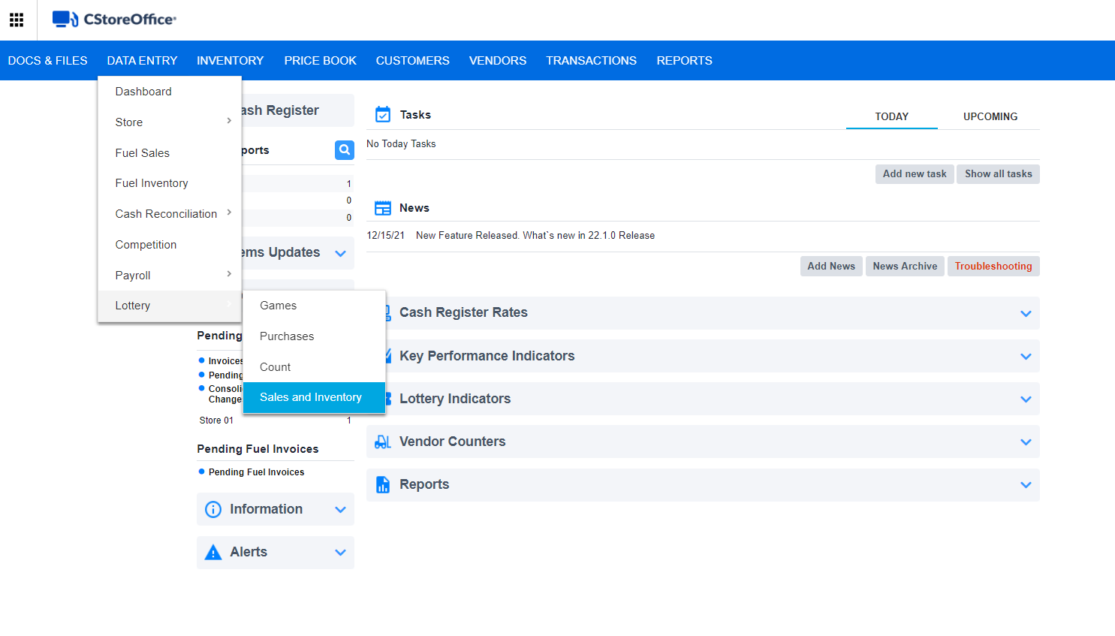
Sales and Inventory
To open the lottery Sales and Inventory tab, go to the CStoreOffice® home page and then click:
Data Entry
Inventory
Lottery Inventory

Slide 37
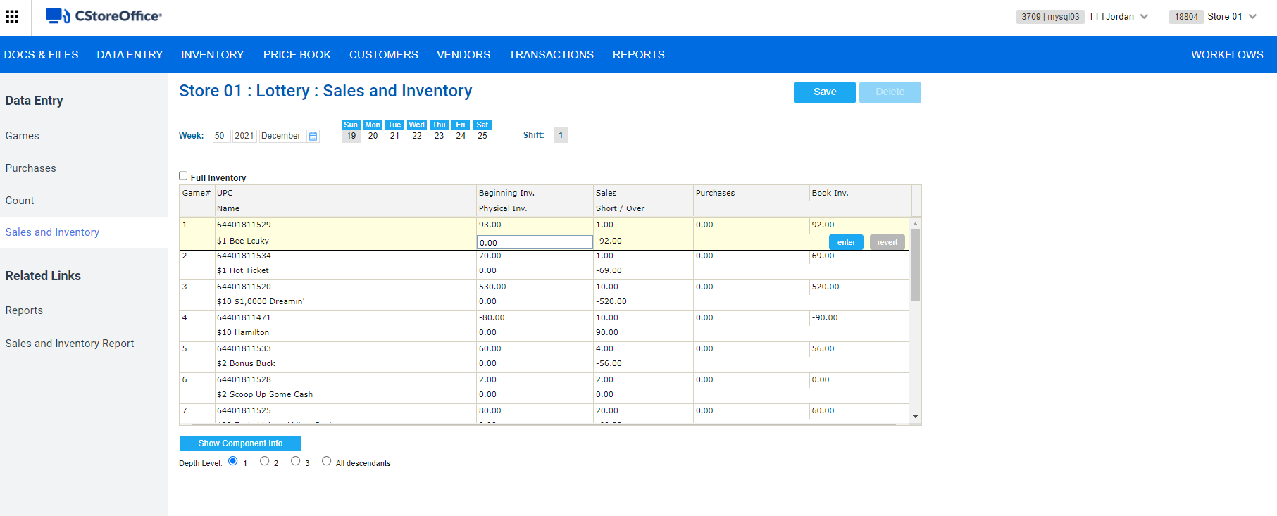
Sales and Inventory
Select the station in which you want to record sales and current inventory.

Slide 38
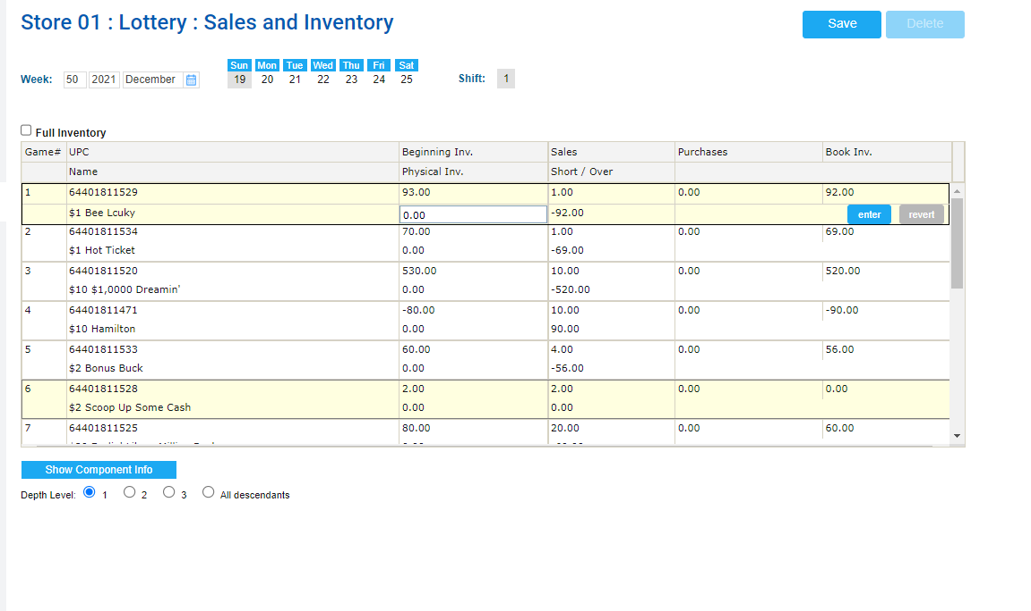
Sales and Inventory
To enter the physical inventory value for a game, follow the steps:
Count the number of tickets for the UPC both at the register and in the back stock.
Click the game you need.
In the Physical Inv. column, enter the total retail value you have.
Click Enter.
Proceed the same way with the rest of the games, and then click Save when you are done.

Slide 39
THANK YOU!
Notes:
Say: Thank you for your time. Does anyone have any questions?
Do: Respond to questions.
Do: <End Meeting>

