Slide 1
LPA

Slide 2
Agenda
About LPA
LPA Reports
LPA Events
Report Filters
Events
Event Parameters
Risk Event Chronicles Reports
Risk Event Rating Reports
Video Journal Reports
Age Verification Reports
Saving Filters
Sharing Filters

Slide 3
About

Slide 4
About LPA
What is Loss Prevention Analytics (LPA)?
Enables you to get a clear view of retail operations
Identify and reduce the number of errors and theft
Combines different sources of information to produce documentation and reports
Can get information in real-time and in the past
How can LPA help me?
Discourages theft with verifiable proof
Identify employee training issues
Quickly verify transactions, risk events and employee claims

Slide 5
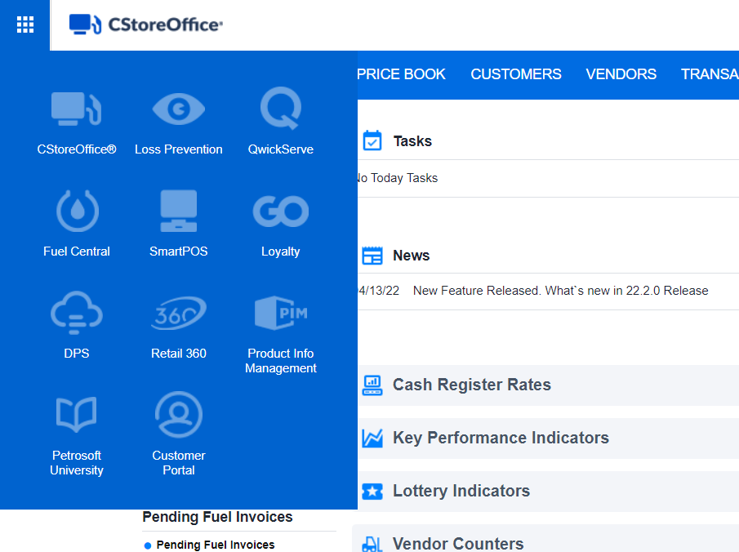
About LPA
How to access LPA
From the CStoreOffice® Homepage:
Click the i icon at the top left of the page
Click Loss Prevention

Slide 6
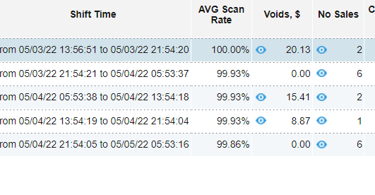
About LPA
How to access LPA
From the CStoreOffice® Shift Report:
Risk events will be marked with the LPA icon
Clicking the LPA icon will take you directly to the video(s) of that risk event

Slide 7
Events

Slide 8
LPA Events
Loss Prevention Analytics allows you to work with the following events:
Event Name | Event Description
Sale | A regular event of sale: inside sale and outside sale (when a customer pays at the pump).
Void | Canceling the whole transaction.
Refund | Issuing a refund.
Safe Drop | Dropping the money to the safe location after the amount in the cash drawer reaches a certain amount set in the cash register settings.
Pump Test | Testing the fuel pump by dispensing a small amount of fuel.
Pay Out | Issuing a pay out (to pay for some services, for example).
Check Cash | Cashing the customer's check. Fee is applied for this action.

Slide 9
LPA Events
Event Name | Event Description
Drawer Loan | Moving money from one cash drawer into the other. For example, when a cashier doesn't have enough change.
Drive Off | An event when customer fueled the car and left without paying.
Pay In | Making a pay in.
Safe Loan | Moving money from safe into the cash drawer. For example, when a cashier doesn't have enough change.
No Sale | An event of opening the cash drawer to break up the money, for example.
Drawer Alarm | An event of opening a cash drawer with a key.
Day Open/Close | An event of opening and closing the day.
Shift Open/Close | An event of opening and closing the shift.

Slide 10
LPA Events
Event Name | Event Description
Register Open/Close | An event of opening and closing the register.
Paypoint Open/Close | An event of opening and closing the paypoint.
No Event | This event appears when customer's camera detects some movement, but there is no cash register event in the relevant period.
Lottery (payout, online sale, sale) | An event of lottery online/regular sale. An event of issuing a lottery payout.
Cancel/Error Correction | Removing one or several items from sale when it is still in progress. In LPA events, error corrections only for goods are displayed without fuel deposits.

Slide 11
LPA Events - Parameters
The following parameters are available for each event:
Parameter Name | Parameter Description
Event End | The event end time.
Event Start | The event start time.
Business Date | A measurement of time that typically refers to any day in which normal business is conducted. This is generally considered to be Monday through Friday from 9 AM to 5 PM local time and excludes weekends and public holidays.
Cashier | Cashier's name or cashier's ID if the name is absent.
Location | The location name or location ID if the name is absent.
Register/Pump | The number of cash register/pump.

Slide 12
Reports

Slide 13
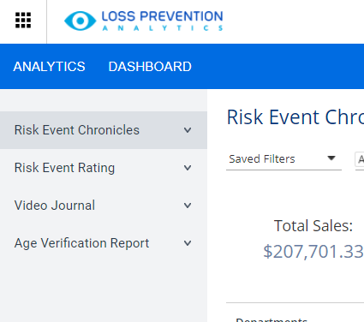
LPA Reports
Loss Prevention Analytics provides information through reports.
Reports are available in the left menu of the Loss Prevention Analytics module.
To get information about retail operations and identify risks, you can use the following groups of reports:
Risk Event Chronicles
Risk Event Rating
Video Journal
Age Verification Report

Slide 14
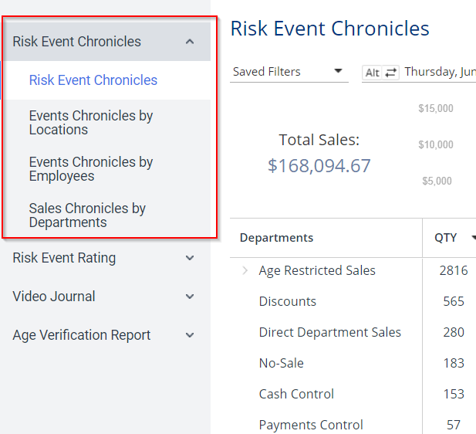
LPA Reports - Risk Event Chronicles
Selecting Risk Event Chronicles will allow you to view 2 sets of reports:
Risk Event Chronicles, which allows you to view risk events for a specific day and time with specific event filters.
Event Chronicle reports, which allows you to view events on a chronological scale by event types, locations, employees and sales by departments.

Slide 15
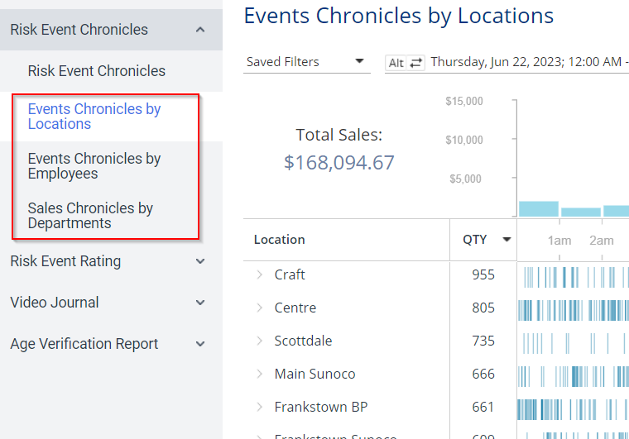
LPA Reports - Risk Event Chronicles
Chronicle Reports:
This group of reports is based on the chronological scale.
With these reports, you can track the location activity for the selected day and time period grouped by different criteria: event types, locations, employees and sales by departments.

Slide 16
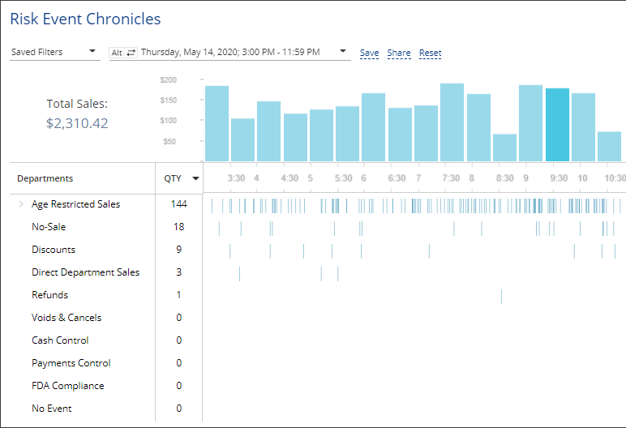
LPA Reports - Risk Event Chronicles
Risk Event Chronicles report: This report combines event chronicles and risk events reports.
With this report, you can view the risk events in the chronological view for the selected day and time period grouped by the necessary filters.
With the Risk Events Chronicles reports group, you can gather chronological data for events that are considered of high risk in the industry. Loss Prevention Analytics collects data for the period of 24 hours for a selected location or all available locations. The data is then grouped by risk events.

Slide 17
LPA Reports - Risk Event Chronicles
Risk Event Chronicles reports flags the following events to filter
Name | Filtering Settings
Age Restricted Sales (available only for Verifone CR) | Alert - Age Verification: - Manual - Scanned - Skipped
Discounts | - MOP - Cash - Sale / Alert - Discount
Direct Department Sales | - Sale / Alert - Direct Department Sales - Sale / Inside / Outside - Inside Sales
No-Sale | Other - No-Sale

Slide 18
LPA Reports - Risk Event Chronicles
Name | Filtering Settings
Cash Control | - Financial - Safe Drop - Financial - Pay Out - Sale / MOP - Cash - Sale / Sum > $100 - Sale / Inside / Outside - Inside - Sales Fuel / Merch Sales - Merchandise
FDA Compliance | - MOP - Food Stamps - Sale / Inside / Outside - Inside - Sales Fuel / Merch Sales - Merchandise
Refunds | - MOP - Cash - Refunds - Itemized Refunds (item refunds) - Refunds - Non-itemized Refunds (department refunds)

Slide 19
LPA Reports - Risk Event Chronicles
Name | Filtering Settings
Payments Control | - Sale / Sum > $50 - MOP - Credits - Sale / Inside / Outside - Inside Sales - Fuel / Merch Sales - Merchandise
Voids & Cancels | - MOP - Cash - Sale / Alert - Void in Sale - Sale / Alert - Void all Sale
No Event | No Event - enabled

Slide 20
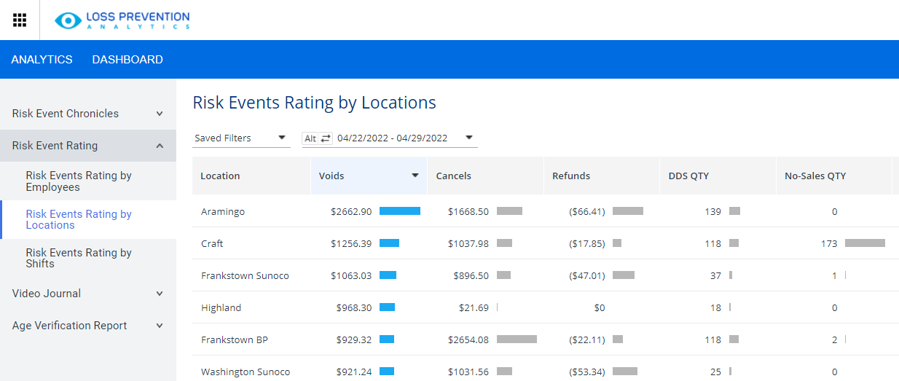
LPA Reports - Risk Event Rating Report
The Risk Event Reports
This group of reports is based on risk events — voids, cancels, refunds, no sales, direct department sales and their rating among the whole selection results.
With these reports, you can view the risk events grouped by different criteria: employees, locations and shifts.
With the Risk Events Rating report, you can gather sales data for the events that are considered high risk in the industry. The data is collected for the period of 24 hours for selected location or all available locations. You can view sales data grouped by locations, cash register departments and employees.

Slide 21
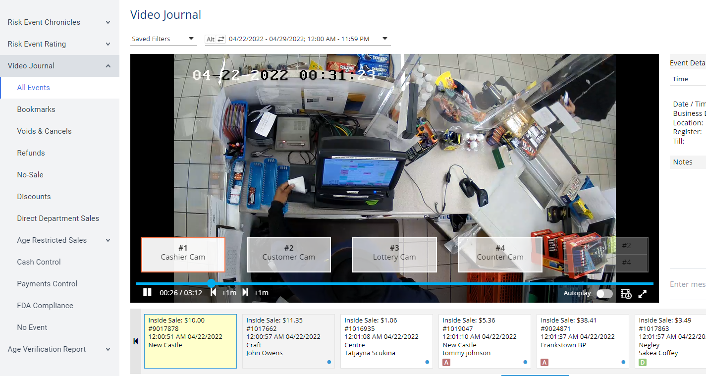
LPA Reports - Video Journal
With the Video Journal, you can view all cash register transaction data and store cameras video records for the selected periods and locations.
A powerful tool for viewing the cash register events matched with the video recording which can be filtered based on various criteria
Can specify which risk events to view or view all register events

Slide 22
LPA Reports - Video Journal
Once a Risk Event is selected, you are presented a list of the risk events on the timeline at the bottom part of the Video Journal.
To navigate through the events, use the mouse wheel or click the right and left buttons at the rightmost and leftmost of the timeline.
To view the transaction details, click it in the timeline.

Slide 23
LPA Reports - Video Journal
To switch between camera views:
Select the name of the camera that you’d like to enlarge
You can choose the right most option to view all available cameras on one screen

Slide 24
LPA Reports - Video Journal
You can view an additional minute before or after the event video clip by clicking the left and right arrows at the bottom of the video image

Slide 25
LPA Reports - Video Journal
You can download the video clip by clicking the download icon

Slide 26
LPA Reports - Video Journal
You can view the video in full screen by clicking the enlarge icon

Slide 27
LPA Reports - Video Journal
Register event details are shown across the bottom of the screen
Event markers beneath each sale identify any risk events that occurred during that transaction:
A = Age Verification
N = No-Sale
R = Refund
V = Void (cancelling the whole transaction)
D = Discount
C = Cancel (Canceling only one item)
P = Price Override

Slide 28
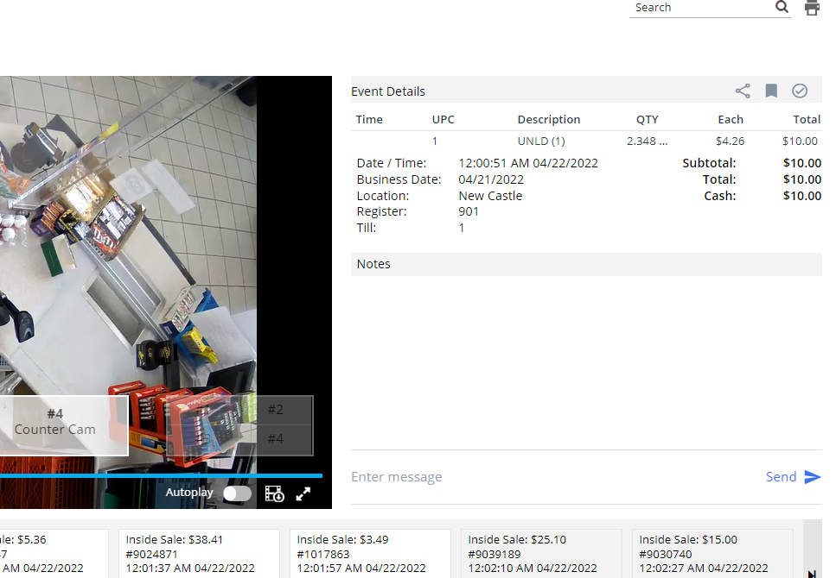
LPA Reports - Video Journal
When a transaction Is selected, details of the event being viewed will appear to the right of the video image

Slide 29
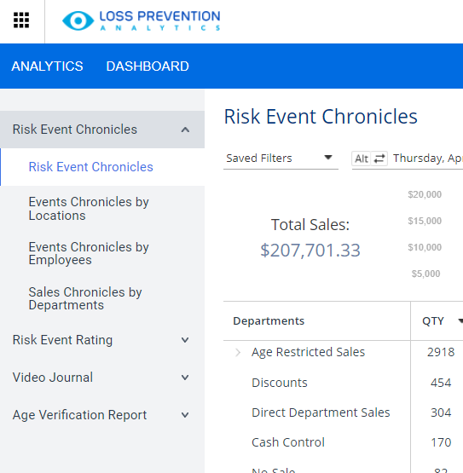
LPA Reports - Age Verification Report
Age Verification Report:
you can estimate quickly the consumer's age by viewing the images from the cameras with the consumer faces.
To display the report for any of the above statuses:
In the left menu of the Loss Prevention Analytics module, expand the Age Verification Report section.
Click the corresponding status.
Result: The Age Verification Report opens for the selected status with the predefined filters applied.

Slide 30
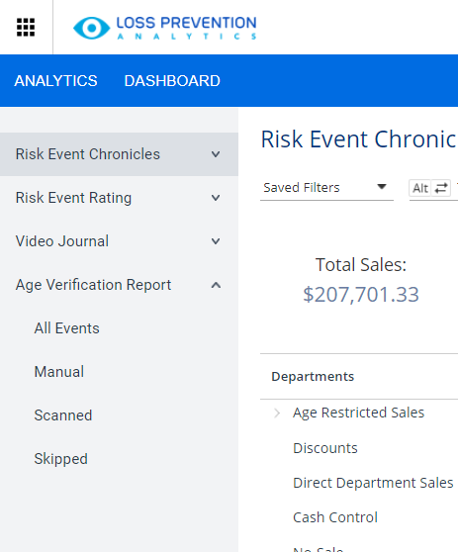
LPA Reports - Age Verification Report
You can filter this report in the following ways:
All Events – Will show all Age verification events, including Skipped, Manual, and Scanned
Skipped – The customer’s age was not confirmed by either scanning the customer’s ID or entering the customer’s date of birth
Manual – The customer’s date of birth was entered
Scanned – The customer’s ID was scanned

Slide 31
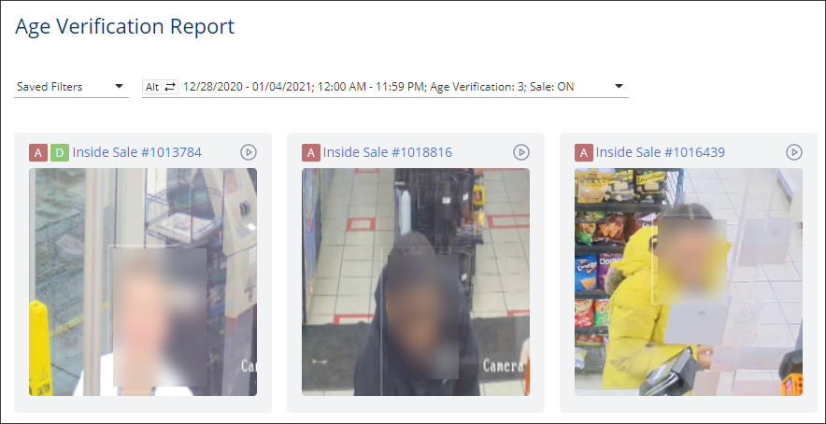
LPA Reports - Age Verification Report
Quickly monitor a potential age restricted item’s sale violation by checking the images of the customer’s face for each age-restricted sale.

Slide 32
Report Filters

Slide 33
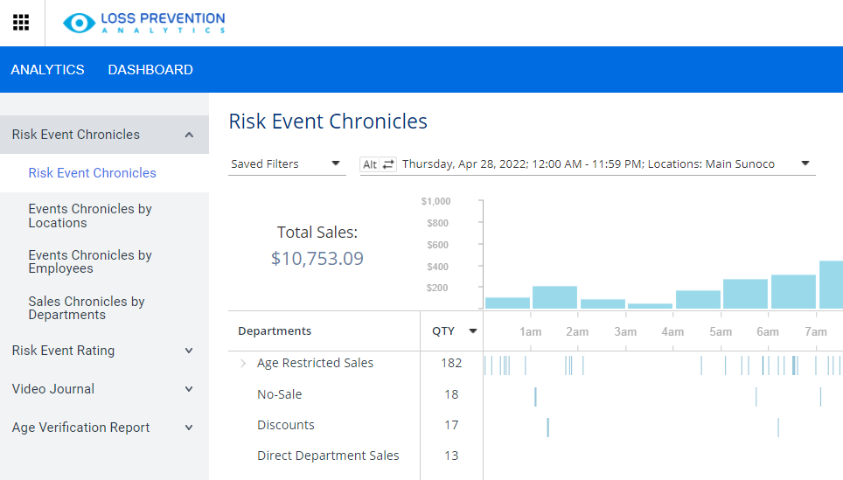
Report Filters
LPA reports provide an advanced set of filters.
You can use filters to get the exact retail information you need.
To filter reports:
Click on the filter pane at the top of any LPA report

Slide 34
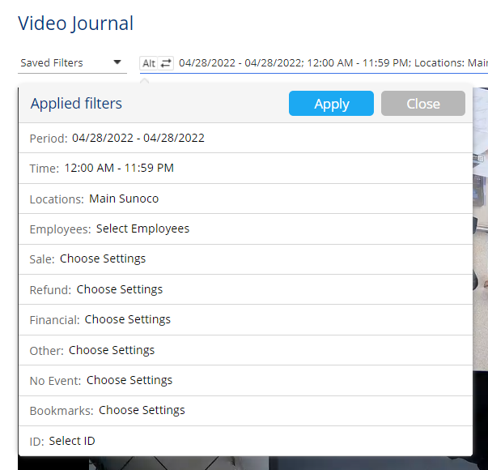
Report Filters
Depending upon the report, you may have several different report filtering options, such as:
Period – Specify the necessary date range
Time – Specific timeframe for events to be reported
Locations/Registers – Select store location(s) from the list. Expands the cash registers list to specify a register
Employees – Select the employee(s) engaged in the events
Departments – Select specific CR Department
Fuel/Merch Sales – Select sale type, fuel/merchandise

Slide 35
Report Filters
Continued:
Sale – Set sale event filters such as Sum, items, MOP, item tags, or Alert type
Refund – Select itemized or non-itemized
Other – select other events such as shift, alert, day, cashier, etc.
No Event (Video Journal Only) – Set this filter to view no event instances
Bookmarks (Video Journal only) – Set this filter to view all bookmarked transactions

Slide 36
Report Filters - Saving Filters
You can set up a filter and save it so that you can quickly access the necessary data in the future.
At the top of the report, select the filter field
Set the desired filter parameters
Click the “Apply” button
To the right of the filter field, click “Save”
Enter a name for the filter and click the check mark icon to the right

Slide 37
Report Filters - Saving Filters
Result:
The saved filter will now appear under “Saved Filters” for the selected report

Slide 38
Report Filters - Sharing Filter
You can copy a filter that you set up and share it with other CStoreOffice® users:
At the top of the report, click the filter field
Set the desired filter parameters
Click the “Apply” button
To the right of the filter field, click “Share”
To the right of the link click “Copy”
You have now copied the link to your clipboard and can share with other account users.

Slide 39
THANK YOU!
Notes:
Say: Thank you for your time. Does anyone have any questions?
Do: Respond to questions.
Do: <End Meeting>

