Slide 1
Invoices Processing Purchases

Slide 2
Your Trainer Jordan Bower Please leave your email address in the comments section for a follow-up training survey

Slide 3
Agenda
DPS (Data Processing Subscription) using Scanning New Invoices
New Invoices Entry
Entering Purchases
Accept Pending Store Purchases
DPS (Data Processing Subscription) using CSO Mobile

Slide 4
DPS using Scanning New Invoices

Slide 5
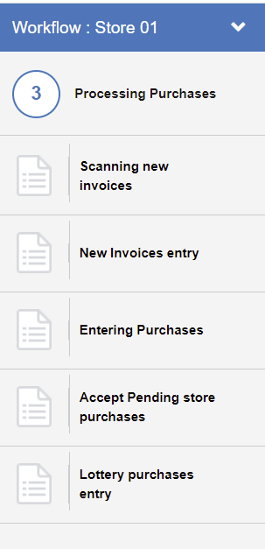
DPS (Data Processing Subscription) using Scanning New Invoices
The Scanning new invoices step is intended for clients with 'full service' accounts. At this step, such clients can add scanned invoices to the system so that Petrosoft representatives can enter the invoices data for them.
To add a scanned invoice:
In the Manager's Daily Workflow, move to the Scanning new invoices step.

Slide 6
DPS using CSO Mobile

Slide 7
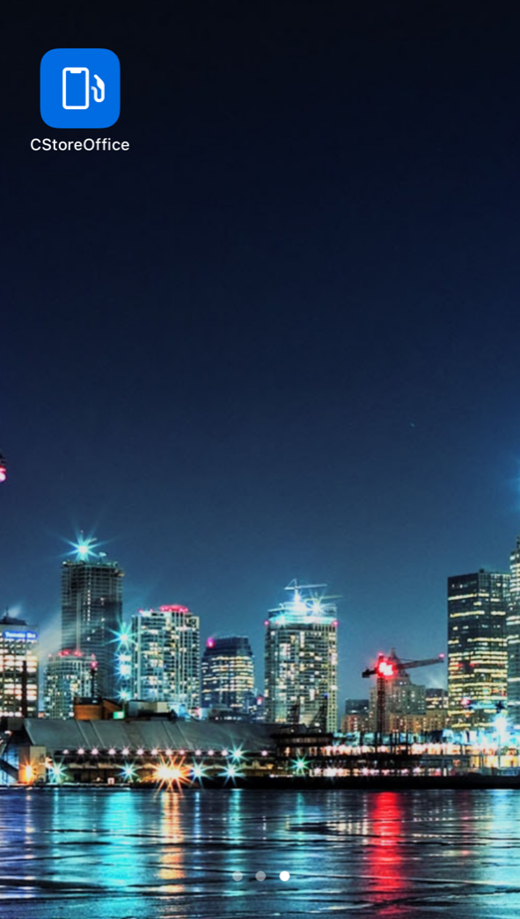
DPS (Data Processing Subscription) using CSO Mobile
With CStoreOffice® Mobile App installed on a mobile device, you can take pictures of paper invoices and upload them to the CStoreOffice® data center.
Petrosoft operators will then turn these documents into electronic invoices, and the invoice data will become available in CStoreOffice®.
This option can be thought of as a 'mobile version' of Docs Scanner.
To scan an invoice with CStoreOffice® Mobile App, open the app.

Slide 8
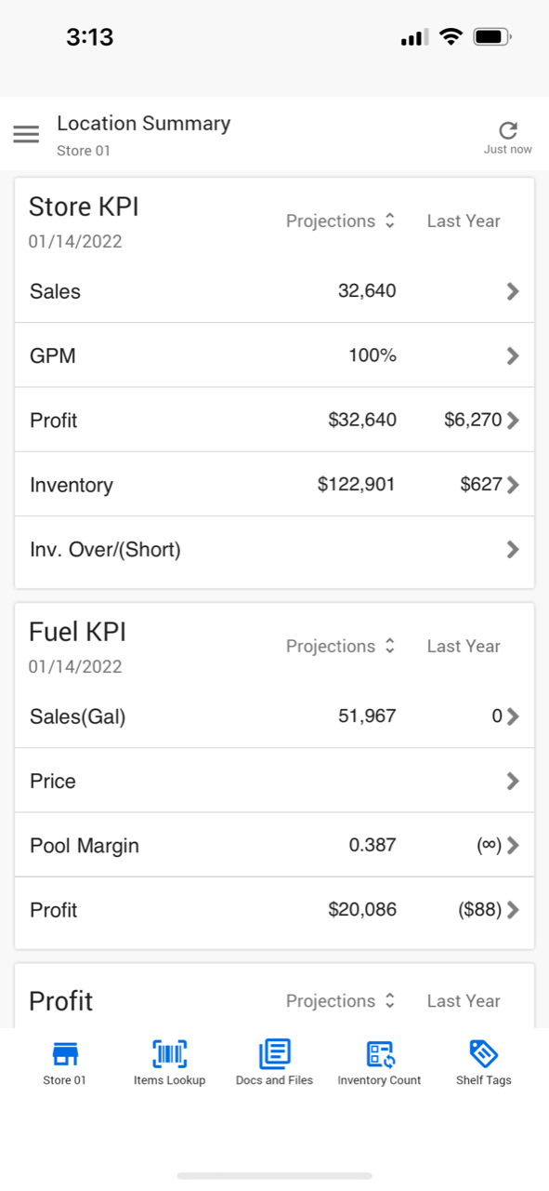
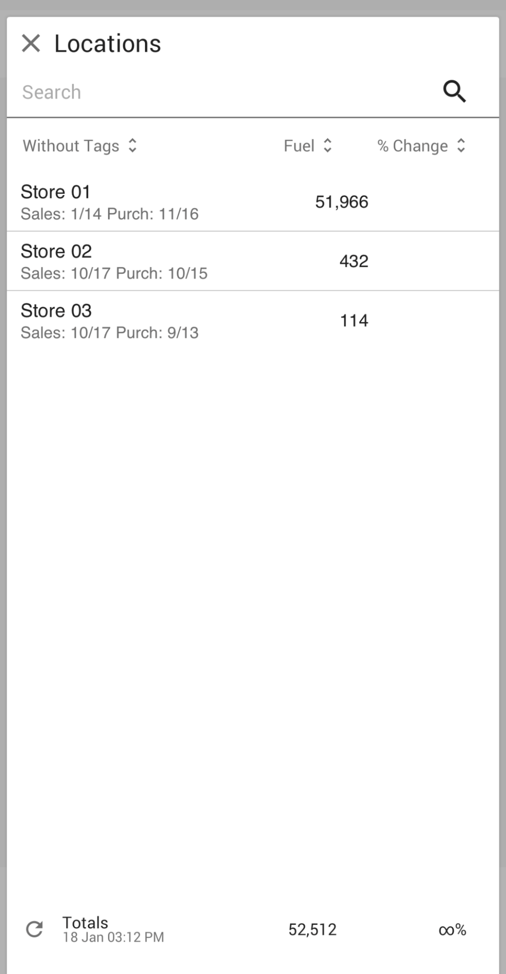
DPS (Data Processing Subscription) using CSO Mobile
At the bottom of the Summary view, tap the location name and from the list, select the location for which you want to add the invoice.

Slide 9
DPS (Data Processing Subscription) using CSO Mobile
At the bottom of the Summary view, tap Docs and Files.

Slide 10
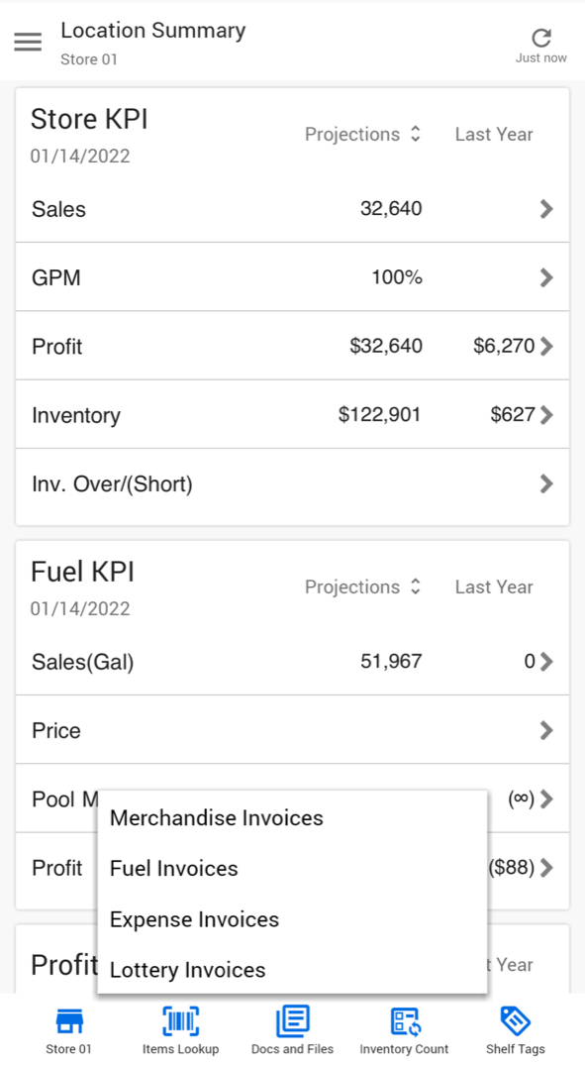
DPS (Data Processing Subscription) using CSO Mobile
In the Docs and Files menu, tap the necessary invoice type.

Slide 11
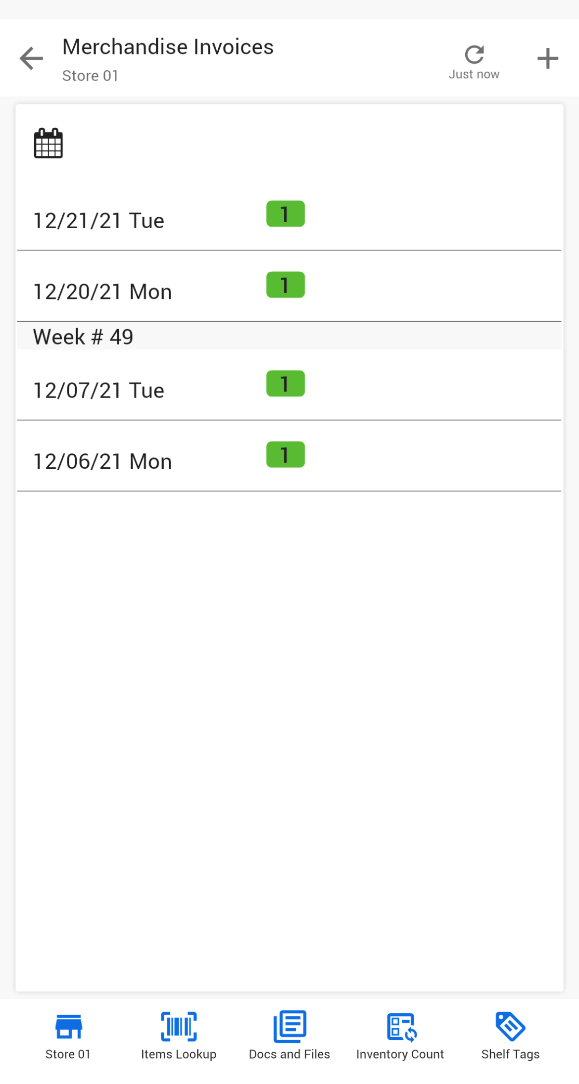
DPS (Data Processing Subscription) using CSO Mobile
Tap the calendar icon and select the date for which the invoice is added.
At the top right corner of the view, tap the + icon to add the invoice.

Slide 12
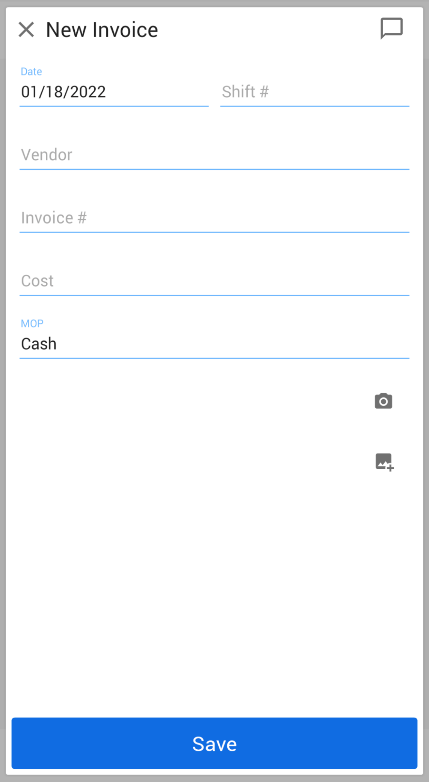
DPS (Data Processing Subscription) using CSO Mobile
In the Invoice form, fill the following invoice data:
Shift number: Type the shift number for the invoice.
Vendor: Select the vendor for which the invoice is added.
Invoice #: Type the invoice number.
Cost: Type the invoice cost.
MOP: Select the method of payment for the invoice.

Slide 13
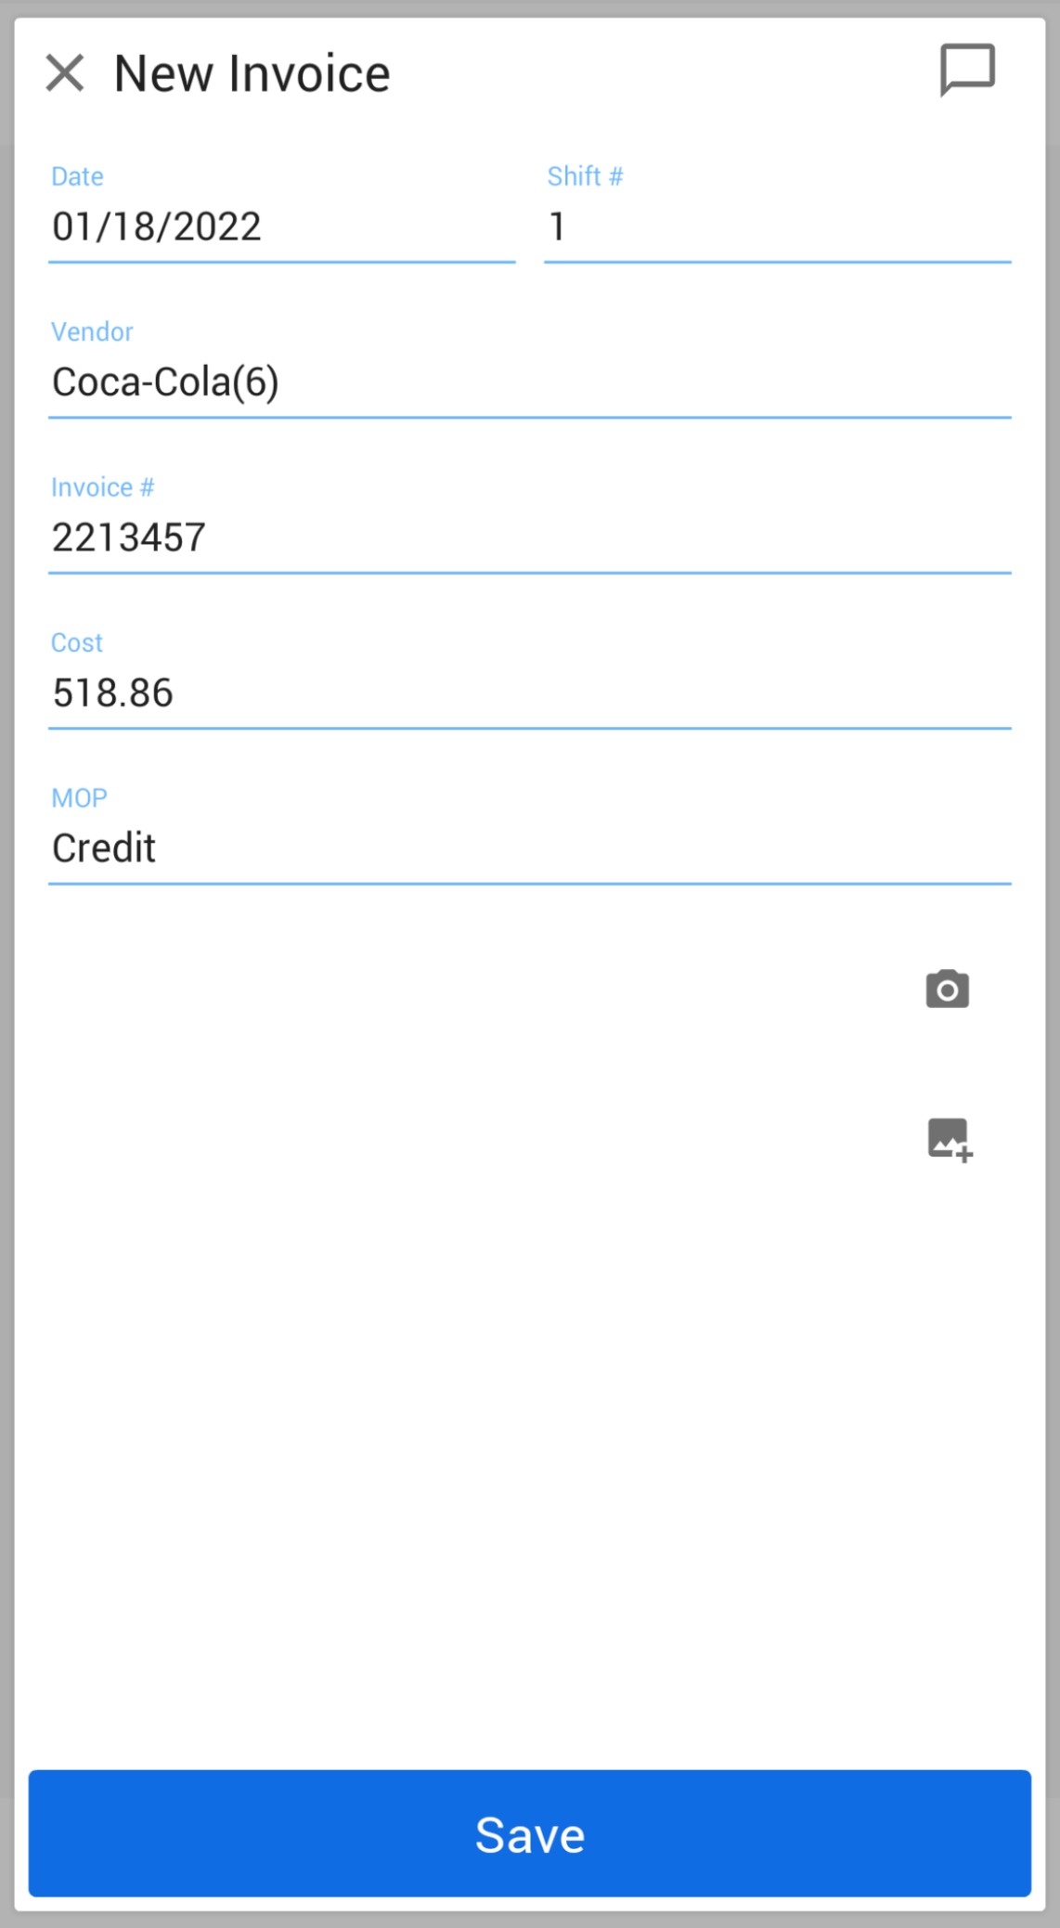
DPS (Data Processing Subscription) using CSO Mobile
Add the invoice image.
You can do it in two ways:
To add a photo, tap the photo icon and take the invoice photo with the device camera.
To add a saved image, tap the image icon and browse to the invoice image on the device.

Slide 14
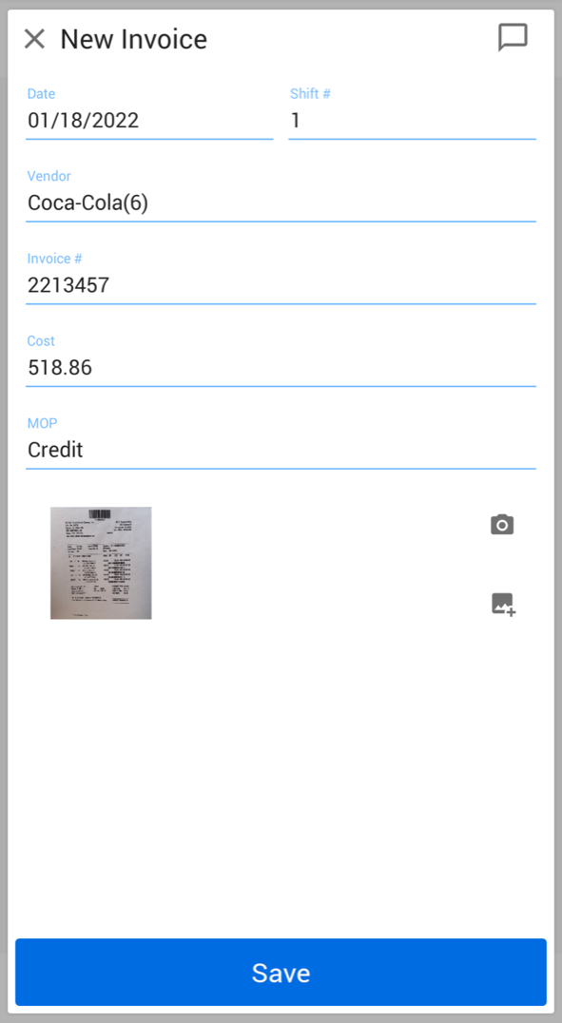
DPS (Data Processing Subscription) using CSO Mobile
At the bottom of the view, tap Save
Result: The invoice is sent to the Petrosoft data center for further processing by operators.

Slide 15
New Invoices Entry

Slide 16
New Invoices Entry
To enter a new invoice:
In the Manager's Daily Workflow, move to the New invoices entry step.

Slide 17
Entering Purchases

Slide 18
Entering Purchases
In the Entering Purchases step, you can enter information about store purchases at the category level in the Non-Itemized Invoice Entry form.
With this method, you add only minimal information about store purchases to the inventory and can see the cost, retail and GPM for all invoices entered on this day and shift.
To enter information about store purchases at the category level:
In the Manager's Daily Workflow, move to the Entering Purchases step.

Slide 19
Accept Pending Store Invoices

Slide 20
Accept Pending Store Invoices
At the Accept pending store purchases step, you can accept pending invoices in the system.
To accept a pending invoice:
In the Manager's Daily Workflow, move to the Accept pending store purchases step.

Slide 21
Questions?

Slide 22
For additional questions. Please contact our support team: 1. Sign-in to the CStoreOffice® website and create a support ticket 2. Create a support ticket from the CSO main page (before signing in) 3. Live chat with a support agent from the CSO main page (before signing in) 4. Contact support by phone at (412) 306-0640 REMINDER: Please leave your email address in the comments section for a follow-up training survey

Slide 23
Conclusion
Notes:
Say: Thank you for your time. Does anyone have any questions?
Do: Respond to questions.
Do: <End Meeting>

