Slide 1
Manager Daily Workflow Step 2: Fuel Reconciliation

Slide 2
Agenda
BOL (Bill of Lading) Entry
Stick Reading Entry
Competitor Pricing
SIR (Statistical Inventory Reconciliation)
Invoice Entry
Fuel Ordering

Slide 3
Manager Daily Workflow – Step 2 - Fuel
To access the Manager Daily Workflow from the CStoreOffice® homepage :
Hover over Workflows at the top right of the screen
Select Manager Daily Workflow

Slide 4
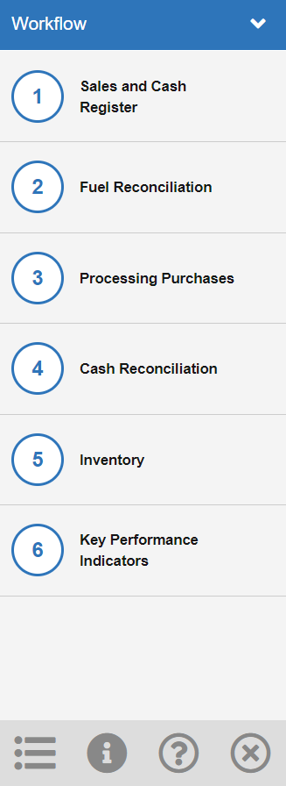
Manager Daily Workflow – Step 2 – Fuel Reconciliation
Click Step 2 – Fuel Reconciliation

Slide 5
MDWF: Fuel Reconciliation - BOL
Click Gasoline Invoices Entry

Slide 6
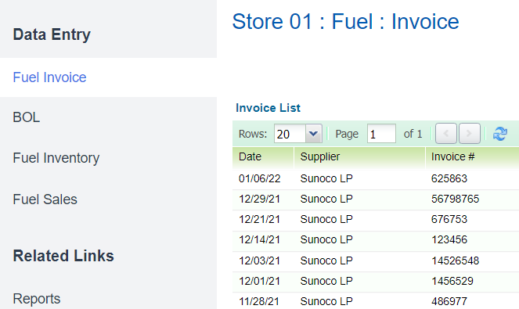
MDWF: Fuel Reconciliation - BOL
It will default to the Fuel Invoice screen
Click BOL

Slide 7
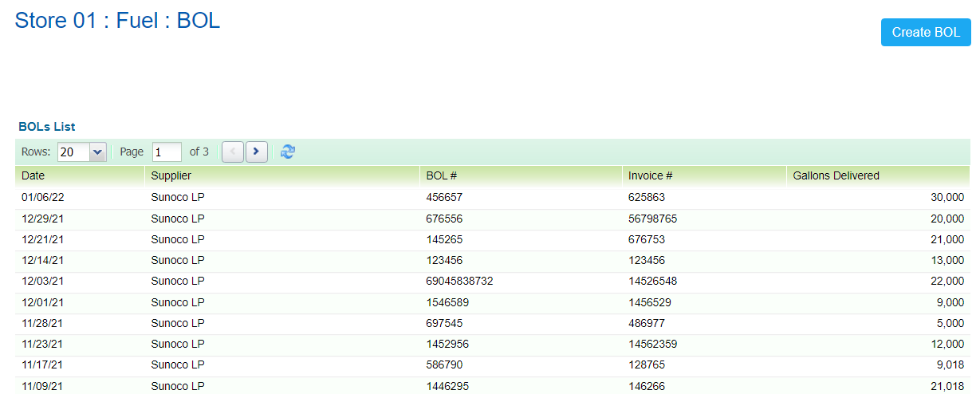
MDWF: Fuel Reconciliation - BOL
A list of previous BOL’s that have been entered will display
To create a new BOL:
Click Create BOL

Slide 8
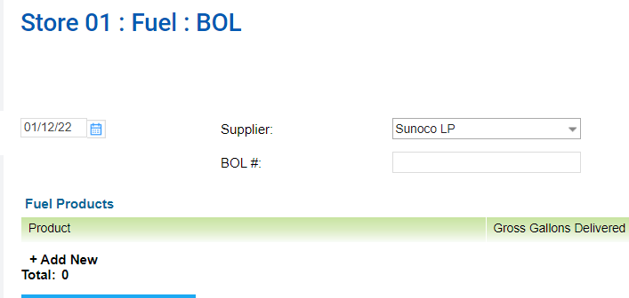
MDWF: Fuel Reconciliation - BOL
Select the correct date of delivery
Select the fuel supplier from the dropdown menu
NOTE: You must have your supplier listed as a fuel vendor in your Vendor’s List
Enter BOL Number
Click Add New to select the fuel product(s) that were delivered

Slide 9
MDWF: Fuel Reconciliation - BOL
Click the dropdown menu
Select the grade of fuel that was delivered
NOTE: This list is specific to the grades of fuel sold at your station location

Slide 10
MDWF: Fuel Reconciliation - BOL
Click below “Gross Gallons Delivered”
Enter the gross gallons from the BOL
NOTE: This will reflect your local units of measure (Gallons, Liters, etc.)

Slide 11
MDWF: Fuel Reconciliation - BOL
Click below “Net Gallons Delivered”
Enter the Net Gallons for the BOL
NOTE: This will reflect your local units of measure (Gallons, Liters, etc.)

Slide 12
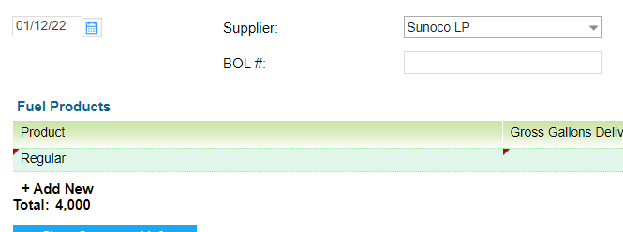
MDWF: Fuel Reconciliation - BOL
To enter additional grades of fuel from the same BOL:
Click Add New

Slide 13
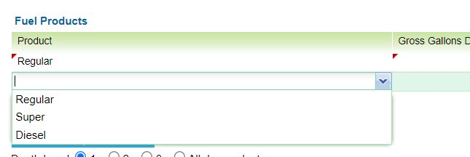
MDWF: Fuel Reconciliation - BOL
Click the dropdown menu
Select the additional grade of fuel that was delivered

Slide 14
MDWF: Fuel Reconciliation - BOL
Enter the Gross and Net Gallons from the BOL for the additional grade(s) of fuel

Slide 15
MDWF: Fuel Reconciliation - BOL
Once all grades of fuel delivered have been entered, be sure to delete any blank fuel product lines
Hover your mouse over the blank line
Click the Red X

Slide 16
MDWF: Fuel Reconciliation - BOL
Click Save

Slide 17
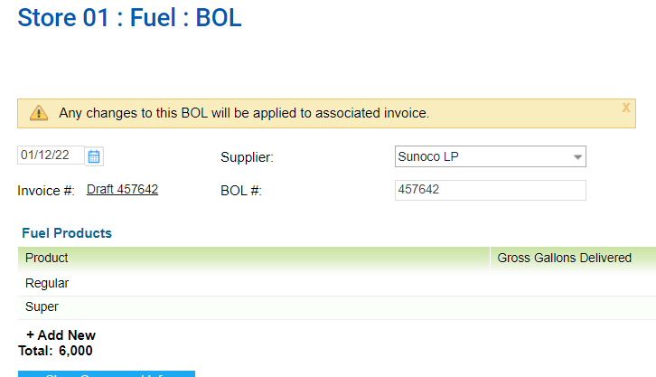
MDWF: Fuel Reconciliation - BOL
An Alert will be displayed:
Any changes to this BOL will be applied to the associated invoice.
A draft invoice will be created with the information that was entered for this BOL

Slide 18
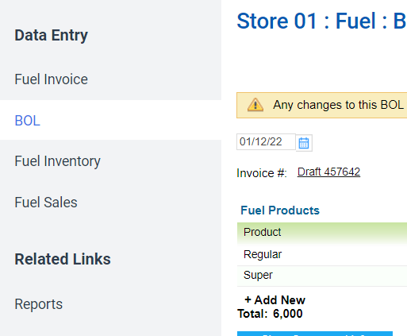
MDWF: Fuel Reconciliation – Invoice Entry
To access the Fuel Invoice screen:
Click Fuel Invoice

Slide 19
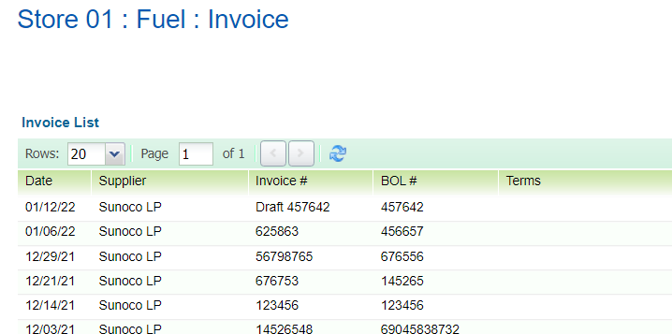
MDWF: Fuel Reconciliation – Invoice Entry
Double click the draft invoice line, that was created from the previous BOL

Slide 20
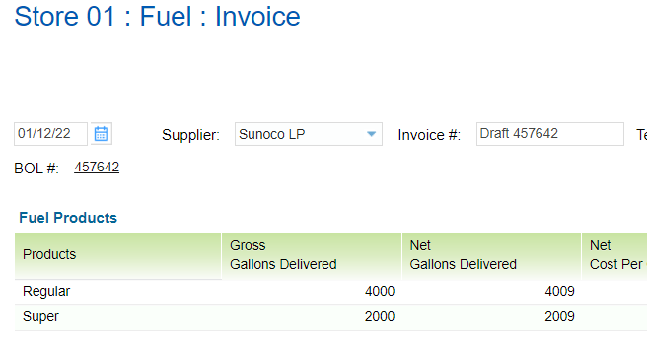
MDWF: Fuel Reconciliation – Invoice Entry
The draft invoice will have the information from the corresponding BOL pre-populated
Enter the correct Invoice Number

Slide 21
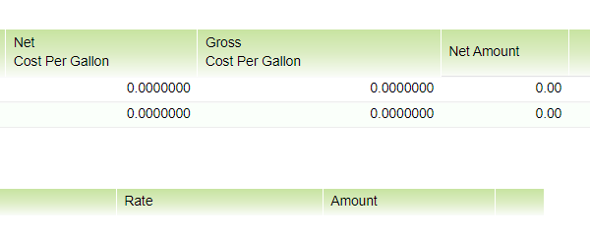
MDWF: Fuel Reconciliation – Invoice Entry
Enter the Net Amount charged for each grade of fuel that was delivered
NOTE: CStoreOffice® will do the math to calculate the net and gross cost per gallon

Slide 22
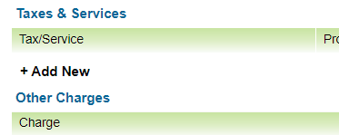
MDWF: Fuel Reconciliation – Invoice Entry
Taxes & Services – To add any taxes to the invoice:
Click Add New

Slide 23
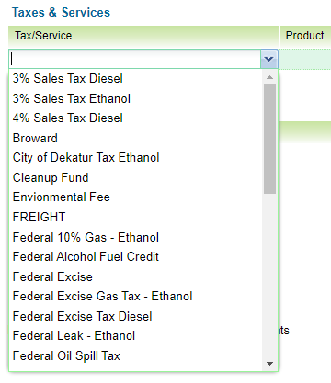
MDWF: Fuel Reconciliation – Invoice Entry
Click the dropdown arrow
Select a tax name from the list
OR
Type in the name of your tax

Slide 24
MDWF: Fuel Reconciliation – Invoice Entry
Click below “Product”
Select the fuel product(s) that this tax applies to
NOTE: You may select multiple fuel products for each tax
The Quantity will auto-populate based on the fuel products selected
The Rate will auto-populate based on the amount that is entered
Type the dollar amount of this tax
Click Add New to add any additional taxes

Slide 25
MDWF: Fuel Reconciliation – Invoice Entry
Other Charges – To add any additional charges associated with the fuel delivery:
Click Add New

Slide 26
MDWF: Fuel Reconciliation – Invoice Entry
Type the name of the other charge
Enter a quantity, if applicable
Enter a rate, if applicable
Enter the dollar amount of the charge
Click Add New to add any other additional charges

Slide 27
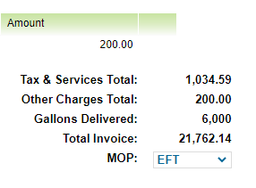
MDWF: Fuel Reconciliation – Invoice Entry
A summary of the charges on the invoice will populate at the bottom
Select your Method of Payment (MOP) from the dropdown menu

Slide 28
MDWF: Fuel Reconciliation – Invoice Entry
Click Save

Slide 29
MDWF: Fuel Reconciliation – Stick Reading Entry
Click Stick reading entry

Slide 30
MDWF: Fuel Reconciliation – Stick Reading Entry
Click Stick reading entry

Slide 31
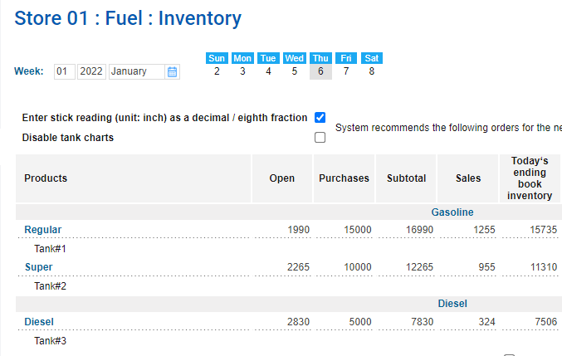
MDWF: Fuel Reconciliation – Stick Reading Entry
Products: Lists each fuel product stored in your underground tanks
Open: The ending stick reading from the previous day
Purchases: Any fuel deliveries that day
Subtotal: Open + Purchases
Sales: Gallons sold that day
Today’s ending book inventory: Subtotal - Sales

Slide 32
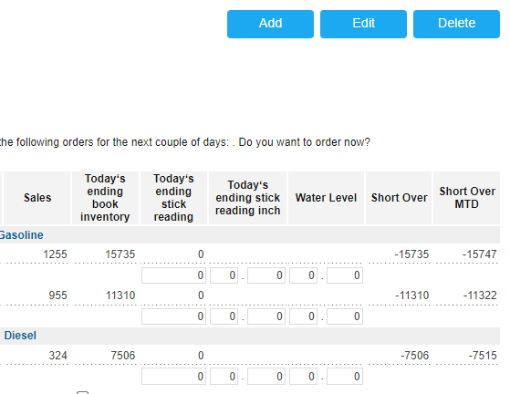
MDWF: Fuel Reconciliation – Stick Reading Entry
To Enter Stick reading (tank level reading from Veeder-Root):
Click Edit
Type reading for each grade of fuel in local units of measure (gallons, liters, etc.)
NOTE: ending stick reading inches and water level are optional

Slide 33
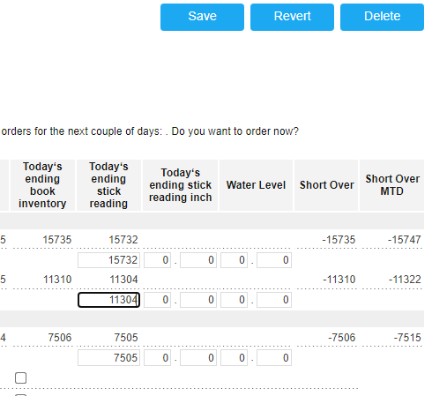
MDWF: Fuel Reconciliation – Stick Reading Entry
Click Save

Slide 34
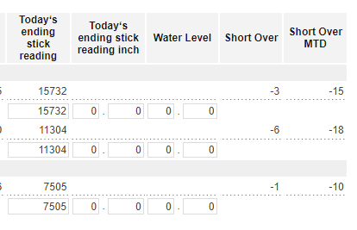
MDWF: Fuel Reconciliation – Stick Reading Entry
Short Over – Over short in local unit of measure (gallons, liters, etc.) for that day
Short Over MTD - Over short in local unit of measure (gallons, liters, etc.) Month-To-Date

Slide 35
MDWF: Fuel Reconciliation – SIR (Statistical Inventory Reconciliation)
Click Check SIR

Slide 36
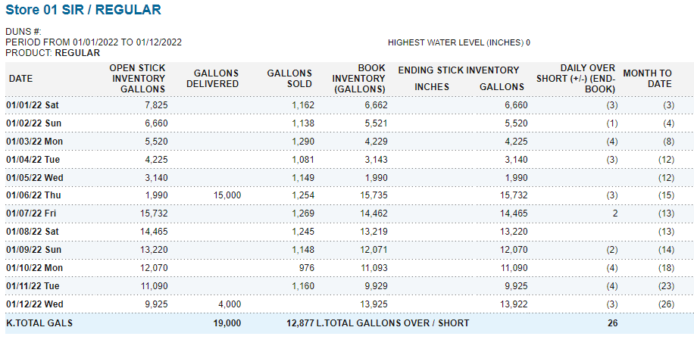
MDWF: Fuel Reconciliation – SIR (Statistical Inventory Reconciliation)
The SIR (Statistical Inventory Reconciliation) for all Products report displays daily over/shorts for fuel gallons based on sales, deliveries and stick readings per grade of fuel at each location. It also displays water levels, if entered.

Slide 37
MDWF: Fuel Reconciliation – SIR (Statistical Inventory Reconciliation)
The MTD over/short is compared to the legal leak Test calculation
For each fuel grade, at the end of the report table, you can view on of the following circled statements:
NO – The total gallons over/short is less than the leak test result. No leak detected.
YES – Immediate investigation is required

Slide 38
MDWF: Fuel Reconciliation – SIR (Statistical Inventory Reconciliation)
There are 3 data entry errors that would cause YES to be circled:
BOL entry error – ex. BOL is missing, understated, overstated, or entered under wrong fuel grade
Fuel sales that are not pulled over (ensure all shifts have been accepted)
Wrong Stick reading entered
NOTE: If none of these issues are discovered, you might have a leak and fuel is leaking into the ground

Slide 39
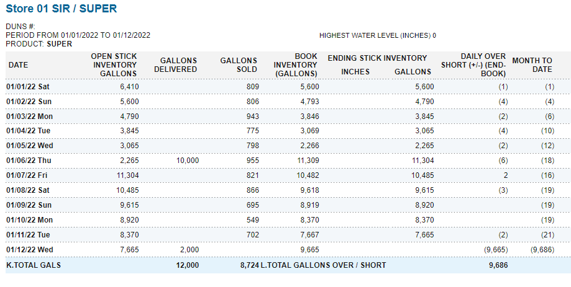
MDWF: Fuel Reconciliation – SIR (Statistical Inventory Reconciliation)
Scroll down to check the Leak Test Calculation results for each grade of fuel

Slide 40
MDWF: Fuel Reconciliation – Fuel Ordering
Click Order Fuel

Slide 41
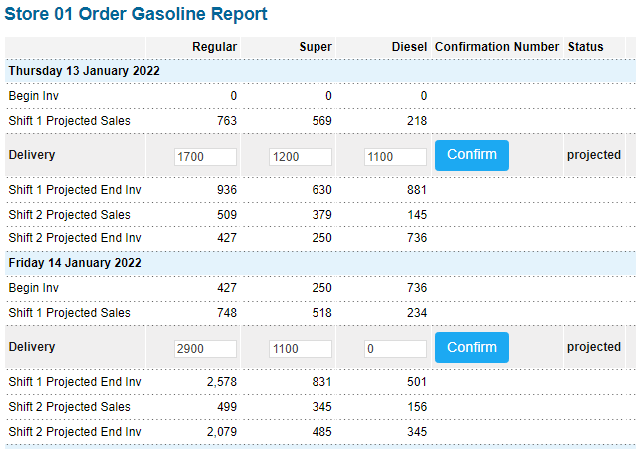
MDWF: Fuel Reconciliation – Fuel Ordering
The Order Gasoline report provides the prediction on the gasoline purchases for the upcoming 4 weeks for the selected station.

Slide 42
MDWF: Fuel Reconciliation – Competitor Pricing
Click Enter Competitor gas prices

Slide 43
MDWF: Fuel Reconciliation – Competitor Pricing
To add a new competitor to the list:
Click Add Competitor

Slide 44
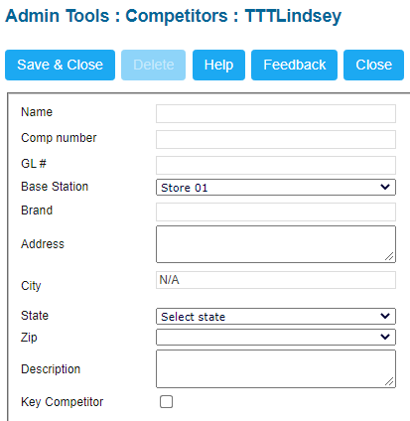
MDWF: Fuel Reconciliation – Competitor Pricing
Enter the name of your Competitor
NOTE: All other fields are optional
Click Save & Close
Repeat for each competitor you wish to track

Slide 45
MDWF: Fuel Reconciliation – Competitor Pricing
To input competitor’s pricing:
Click Edit
Enter competitor’s price for each grade of fuel
Enter time price was recorded, if desired

Slide 46
MDWF: Fuel Reconciliation – Competitor Pricing
Click Save

Slide 47
THANK YOU!
Notes:
Say: Thank you for your time. Does anyone have any questions?
Do: Respond to questions.
Do: <End Meeting>

