Slide 1
Manager Daily Workflow Step 4: Cash Reconciliation Step 5: Inventory

Slide 2
Agenda
Cash Reconciliation
Inventory
Expenses
Cash Reconciliation
NRGT
Write-Offs
Checking and processing price change tickets
Item Group Reconciliation
Inventory Audit

Slide 3
Step 4: Cash Reconciliation

Slide 4
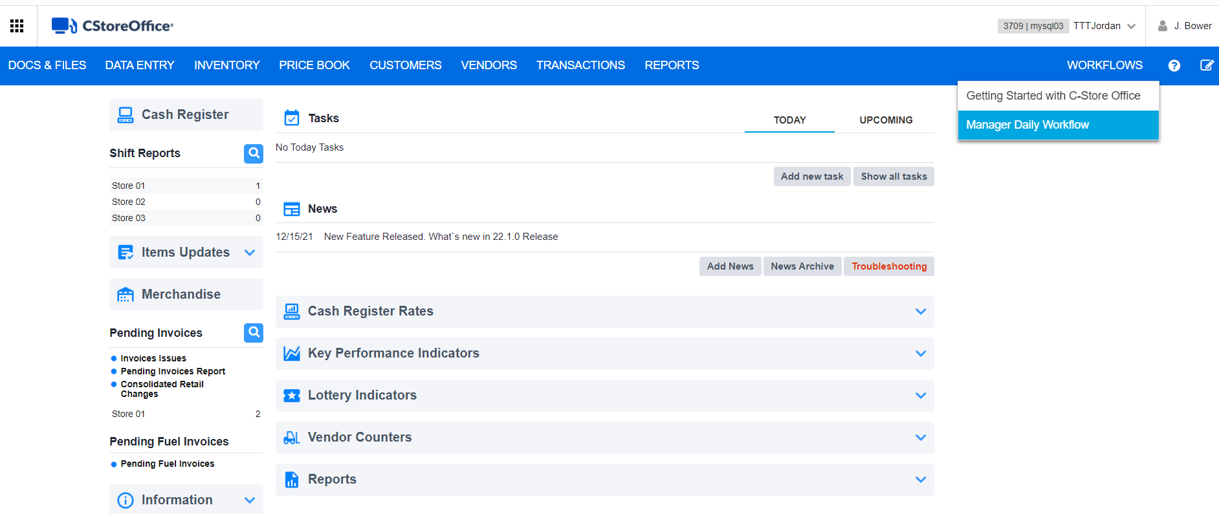
Expenses
To access Expenses through the Managers Daily Workflow:
Workflows
Manager Daily Workflow
In the Manager's Daily Workflow, move to the Expenses step.

Slide 5
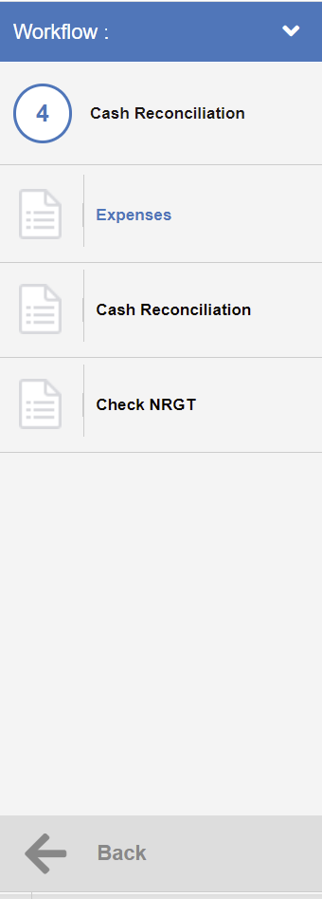
Expenses
Select
Step 5 – Cash Reconciliation
Select
Expenses

Slide 6
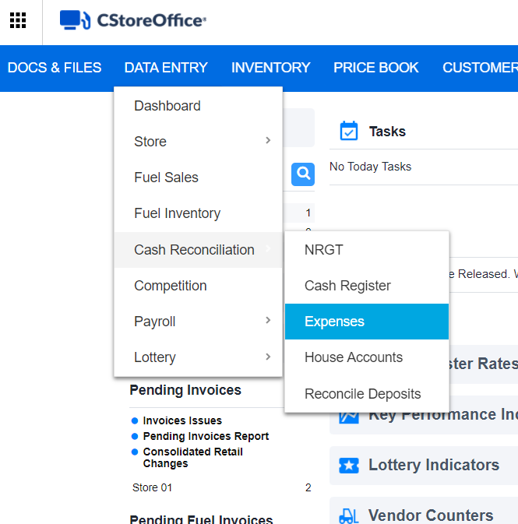
Expenses
To access Expenses through CStoreOffice® main page, go to
Data Entry
Cash Reconciliation
Expenses

Slide 7
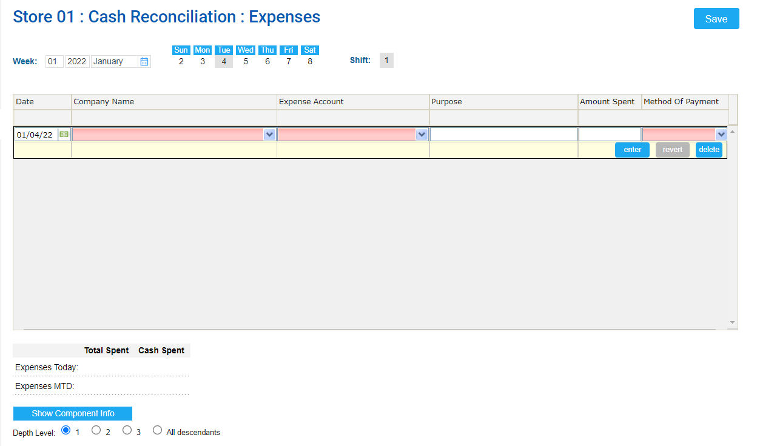
Expenses
At the top of the Expenses form, specify the following data:
Select a week, for which you are going to enter your expenses.
Select a day, which you want to set as the default date for each expense entry.
Select a shift, if any for the selected day.
Result: Saved expenses for the selected date and shift are displayed in the Expenses form.

Slide 8
Expenses
In the table, add each expense, specifying the following data:
In the Date column, specify the expense date, in case it differs from the default date.
In the Company Name column, select the company, to which the expanse shall be written.
In the Expense Account column, select the expense account from the list of available accounts.

Slide 9
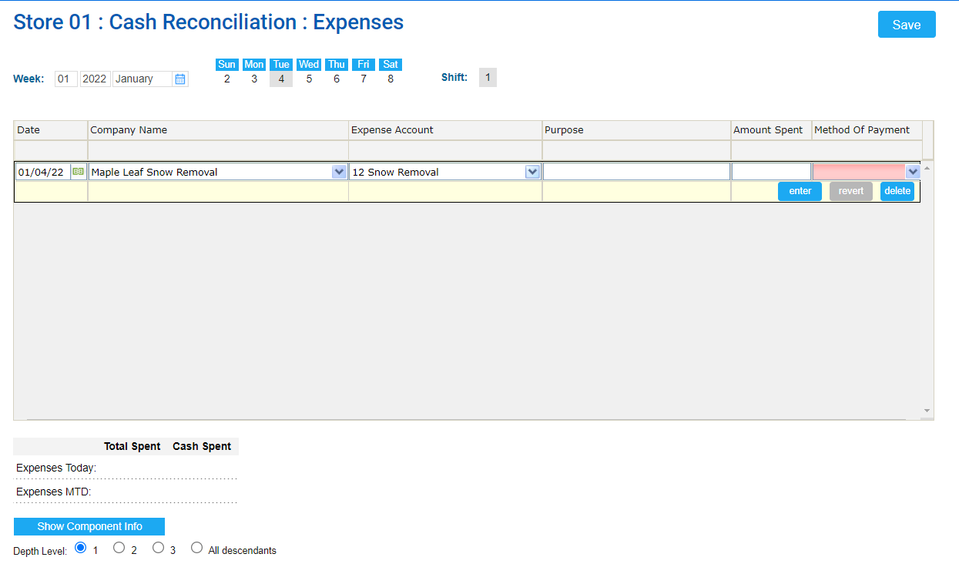
Expenses
In the Purpose column, enter the expense purpose.
In the Amount Spent column, enter the amount of the expense.
In the Method of Payment column, select the method of payment from the list of available methods.
Click the enter button.

Slide 10
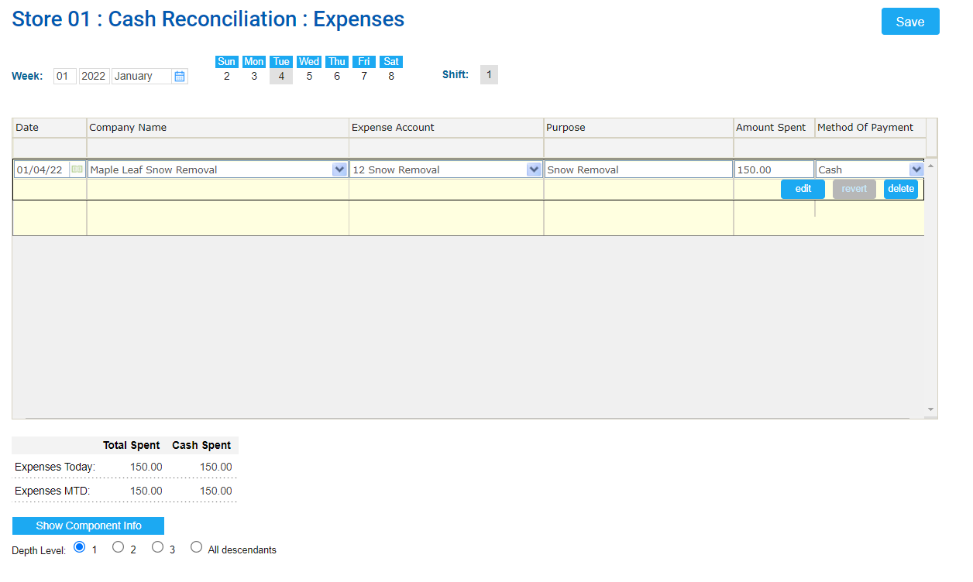
Expenses
At the top right of the Expenses form, click the Save button.
Result: Entered expenses are saved.

Slide 11
Cash Reconciliation
To access Cash reconciliation through the Managers Daily Workflow:
Workflows
Manager Daily Workflow
In the Manager's Daily Workflow, move to the Cash Reconciliation step.

Slide 12
Cash Reconciliation
Select
Step 5 – Cash Reconciliation
Select
Cash Reconciliation

Slide 13
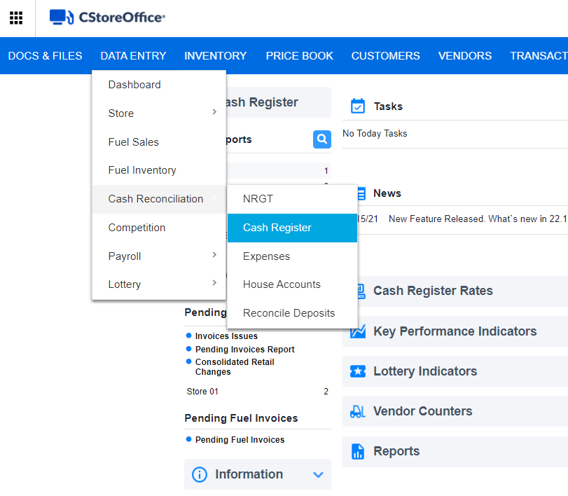
Cash Reconciliation
To access the Cash Reconciliation form through CStoreOffice® main page, go to
Data Entry
Cash Reconciliation
Cash Register

Slide 14
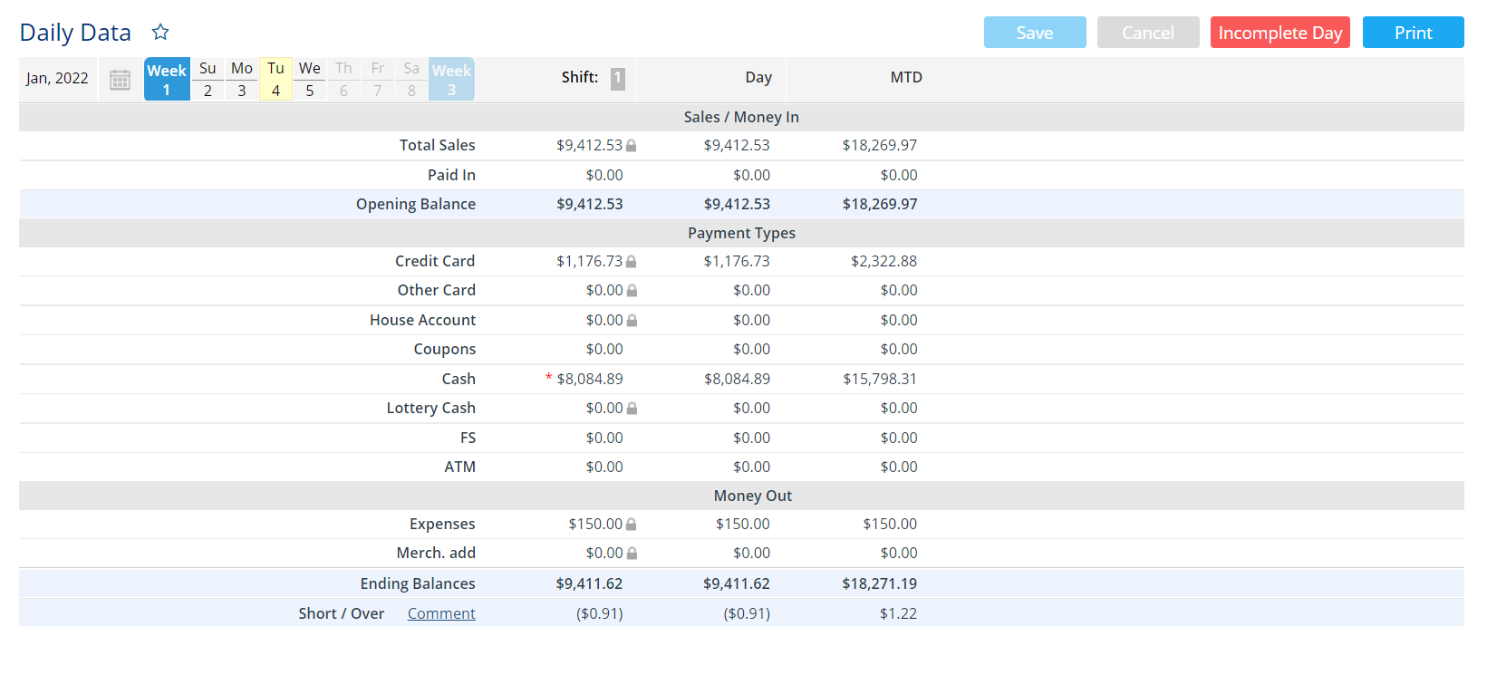
Cash Reconciliation
This will navigate to the Daily Data Form.
This form represents all the data for the shift, day (if there is only one shift in the day, the columns will be equal), and month to date data for comparison.

Slide 15
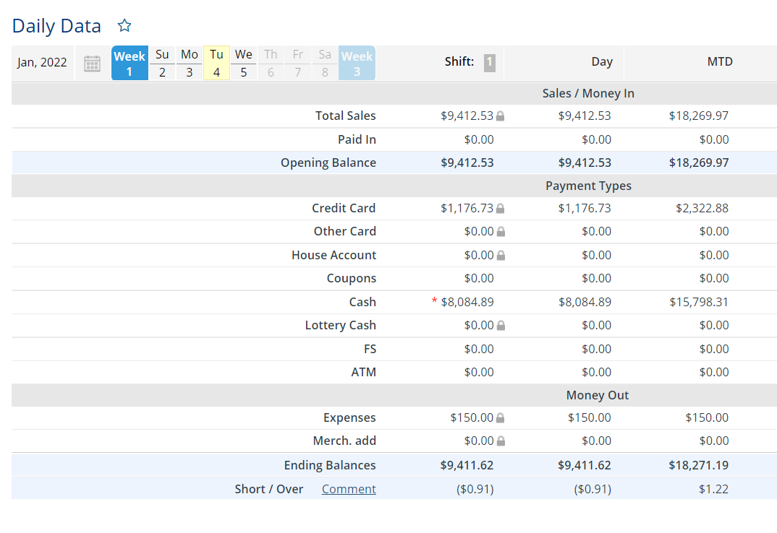
Cash Reconciliation
Sales / Money In
This section contains the following information on incoming finances:
Total Sales
the amount sold for the selected period.
Paid In
the amount present in the register at the beginning of a shift.
Opening Balance
Total sales + Paid Ins + Beginning Cash

Slide 16
Cash Reconciliation
Payment Types
The section information on the incoming finances subtotaled by base MOPs:
Credit Card
Other Cards
House Accounts
Coupons
Cash
Lottery Cash
FS (Food Stamps)
ATM

Slide 17
Cash Reconciliation
Money Out
The section contains the following information on the outcoming finances.
Expenses Merchandize additions
Displays the Total Cost value for the selected period. You can verify this value using the Invoices report.
CR paid outs
only when present Unmatched paid outs
only when present

Slide 18
Cash Reconciliation
Ending Balances
Cash the end of the shift (used as Beginning cash for the next shift)
Short / Over
The section contains information on the shortages and overages for the shift. You can leave a comment by clicking Comment in the corresponding section.

Slide 19
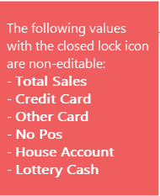
Cash Reconciliation
In the Sales / Money In, Payment Types, Custom MOPs and Money Out sections, if you see the closed lock icon to the right of the payment value in the Daily Data section, it means that this value is non-editable.

Slide 20
Check NRGT
To access Check NRGT through the Managers Daily Workflow:
Workflows
Manager Daily Workflow
In the Manager's Daily Workflow, move to the Check NRGT step.

Slide 21
Check NRGT
Select
Step 5 – Cash Reconciliation
Select
Check NRGT

Slide 22
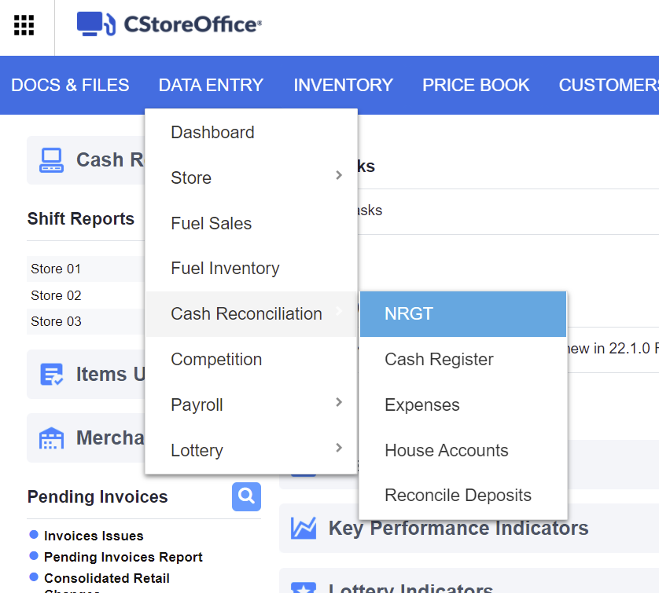
Checking and Processing Price Changes
To access NRGT through CStoreOffice® main page, go to
Data Entry
Cash Reconciliation
Check NRGT

Slide 23
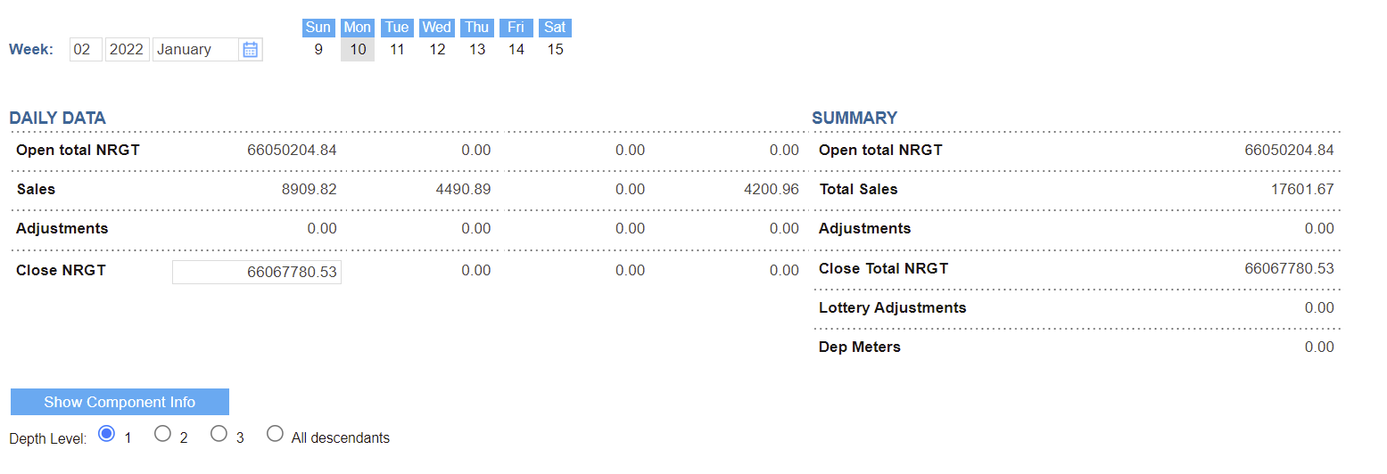
Check NRGT
The NRGT (Non-Resettable Grand Total) is equal to the odometer in a car. It measures the amount of sales since the cash register was first turned on.
Depending on the cash register type, you will see this increase every day because of sales.
The Non-Resettable Grand Total is a cumulative amount. You can manually adjust these numbers if they do not transfer over.

Slide 24
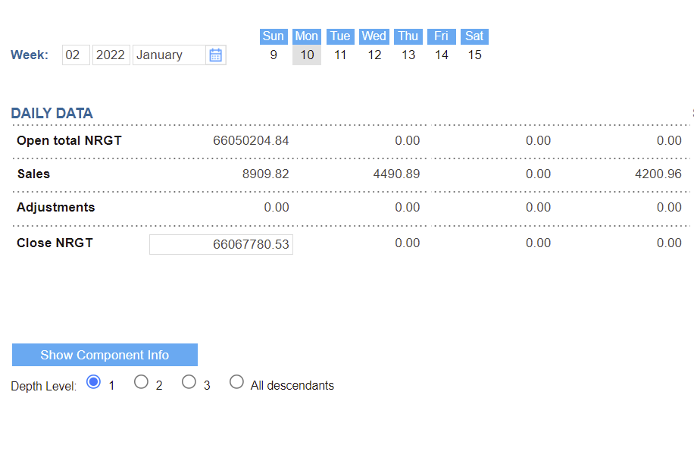
Check NRGT
The NRGT form displays the following data:
Daily Data grouped by shifts
Open total NRGT: Total NRGT at the beginning of the shift.
Sales: Sales amount for the shift.
Adjustments: NRGT adjustments are calculated by the following formula: Adjustments = Close NRGT - Open total NRGT - Sales.
Close NRGT: Total NRGT at the end of the shift.

Slide 25
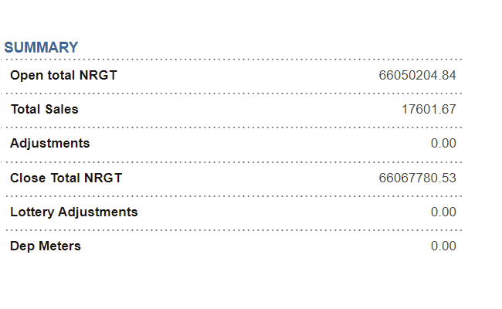
Check NRGT
Summary data for the selected date:
Open total NRGT: Total NRGT at the beginning of the day.
Total Sales: Total sales amount for the day.
Adjustments: NRGT adjustments are calculated by the following formula: Adjustments = Close Total NRGT - Open total NRGT - Total Sales.
Close Total NRGT: Total NRGT at the end of the day.
Lottery Adjustments
Dep Meters

Slide 26
Step 5: Inventory

Slide 27
Write-Offs
To access Write-Offs through the Managers Daily Workflow:
Workflows
Manager Daily Workflow
In the Manager's Daily Workflow, move to the Write-Offs step.
To access Write-Offs through the Managers Daily Workflow:
Workflows
Manager Daily Workflow
In the Manager's Daily Workflow, move to the Write-Offs step.

Slide 28
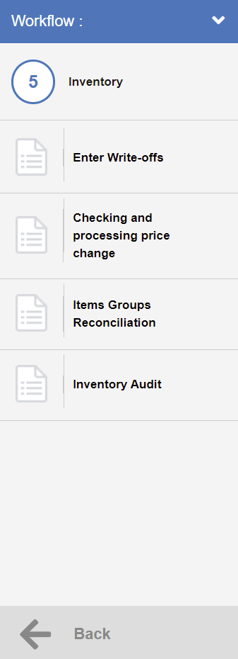
Write-Offs
Select
Step 6 – Inventory
Select
Enter Write-Offs

Slide 29
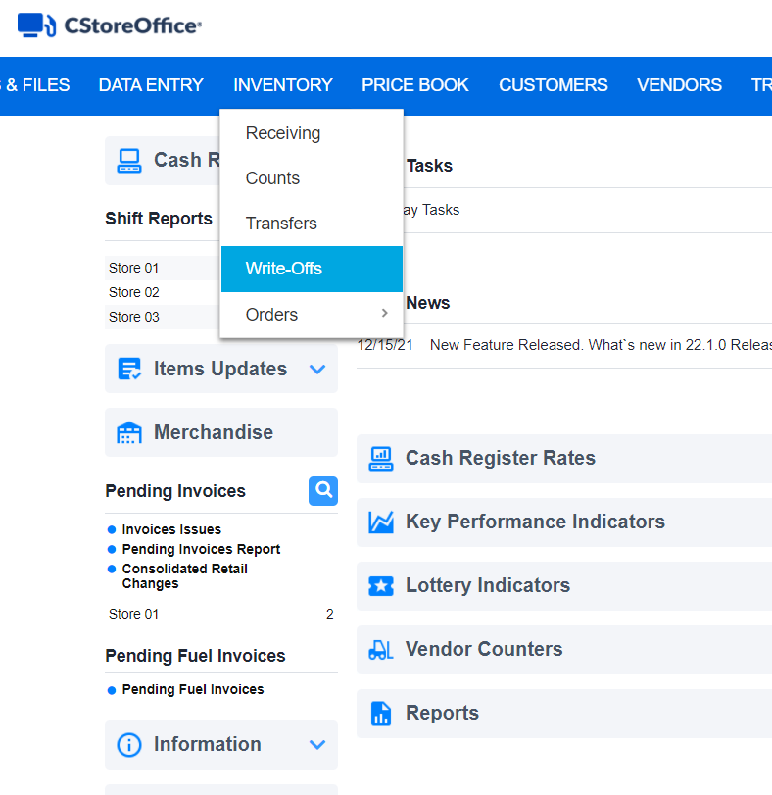
Write-Offs
The Write-Offs Entry section is designed to enter any store shrinkage, spoilage or store use which is not eligible to be returned to vendor.
To access Write-Offs through CStoreOffice® main page, go to:
Inventory
Write-Offs

Slide 30
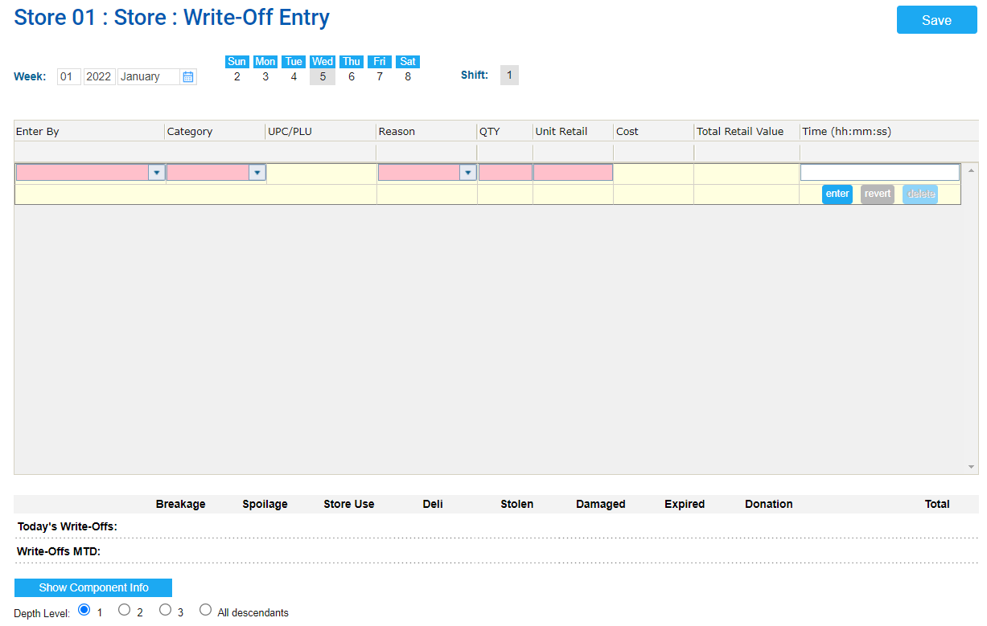
Write-Offs
To enter a write-off to the system, in the Write-Off Entry form:
Select the day and the shift, if any.
In the Enter By list, select Enter UPC / PLU.
In the UPC/PLU list, enter the item UPC and then click any empty space on the form.
Result: The following item's settings fields are automatically populated by the system:
Description
Category
Unit Retail

Slide 31
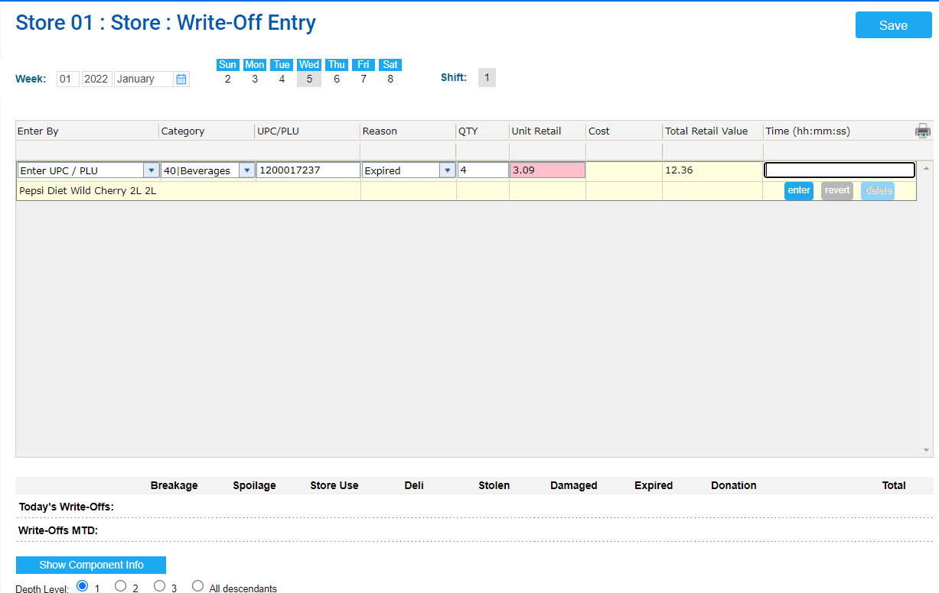
Write-Offs
Result: The following item's settings fields are automatically populated by the system:
Description
Category
Unit Retail
In the Reason list, select the reason for adding the item to the write-offs.
In the QTY field, enter the item's quantity. Result: The Total Retail Value is calculated automatically.

Slide 32
Write-Offs
In the Time field, enter the exact time of the entry. It is necessary for accurate real time write-off calculation.
Click the enter button.
At the top right of the form, click Save

Slide 33
Checking and Processing Price Changes
To access Checking and Processing Price Changes through the Managers Daily Workflow:
Workflows
Manager Daily Workflow
In the Manager's Daily Workflow, move to the Checking and processing price changes step.

Slide 34
Checking and Processing Price Changes
Select
Step 5 - Inventory
Select
Checking and Processing Price Changes

Slide 35
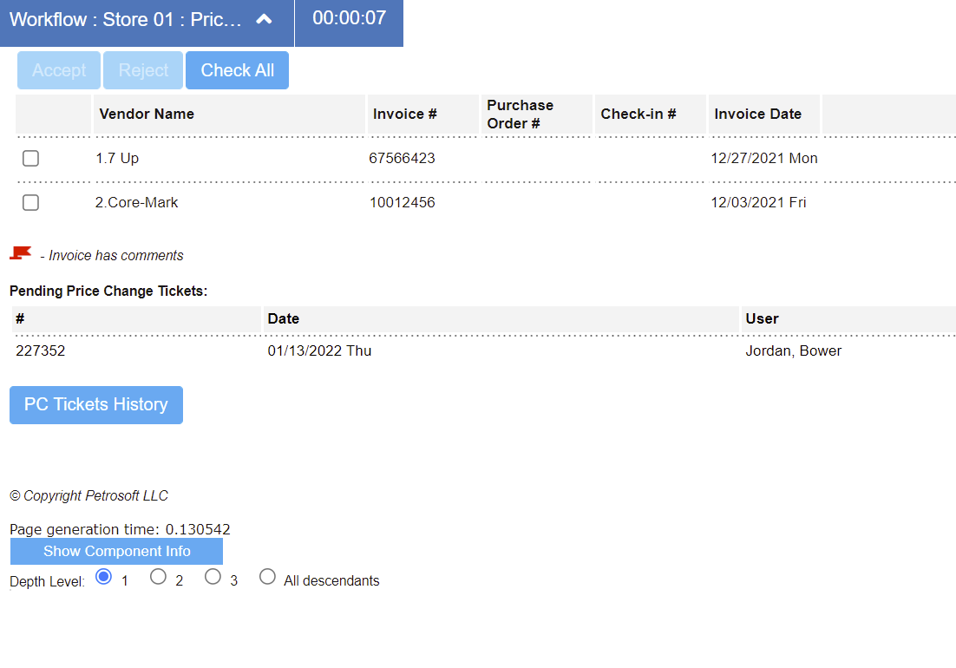
Checking and Processing Price Changes
After a price is changed, a price change ticket is generated. When you accept item updates, you will need to print out the price change ticket.
Go out to the floor and count all items that you currently have on hand.
Check the Price Change Ticket form. The date field is auto-populated based on the price change date.
Select the correct Price Change Ticket

Slide 36
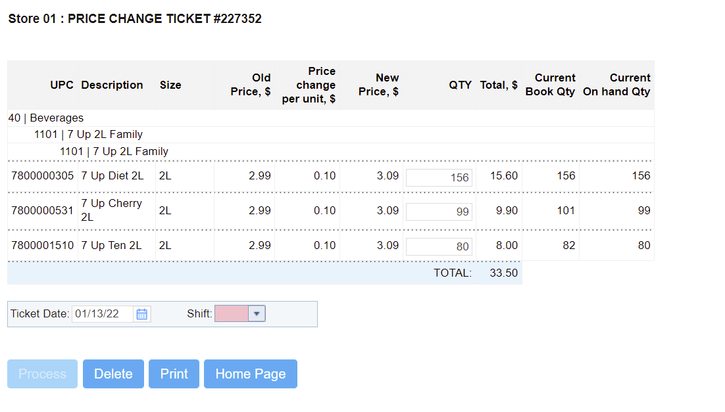
Checking and Processing Price Changes
In the QTY field, enter the item quantity.
From the Shift list, select the shift number.
At the bottom of the form, click Process

Slide 37
Item Groups Reconciliation
To access Item Groups Reconciliation through the Managers Daily Workflow:
Workflows
Manager Daily Workflow
In the Manager's Daily Workflow, move to the Items Group Reconciliation step.

Slide 38
Item Groups Reconciliation
Select
Step 6 – Inventory
Select
Item Groups Reconciliation

Slide 39
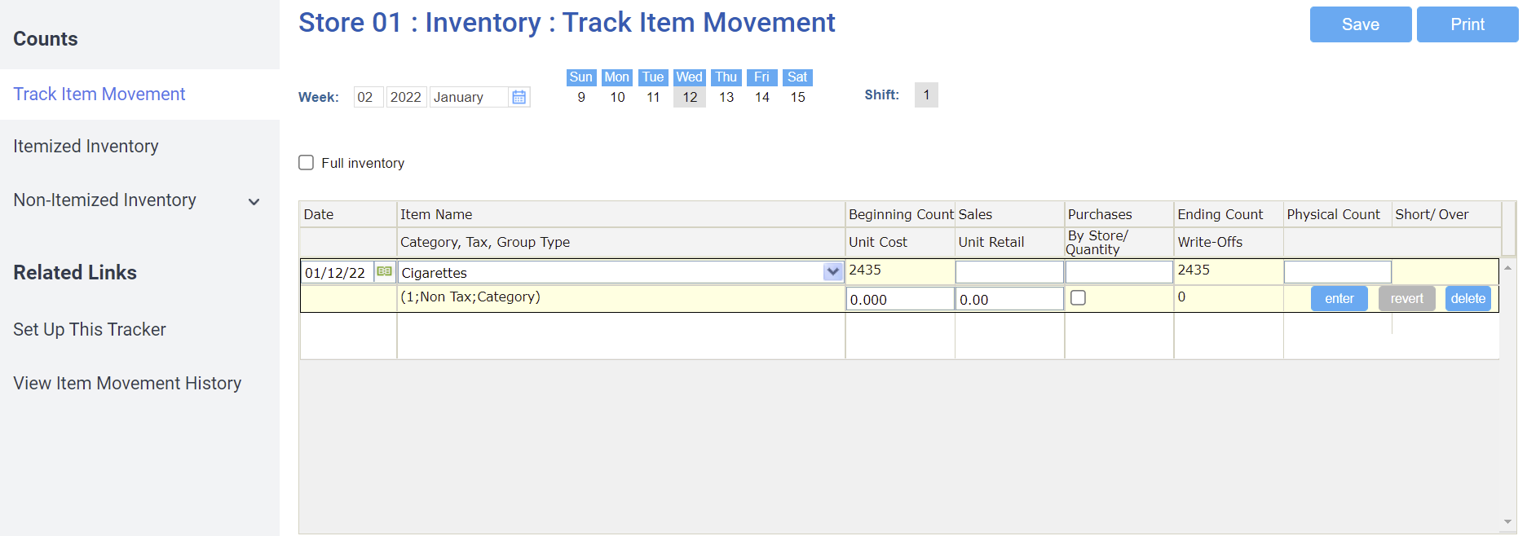
Item Groups Reconciliation
At the Items Groups Reconciliation step, you can reconcile item groups.
Before you start working with this form, you need to assign items to price groups or categories that you want to count.

Slide 40
Item Groups Reconciliation
To reconcile item groups:
Count your items.
In the Physical Count field, enter the count and click enter.
At the top right corner of the form, click Save.

Slide 41
Inventory Audit
To access Inventory Audit through the Managers Daily Workflow:
Workflows
Manager Daily Workflow
In the Manager's Daily Workflow, move to the Inventory Audit step.

Slide 42
Inventory Audit
Select
Step 6 – Inventory
Select
Inventory Audit

Slide 43
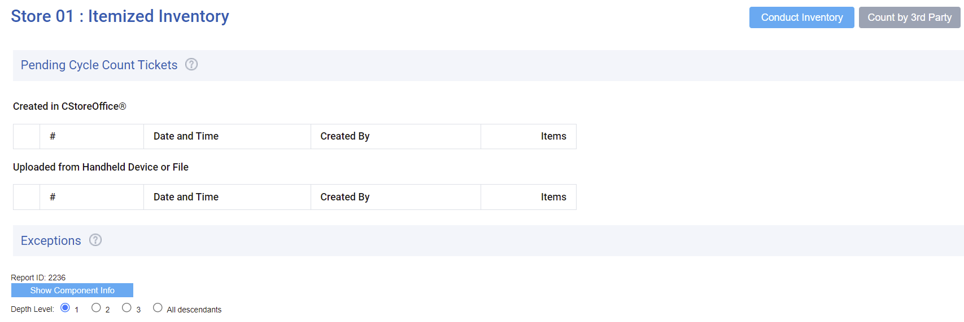
Inventory Audit
At the Inventory Audit step, you can count sections or planograms or groups for on hand accuracy.
To perform inventory audit:
Click Conduct Inventory.

Slide 44
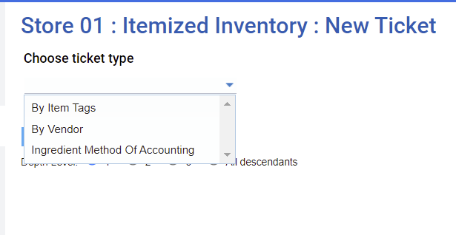
Inventory Audit
From the Choose ticket type list dropdown
Select By Item Tags.

Slide 45
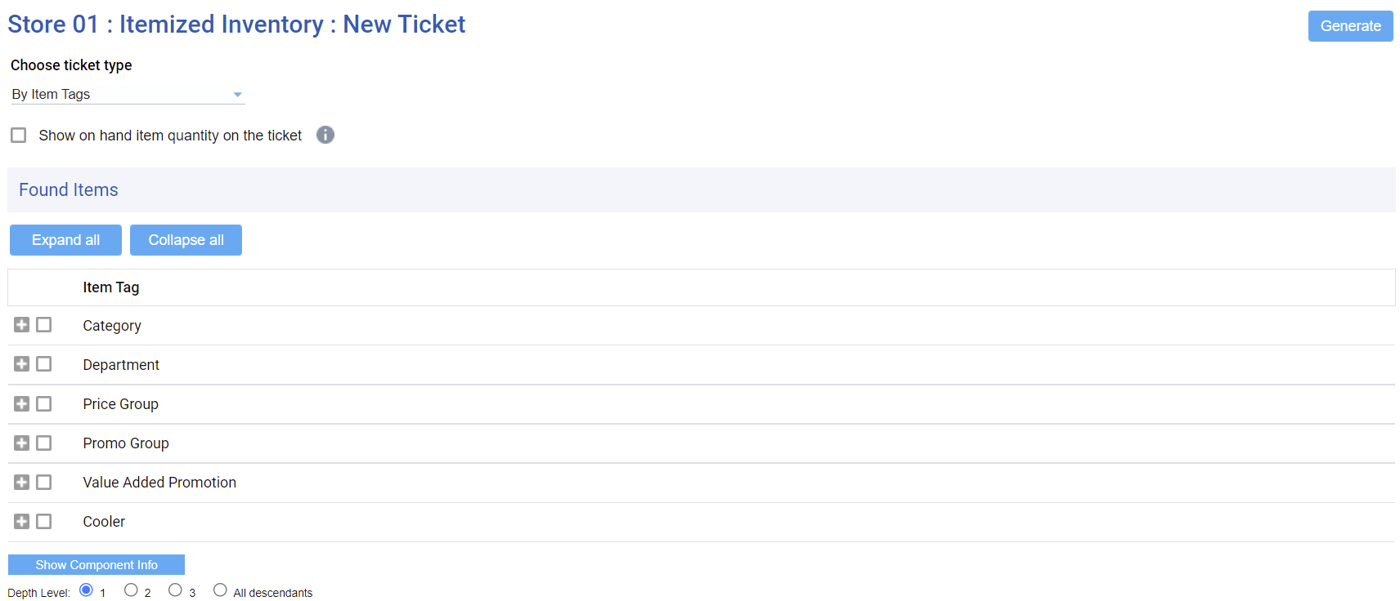
Inventory Audit
In the Found Items list, select the check boxes next to the necessary item tags.
Click Generate. The itemized inventory (inventory audit) is created, and the system prompts you to print it.
Print it out and go count the items.

Slide 46
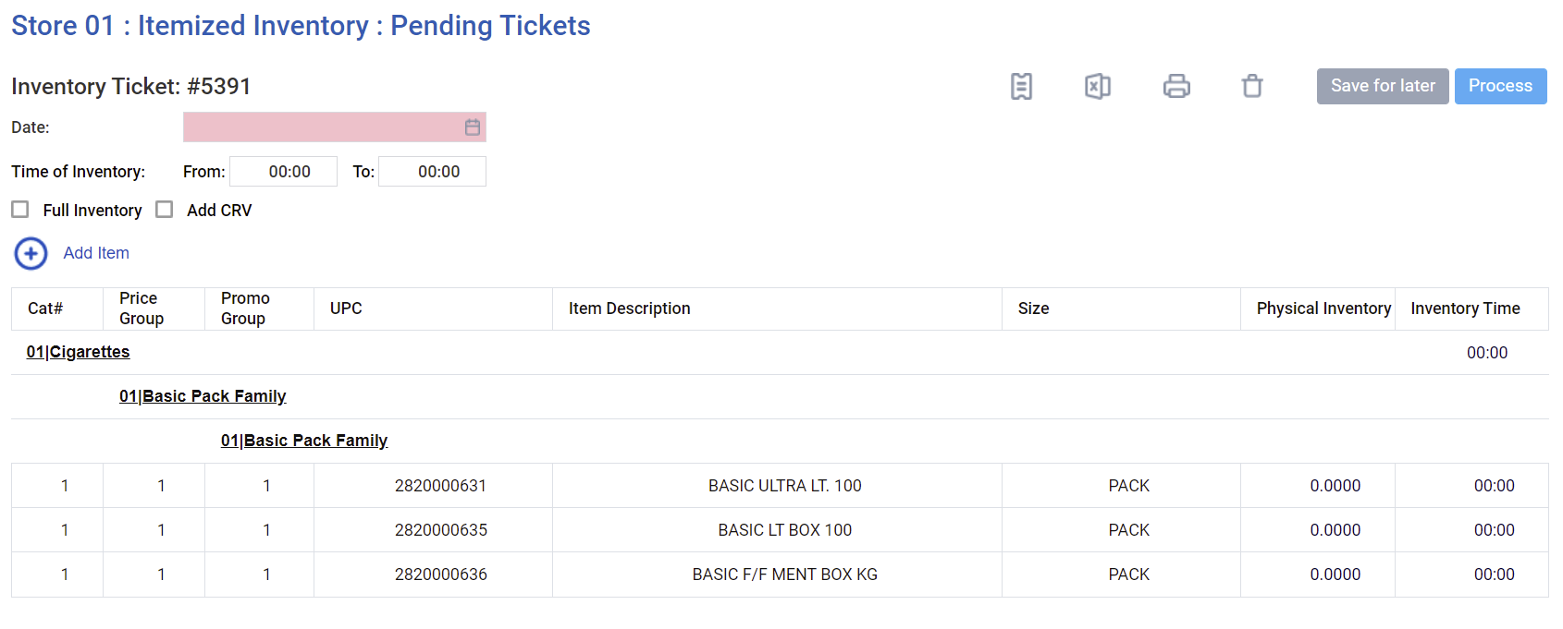
Inventory Audit
Print it out the created Inventory Ticket and physically count the items.

Slide 47
Inventory Audit
Come back to CStoreOffice® and enter the counts.
Choose the date to which you are applying the count.
Specify the start and end time.
The start and end times should be within the shift times.
Input you Physical Inventory counts each item.
Click Process.

Slide 48
THANK YOU!
Notes:
Say: Thank you for your time. Does anyone have any questions?
Do: Respond to questions.
Do: <End Meeting>

