Slide 1
C-STORE OFFICE
ADVANCED ACCOUNTING – CSO Clearing Account Reconciliation
www.cstoreoffice.com

Slide 2
Agenda
Review of Transaction Assignment setup
Review of the need for CSO Clearing Account
Steps to Reconcile CSO Clearing if out of Balance
Sales Summary Report
Cash Reconciliation Report
Account Register Report
www.cstoreoffice.com

Slide 3
What are Transaction Assignments?
Transaction Assignments are the data mapping in CSO
Data is mapped based on the type and given a specific Debit and Credit General Ledger Account
The Transaction Assignments are the basis of how things get into your General Ledger
The cash register data flowing thru the CSO Clearing Account(or similar clearing account with another name)
The CSO Clearing account should have a Zero Balance every shift, on every day
www.cstoreoffice.com

Slide 4
Transaction Assignments
www.cstoreoffice.com

Slide 5
Steps to reconcile an out of balance CSO Clearing Account
Run the Account Register Report for the period of time being researched
Go to Transactions > Account Register to run the report
Review the report to find the first day CSO Clearing account shows a balance.
www.cstoreoffice.com

Slide 6
www.cstoreoffice.com

Slide 7
Steps to reconcile an out of balance CSO Clearing Account
Run the Sales Summary Report for the first day you see the out of balance on the Account Register Report.
Go to Reports > Accounting. Select the station on the left side of screen. Sales Summary Report is under the Review Sales Heading.
Match the entries processed in Accounting (by Data Type) to the Sales Summary report.
www.cstoreoffice.com

Slide 9
Steps to reconcile an out of balance CSO Clearing Account
Once the Data Type causing the issue is identified, check the Transaction Assignment Mapping.
If the Data Type is missing you need to make it active and fill in the Debit and Credit GL accounts.
Go to the Cog Wheel in the upper right corner of your screen and select Transaction Assignments.
www.cstoreoffice.com

Slide 10
www.cstoreoffice.com

Slide 11
Steps to reconcile an out of balance CSO Clearing Account
Go to Transaction Assignments, scroll to the bottom of the screen and select REQUIRED DATA TYPES button.
All available Data Types listing will show. Just select the missing Type and click SAVE at the top of the screen.
You should see the Data Type available for mapping.
www.cstoreoffice.com

Slide 12
www.cstoreoffice.com

Slide 13
Steps to reconcile an out of balance CSO Clearing Account
Once you have pulled the Data Type into the Transaction Assignments enter the Debit and Credit Accounts. One will obviously be the CSO Clearing Account Mapping. Example: Money Order Sales Data Type would be a Debit to CSO Clearing Account and Credit to Money Order Sales account of your choice.
Enter the Debit and Credit. Make sure you ENTER the line (button is on the right) and SAVE at the bottom of the screen.
www.cstoreoffice.com

Slide 14
www.cstoreoffice.com

Slide 15
What is the Data Converter Tool ?
The Data Converter Tool is a way to refresh the data as it moves over into the Accounting Module of CSO.
The Data Converter Tool is a custom interface that identifies the different types of Data and allows the data to move over to accounting, based on the Data Type.
You should now run the Data Converter Tool for the newly added Data Type. Go to Transactions > Tools > Data Converter. Select the date and new Data Type, Class and UPDATE DATA button.
www.cstoreoffice.com

Slide 16
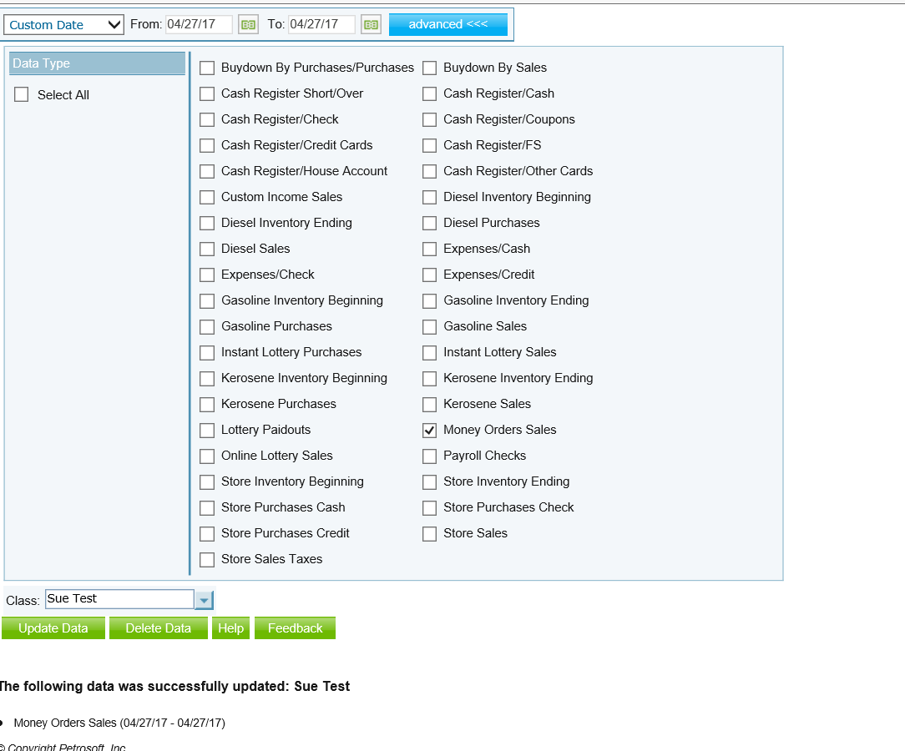
www.cstoreoffice.com

Slide 17
Steps to reconcile an out of balance CSO Clearing Account
The Data Type now shows in the account register of the CSO Clearing account.
Follow the same steps until you get to zero.
If you do not need to add new Data Types, you may just need to run the Data Converter Tool for that already existing type, to refresh the data.
www.cstoreoffice.com

Slide 18
www.cstoreoffice.com

Slide 19
Steps to reconcile an out of balance CSO Clearing Account
Final Step is to review the Cash Reconciliation for that Day/Shift if you are still out of balance.
Look for Unassigned Paidouts with no invoices. If Paidout control is turned on in CSO, then you are required to enter an invoice for each paidout. You will clearly see these paidouts on your Cash Reconciliation screen.
Once invoices are entered for these, you will see them in the CSO Clearing account.
www.cstoreoffice.com

Slide 20
www.cstoreoffice.com

Slide 21
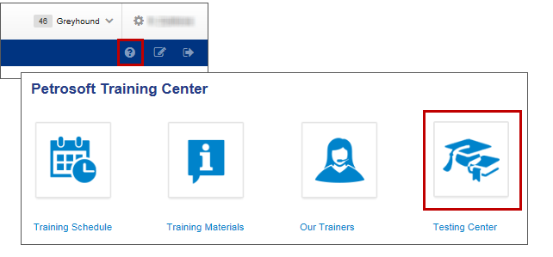
Training Center
For additional testing on what you have learned, please refer to our new “Testing Center”.
To access this new feature, click the help icon, and then select Testing Center.
www.cstoreoffice.com

Slide 22
THANK YOU FOR YOUR TIME!
Get in Touch
Petrosoft LLC
260 Bilmar Drive
Pittsburgh, PA 15205
1.412.306.0640
www.cstoreoffice.com

